Slide 1
Setting posterior teeth
Dr. Nesreen Salim

Slide 2
Factors affecting occlusal balance (Hanau’s Quint)
Condylar guidance
Incisal guidance
Plane of occlusion
Compensating curve
Angulation of the teeth/ Cuspal height.

Slide 3
Plane of occlusion

Slide 4
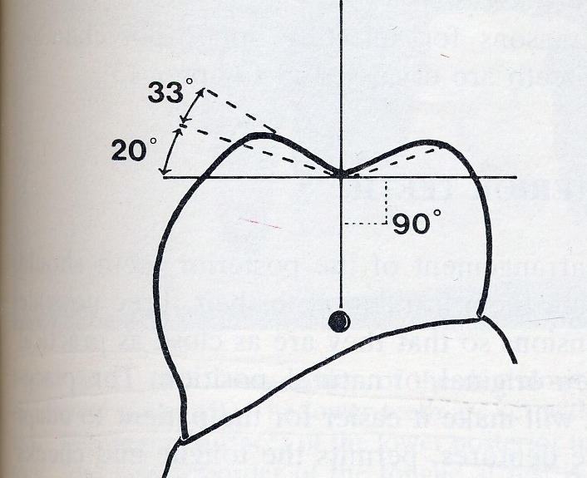
Cusp angle

Slide 5
Protrusion
During protrusion, the incisal guidance allows the incisal edges of the mandibular and maxillary incisor teeth to touch; posterior teeth should remain in contact. If no contact on posterior teeth, lower incisor teeth need to be lowered to provide balanced articulation. At CO no contact between U & L anterior teeth.
Incisal guidance is the path on the lingual surface of the maxillary anterior teeth along which the mandibular anterior teeth glide

Slide 7
Compensating curves
The anteroposterior and lateral curvatures in the alignment of the occluding surfaces and the incisal edges of artificial teeth which are used to develop balanced occlusion.

Slide 8
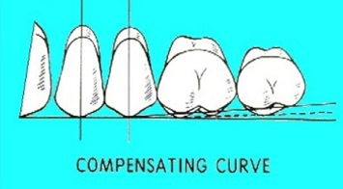
Compensating curves
To achieve balance there should be anteroposterior curve for the posterior teeth (curve of Spee) and mediolateral curve (curve of Monson)

Slide 10
Anteroposterior curvature
Anatomic carvature of the occlusal alignment of teeth beginning at the tip of the lower canine and following the buccal cusps of the PM and M, continuing to the anterior border of the ramus (imaginary curve). It is imaginary curve joining the buccal cusps of the mandibular posterior teeth starting from the canine passing through the head of the condyle.
Significance: In protrusion the posterior teeth arranged incorporating this curve will remain in contact without disocclusion

Slide 11
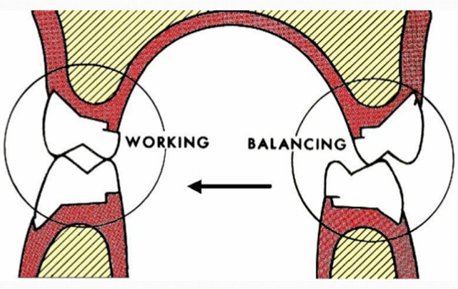
Mediolateral curvature
This curve runs across the palatal and buccal cusps of the maxillary molars. During lateral movement the mandibular lingual cusps on the working side should slide along the inner inclines of the maxillary buccal cusp. In the balancing side the mandibular buccal cusps should contact the inner inclines of the maxillary palatal cusp. This relationship forms a lateral balance.
It is determined by the inclination of the posterior teeth and their vertical relationship to the occlusal plane so that the occlusal surface results in a curvature that is in harmony with the movement of the mandible as guided posteriorly by the condylar path.

Slide 14
The equation for balanced occlusion
Orientation of the occlusal plane
Condylar guidance
Cusp angle
Incisal guidance
Compensating curves

Slide 19
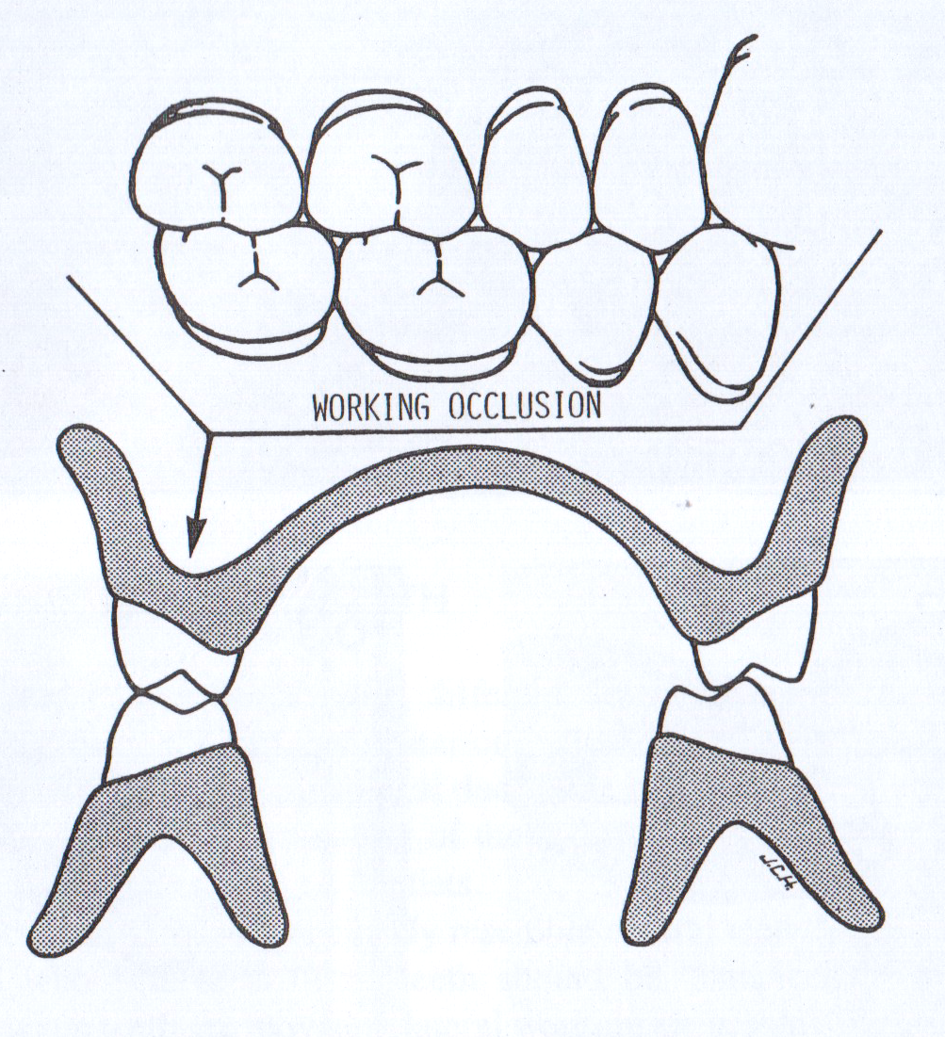
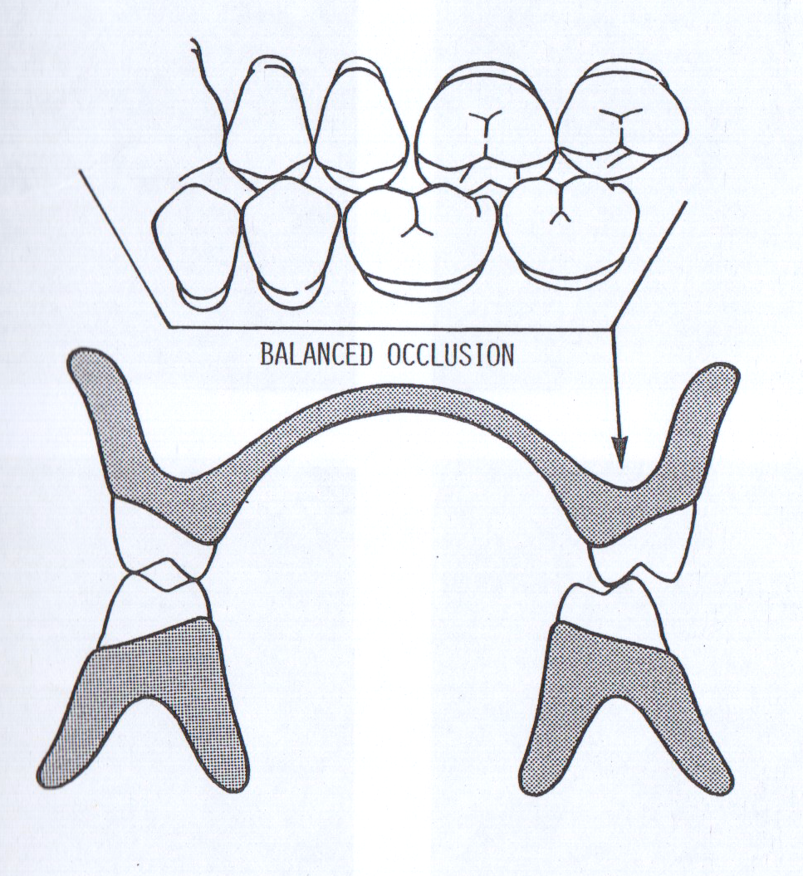

Slide 20
If the incisal guidance is steep, it requires steep cusps, a steep compensating curve to keep occlusal balance.
A steep inclined plane, is detrimental to the stability hence the incisal guidance should be flat as aesthetics and phonetics will permit.
A steep condylar path requires a steep compensating curve for occlusal balance.

Slide 21
Horizontal overlap of Increased Posterior cusps must be shorter
Anterior teeth Reduced Posterior cusps may be taller
Vertical overlap of Increased Posterior cusps may be taller
Anterior teeth Reduced Posterior cusps must be shorter
OTHERS
Occlusal plane - More parallel to Posterior cusps must be shorter
condylar guidance
- Less parallel to Posterior cusps may be taller
condylar guidance
Curve of Spee More convex The most posterior cusps
must be shorter
Less convex The most posterior cusps
may be taller

Slide 23
A gap occurring in the natural dentition or between the opposing posterior flat occlusal rims when the mandible is protruded (posterior open bite). It can lead to instability in full dentures unless compensating curves are incorporated into the dentures.

Slide 25
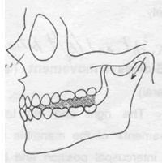
Christensen’s phenomena

