Slide 1
Brain stem sections
Medulla oblongata
Lab 4

Slide 2
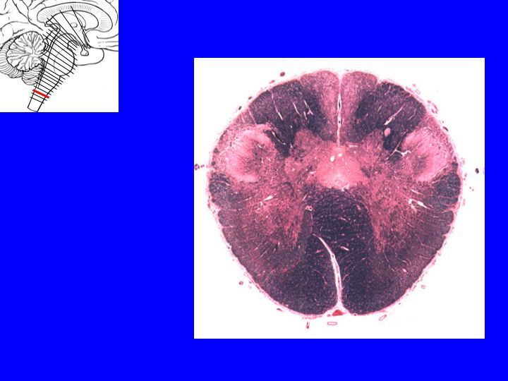
Medulla at level of pyramidal decussation
Fasiculus gracilis
Fasiculus cuneatus
Spinal nucleus of
trigimenal nerve
Central canal
pyramidal decussation
pyramid

Slide 3
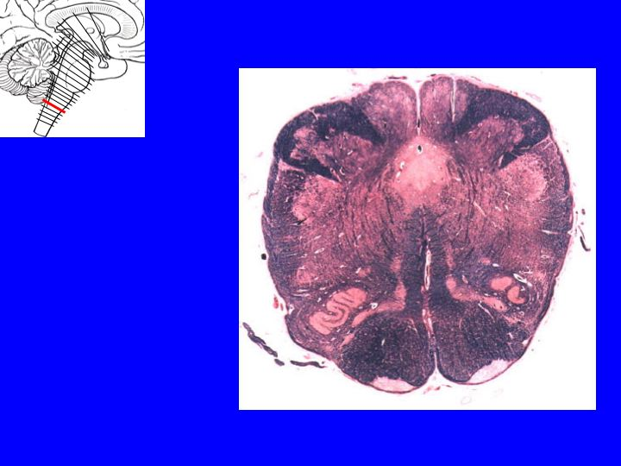
Medulla at level of sensory decussation
Nucleus gracilis
Nucleus cuneatus
Central canal
Spinal nucleus of
trigimenal nerve
Internal arcuate fibers
Medial leminiscus
pyramid

Slide 4
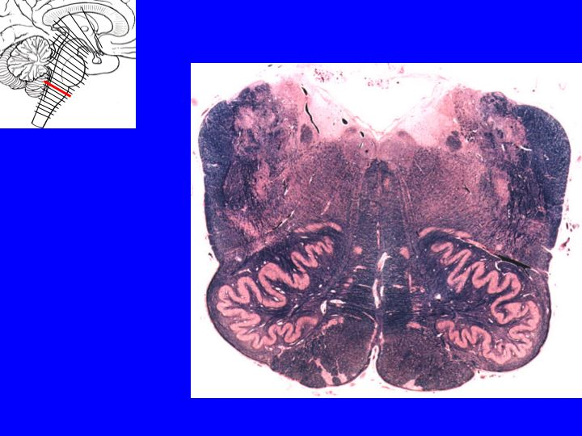
Medulla at level of olives
Dorsal vagal nucleus
Hypoglossal nucleus
Solitary
nucleus
4TH VENTRICLE
ICP
MLF
RF
Medial leminiscus
Inferior olivary nucleus
pyramid

Slide 5
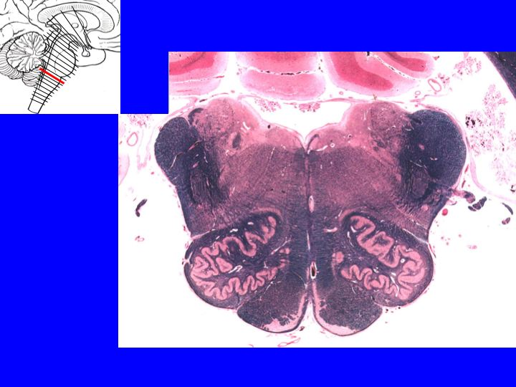
Exam

