Slide 1
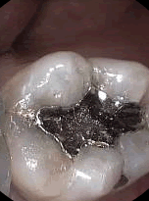
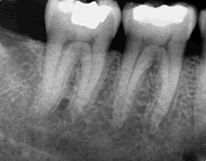
46 years old doctor, intermittent pain in lower right quadrant when chewing. No caries or periodontal pathology, yet the lower first molar responded negative to vitality testing.

Slide 2
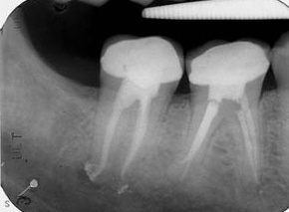
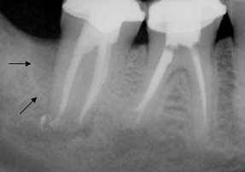
Lower second molar root canal treated since 6 months. Shows favorable healing and satisfactory obturation.
At the 6 years recall, deep distal pocket and vertical bone loss (arrows).

Slide 3
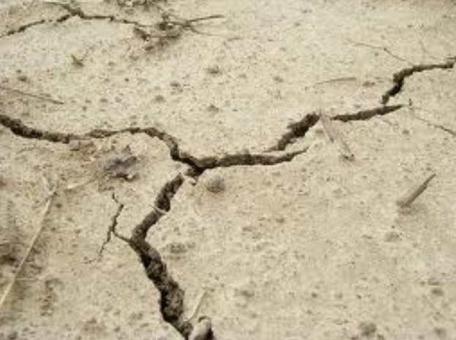
CRACKED TOOTH
Diagnosis
AND
Management

Slide 4
What are teeth crack?
Etiology of cracks.
Types of teeth cracks.
How to diagnose such cracks.
Management of teeth cracks.

Slide 5
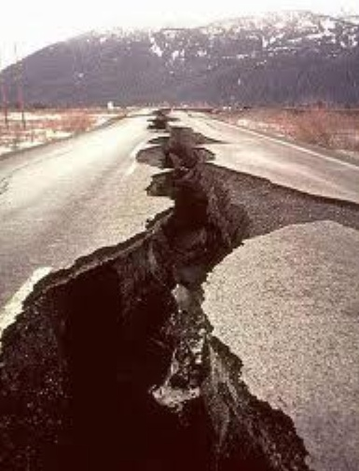
A fracture plane of unknown depth and direction passing through tooth structure that, if not already involving, may progress to communicate with the pulp and/or periodontal ligament.

Slide 6
In patients aged between 30 years and 60 years.
Men = women.
Mandibular second molars > mandibular first molars > maxillary premolars.
Usually mesio-distal orientation but may run buccolingually in mandibular molars.
10% of the population, 15% resulting in pulpal involvement or extraction.
35% of fractures occurred in caries and restoration free teeth.

Slide 7
Etiology of cracks
Naturally occurring causes such as bruxism, clenching and severe attrition.
Iatrogenic causes such as excessive tooth structure removal.

Slide 8
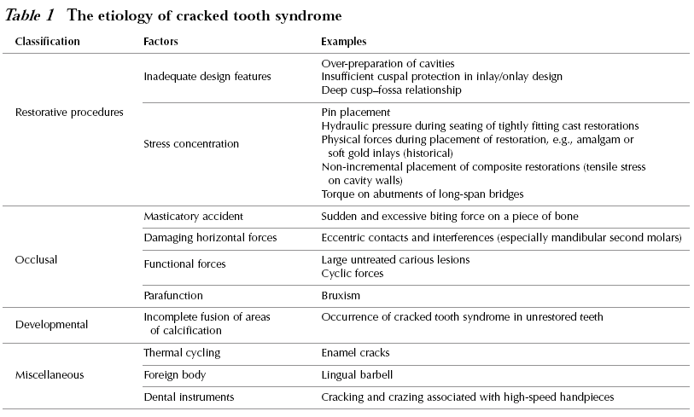

Slide 9
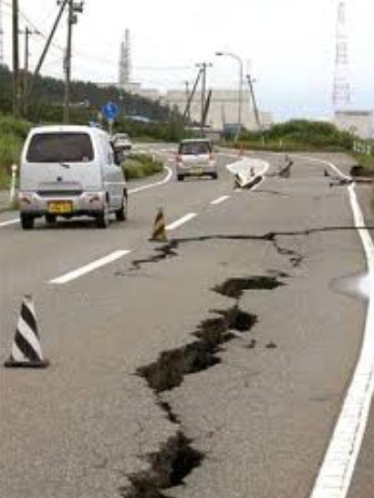
Types of tooth cracks

Slide 10
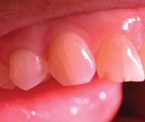
Craze lines
Visible fractures that only involve enamel

Slide 11
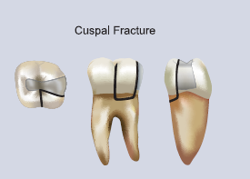
Fractured cusps
Usually originate in the crown, extend into dentin, and end in the cervical region.

Slide 12
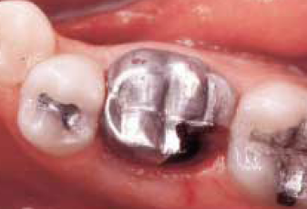
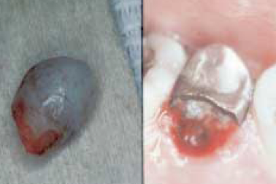
Fractured distolingual cusp
Fractured palatal cusp

Slide 13
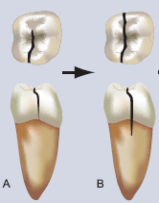
Cracked tooth
A crack extending from the occlusal surface of the tooth apically without separation of the two segments (incomplete fracture).

Slide 14
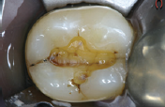

Slide 15

Split tooth
A crack that extends through both marginal ridges usually in a mesiodistal direction, splitting the tooth completely into two separate segments.

Slide 16
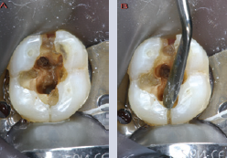
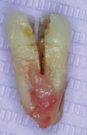

Slide 17
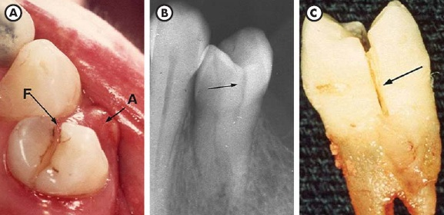

Slide 18
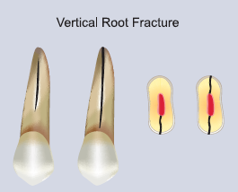
Vertical root fracture
A complete or incomplete crack initiated from the root at any level, usually directed buccolingually.

Slide 20
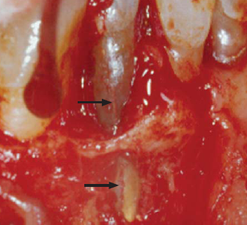

Slide 21
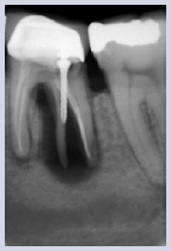

Slide 22
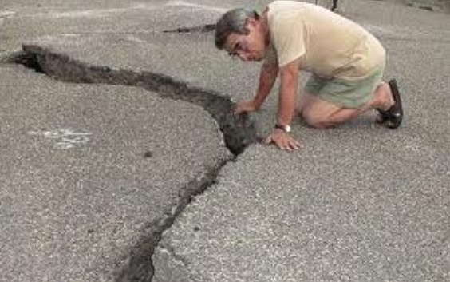
Diagnosis of cracks
Often presents a diagnostic dilemma to the dentist and a painful, frustrating event to the patient, 20% of patients presenting with diagnostic uncertainties to endodontists were eventually diagnosed with teeth cracks.

Slide 23
Patient complaints

Slide 24
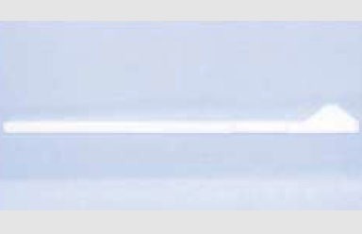
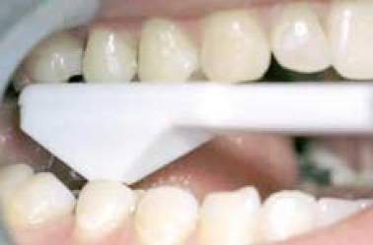
Bite test
Tooth Slooth

Slide 25
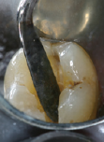
Wedging

Slide 26
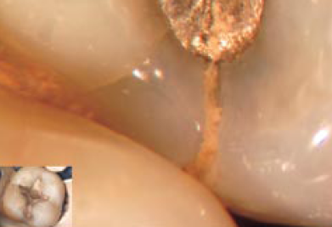
Magnification

Slide 27
Transillumination.
Staining.
Restoration removal.

Slide 28
Surgical assessment.
Radiographs.

Slide 29
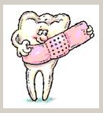
Management of teeth cracks
The severity and consequences of the fracture can range from minor, needing no treatment at all, to severe, resulting in root canal therapy (RCT), or even tooth loss.

Slide 30
Treatment planning depending upon the amount of remaining tooth structure. Affected tooth part removed and defect restored.
Root canal treatment or vital pulp therapy is only necessary in the event that the crack affects the pulp chamber or has resulted in irreversible pulpitis or pulp necrosis.

Slide 31
Craze line: no treatment warranted.
Fractured cusps: affected cusp removed, RCT if pulp involved, bonded tooth restoration.
Cracked tooth: depends on location and extent of crack, RCT if pulp involved. Full crown or onlay. Poor prognosis.

Slide 32
Split tooth: depends on depth of fracture, usually extraction.
Vertical root fracture: removal of fractured root or extraction.

Slide 33
Prognosis of teeth
The location and extent of the crack.
Anatomy of the tooth and roots.
Previous operative/restorative history of the tooth.
Functional forces applied to the tooth (during both functional and parafunctional activity).
Loss of vitality.

Slide 34
Endodontically treated cracked teeth have been shown to display a relatively high failure rate of 14.5% after an evaluation period of two years.
It has been reported that approximately 20% of teeth with cracked tooth syndrome will require root canal therapy.

Slide 35
46 years old doctor, intermittent pain in lower right quadrant when chewing. No caries or periodontal pathology, yet the lower first molar responded negative to vitality testing.

Slide 36
