Slide 1
Endocrine disorders
Dental Course

Slide 2
Thyroid hormone synthesis and physiology
ANATOMY :
10-20 gm in nl adults
M > F
Size increases with age and body weight,
Size decreases with increasing iodine intake .

Slide 3
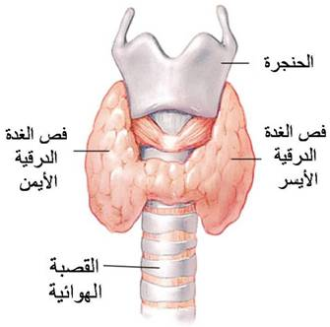

Slide 4
Iodine economy
• Foods rich in iodine :
- seafood, kelp, dairy products.
- iodized salt (45 to 80 mcg/g)

Slide 5
The recommended daily iodine intake :
0 -6 months: 110 mcg
7- 12 months: 130 mcg
1- 8 years: 90 mcg
children 9-13 years: 120 mcg
adolescents and adults: 150 mcg
pregnant women: 220 mcg
lactating women: 290 mcg

Slide 6
Iodine deficiency
• Iodine deficiency is defined by urinary iodine excretion, as follows:
-mild 50- 99 mcg/L
-moderate 20-49 mcg/L
-severe <20 mcg/L

Slide 7
Severe iodine deficiency in fetuses and infants:
- severe mental and growth retardation
Mild iodine deficiency :
- thyroid enlargement and learning disabilities in children

Slide 8
Thyroid hormones synthesis
1. iodide transport :
Sodium iodine transporter on follicular cells

Slide 9
Hormone Synthesis-2
2. Tyrosyl iodination :
Thyroid peroxidase:
- The oxidation of iodide
- iodination of tyrosine residues
- Coupling of iodotyrosyl residues of
thyroglobulin

Slide 10
Triiodothyronine (T3)
80 % by extrathyroidal deiodination of T4
20% by the thyroid
Reverse T3: Nearly all by extrathyroidal deiodination of T4

Slide 11
REGULATION OF THYROID HORMONE PRODUCTION
• Regulation by
- Thyrotropin (TSH)
- Thyrotropin-releasing hormone (TRH).

Slide 12
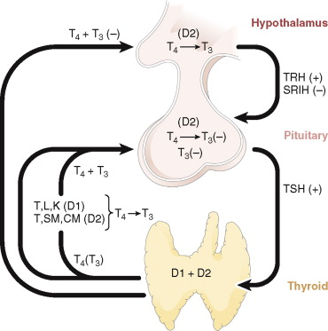

Slide 13
Thyroid hormone deiodinases
• Type I 5'-deiodinase (D1)
• Type II 5'-deiodinase (D2): majority of circulating T3 in humans
• Type III 5-deiodinase (D3) inactivates T4

Slide 14
PRIMARY HYPOTHYROIDISM

Slide 15
1. Chronic autoimmune (Hashimoto's) thyroiditis
The most common cause in iodine-sufficient areas of the world.
- Cytotoxic T cells may directly destroy thyroid cells.

Slide 16
> 90 % of pts have high serum ab’s to TG, TPO , or Na/I transporter .
Ab’s block the action of TSH on the TSH receptor or are cytotoxic to thyroid cells .

Slide 17
high serum TPO ab: 5 % of adults and 15 % of older women
Subclinical hypothyroidism: 5 %-15% (adults)
Overt hypothyroidism: 0.1-2 %
Hypothyroidism: (5- 8 x) F > M

Slide 18
more common in older women
most common cause of hypothyroidism in children
genetic susceptibility
Turner's syndrome and Down syndrome

Slide 19
2. latrogenic disease
a. Thyroidectomy: 2- 4 wks later
b. RAI Rx : mostly in first yr, then annual rate of 0.5 - 2 % / yr
c. External neck irradiation

Slide 20
3. Iodine deficiency
most common cause of hypothyroidism (and goiter) worldwide .
- iodine intake < 100 mcg/day

Slide 21
4. Drugs
Methimazole and PTU
Ethionamide: an antimycobacterial drug. structurally similar to methimazole
Lithium carbonate
amiodarone
interferon alfa
interleukin-2

Slide 22
5. Rare Causes
Infiltrative disease: fibrous thyroiditis (Reidel's thyroiditis), hemochromatosis, scleroderma, leukemia.
Infections : TB and Pneumocystis carinii
Sarcoidosis

Slide 23
CLINICAL MANIFESTATIONS
1. generalized slowing of metabolic processes :
- fatigue
- slow movement and slow speech
- cold intolerance
- constipation
- weight gain (but not morbid obesity)
- delayed relaxation of deep tendon reflexes
- bradycardia

Slide 24
2. Accumulation of glycosaminoglycans in the interstitial spaces :
- coarse hair and skin
- puffy face
- enlargement of the tongue
- hoarseness

Slide 25
Skin signs
Cool and pale, dry
Hair loss, with brittle nails
Nonpitting edema (myxedema)

Slide 26
Eyes
Periorbital edema

Slide 27
• Pericardial effusion
• BP increases are small ( < 150/100 mmHg)

Slide 28
- Modest weight gain due to decreased metabolic rate and accumulation of fluid
- Marked obesity is not characteristic
- Ascites is rare

Slide 29
Gastrointestinal disorders
- Decreased gut motility : constipation.
- Decreased taste sensation
- Gastric atrophy: + antiparietal cell abs
- Celiac disease is 4 x more common

Slide 30
Reproductive abnormalities
hypothyroid women------------- normal women
nl cycles 77% 92
Oligo/amenorrhea 16% 7
menorrhagia 7% 1
Decreased fertility
Hyperprolactinemia

Slide 31
Metabolic abnormalities
• Hyponatremia : reduction in free water clearance
• Reversible increases in s Cr in 20 -90 %
High Cholesterol : 56 %,
High Cholesterol and TG : 34 %,
High TG : 1.5 %
8.5 % : normal lipids

Slide 32
DIAGNOSIS
• Primary hypothyroidism : high serum TSH and a low serum free T4
- high TSH and a nl FT4 =subclinical hypothyroidism
• Central hypothyroidism : low T4 and a TSH that is not appropriately elevated

Slide 33
Rx of hypothroidism
- T4 usual replacement dose 1.6 mcg/kg
- Dose adjustment: 6-8 weeks later.
- Once euthyroid : f/u every 6-12 months

Slide 34
Myxedema coma
- decreased mental status, hypothermia, and bradycardia
- Rx on clinical suspicion without waiting for laboratory results

Slide 35
Mortality rate is high 30 -40 % :
- Elderly patients
- cardiac complications
- reduced consciousness
- persistent hypothermia
- sepsis

Slide 36
Treatment
- Thyroid hormone ( T4 200- 400 mcg loading followed by 1.6 mcg/kg daily),
- supportive measures
- glucocorticoids in stress doses

Slide 37
Hyperthyroidism

Slide 38
Causes
1. high radioiodine uptake :
a. Grave’s disease: most common
b. toxic nodules
2. low radioiodine uptake :
a - thyroiditis
b - extrathyroidal source of thyroid hormone.

Slide 39
SKIN
warm and smooth
• Sweating
• Onycholysis, and softening of the nails.
• Hyperpigmentation in severe cases: increased cortisol metabolism, leading to increased ACTH
• Vitiligo and alopecia areata

Slide 40
Graves dis:
Infiltrative dermopathy on shins
raised, hyperpigmented, violaceous, orange-peel textured papules

Slide 41
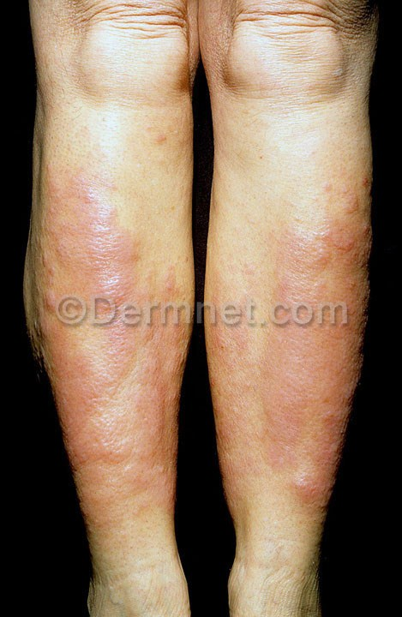

Slide 42
EYES
- Lid lag and retraction ( any cause)
- Proptosis (exophthalmos) (only Graves)
- Ophthalmopathy : more common in smokers
- Optic neuropathy and even blindness

Slide 43
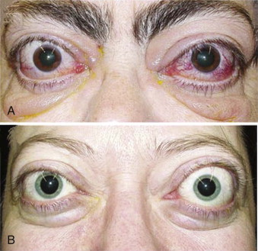

Slide 44
CARDIOVASCULAR
sys HTN is common
High output CHF
AF: 10 -20 % of pts, more common in elderly
Subclinical hyperthyroidism : 3-fold increased risk of AF

Slide 45
GASTROINTESTINAL
Weight loss: increased metabolic rate
Celiac disease is more prevalent in Graves'
Anorexia may be prominent in elderly
• Vomiting and abdominal pain
• Dysphagia due to goiter

Slide 46
BONE
T4/T3 stimulate bone resorption
Alk phosphatase and osteocalcin are high
? hypercalcemia
osteoporosis

Slide 47
NEUROPSYCHIATRIC
psychosis, agitation, and depression
Anxiety, restlessness, irritability
Insomnia

Slide 48
THYROID FUNCTION TESTS
The best screening test: serum TSH
If TSH is normal : hyperthyroidism is very unlikely

Slide 49
Treatment of Graves Hyperthyroidism

Slide 50
Thionamides
1. Methimazole
2. Propyl ThioUracil (PTU) is preferred during pregnancy
S/E : agranulocytosis

Slide 51
Radioiodine ablation
- ? increased risk of worsening ophthalmopathy
Primary Rx: mild hyperthyroidism

Slide 52
Surgery/indications
- obstructive goiter / very large goiter
- pregnant women who are allergic to ATD
- allergies to ATD and refuse RAI
- coexisting suspicious or malignant thyroid nodule
- Pts who want rapid euthyroidism

Slide 53
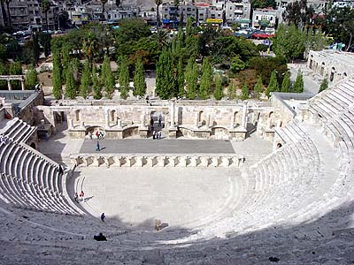

Slide 54
Diabetes Mellitus

Slide 55
Estimated prevalence of diabetes worldwide in 2025
Number of persons
<5,000
5,000 – 74,000
75,000 – 349,000
350,000 – 1,500,000
>1,500,000
No data available
A projected 300 million people with diabetes worldwide by 2025
WHO. The World Health Report 1998; 91; King H, et al. Diabetes Care 1998; 21:1414–1431.
Notes:
Diabetes affects over 140 million worldwide and this figure is likely to reach 300 million by 2025
The causes behind this rapid rise in prevalence include population growth and aging, an increasing trend towards a poor diet, obesity, a sedentary lifestyle and urbanization
Type 2 diabetes represents therefore a major, and increasing, healthcare burden

Slide 56
Symptoms
Polyuria, increased frequency of urination, nocturia.
Increased thirst, and dry mouth
Weight loss
Blurred vision
Numbness in fingers and toes
Fatigue
Impotence (in some men)

Slide 57
Signs
Weight loss: muscle weakness
Decreases sensation
Loss of tendon reflexes
Foot Inter-digital fungal infections
Retinal changes by fundoscopy

Slide 58
Criteria for the diagnosis of diabetes
1. A1C ≥6.5 percent. *
2. FPG ≥126 mg/dL . Fasting is defined as no caloric intake for at least 8 h.*
3. Two-hour plasma glucose ≥200 mg/dL during an OGTT. 75 g anhydrous glucose dissolved in water.*
4. In a patient with classic symptoms of hyperglycemia or hyperglycemic crisis, a random plasma glucose ≥200 mg/dL .
* In the absence of unequivocal hyperglycemia, criteria 1-3 should be confirmed by repeat testing.

Slide 59
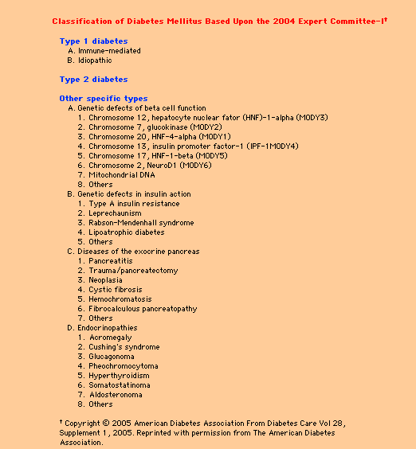

Slide 60
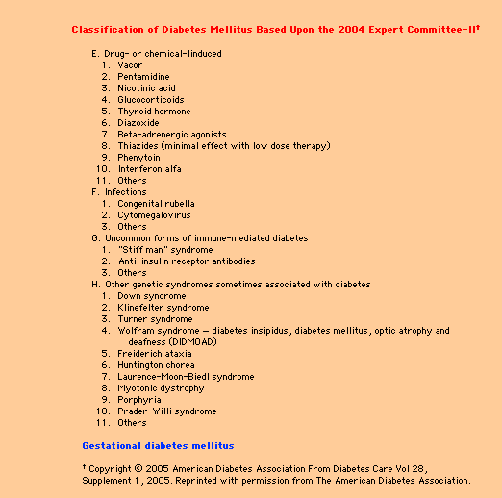

Slide 61
MAJOR RISK FACTORS ( Type2DM)
- Family history of diabetes
-Overweight (BMI > 25 kg/m2)
-physical inactivity
-Race/ethnicity (e.g., African-Americans, Hispanic-Americans)
-Previously identified IFG or IGT
-History of GDM or delivery of a baby weighing > 4.5 kg
-Signs of insulin resistance or conditions associated with insulin resistance :
*Hypertension ( 140/90 mmHg in adults)
*HDL cholesterol 35 mg/dl and/or a triglyceride level 250 mg/dl
*Polycystic ovary syndrome *acanthosis nigricans

Slide 64
ROLE OF DIET, OBESITY, AND INFLAMMATION
Increasing weight and less exercise
Obesity epidemic
Increasing T2DM in children and adolescents

Slide 65
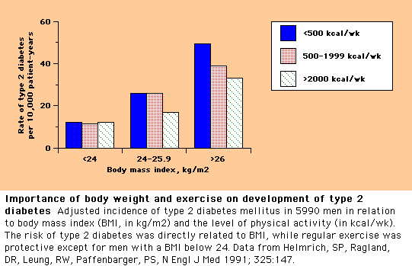

Slide 66
Diabetes Prevention-DPP trial
3234 obese (average BMI 34 kg/m2) subjects aged 25-85 yrs at high risk for DM (Obese+ IFG/IGT):
1. Intensive lifestyle changes: reduce weight by 7 % with low-fat diet and exercise for 150 min / wk
2. Treatment with metformin (850 mg BID) plus information on diet and exercise
3. Placebo plus information on diet and exercise

Slide 67
DPP
The diet and exercise group lost an average of 6.8 kg (7%) of weight in the first year.
At 3 years, fewer patients in this group developed diabetes (14 versus 22 and 29 % in the metformin and placebo groups)
Lifestyle intervention was effective in men and women in all age groups and in all ethnic groups.

Slide 68
Management of Type2DM
1. Lifestyle modifications:
- Medical nutrition therapy
- increased physical activity
- weight reduction
2. Oral Drug Therapy/Noninsulin sc therapy
3. Insulin therapy

Slide 69
complications
Acute:
1. Diabetic Ketoacidosis
2. Hyperglycemic Hyperosmolar state
3. Hypoglycemia: (patients under treatment)

Slide 70
EPIDEMIOLOGY
DKA: usu. type1DM.
T2DM under extreme stress : serious infection, trauma, cardiovascular events
DKA is more common in younger (<65 years) diabetic patients and F>M .
Mortality in DKA : due to the underlying precipitating illness

Slide 71
The prognosis of DKA is worse at the extremes of age and in the presence of coma and hypotension
HHS :
- older than 65 yrs with type 2 DM .
- Mortality is higher: 5 -20 % (underlying illness)

Slide 72
PATHOGENESIS
• Insulin deficiency and/or resistance.
• Glucagon excess
-increased catecholamines and cortisol contribute

Slide 73
CLINICAL PRESENTATION
DKA usually evolves rapidly / 24 hr
HHS:
polyuria, polydipsia, and weight loss,
lethargy, focal signs, and coma
Hyperventilation and abdominal pain are limited to DKA.

Slide 74
Diagnostic criteria for (DKA) and (HHS)
DKA HHS
Mild Moderate Severe
---------------------------
Plasma glucose (mg/dL) >250 >250 >250 >600
Arterial pH 7.25-7.30 7.00-7.24 <7.00 >7.30
Serum bicarbonate (mEq/L) 15-18 10 to <15 <10 >18
Urine ketones* Positive Positive Positive Small
Serum ketones* Positive Positive Positive Small
Effective s. osm. (mOsm/kg)• Variable Variable Variable >320
Anion gapΔ >10 >12 >12 Variable
Mental status Alert Alert/drowsy Stupor/coma
• Calculation: 2[measured Na (mEq/L)] + glucose (mg/dL)/18.
Δ Calculation: (Na+) - (Cl- + HCO3-) (mEq/L).

Slide 75
Management -DKA
1. Underlying cause
2. IV Fluids
3. Insulin Therapy
4. Electrolyte management

Slide 76
Hypoglycemia
With insulin or insulin secretagogues
Higher risk
- type I compared to type II.
- tight/near normal glycemic control
- Hypoglycemia unawareness with repeated
hypoglycemia.
can lead to permanent neurological deficit

Slide 77
Symptoms/signs
Feeling of hunger
Palpitations
Sweating
Tremors
Reduced concentration
Blurred vision
Dizziness
Seizures
coma

Slide 78
hypoglycemia
- Mild-moderate: self, oral glucose ( 15-20 gm)
- Severe ( loss of consciousness) : needs help by others, IV glucose, glucagon injection

Slide 79
Thank you

