Slide 1
The Visual System

Slide 2
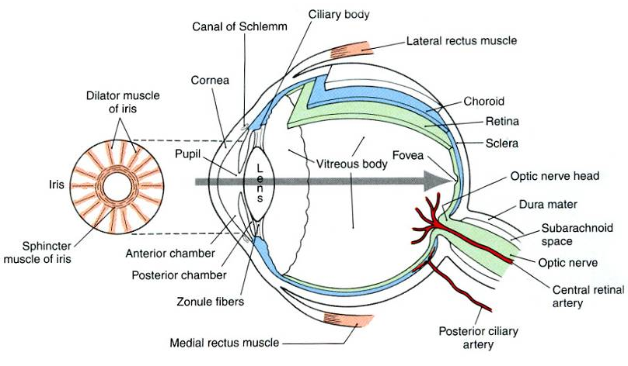
Anatomy of the eye

Slide 3
Anatomy of the eye

Slide 4
Anatomy of the eye

Slide 5
Anatomy of the eye

Slide 6
Anatomy of the eye

Slide 7
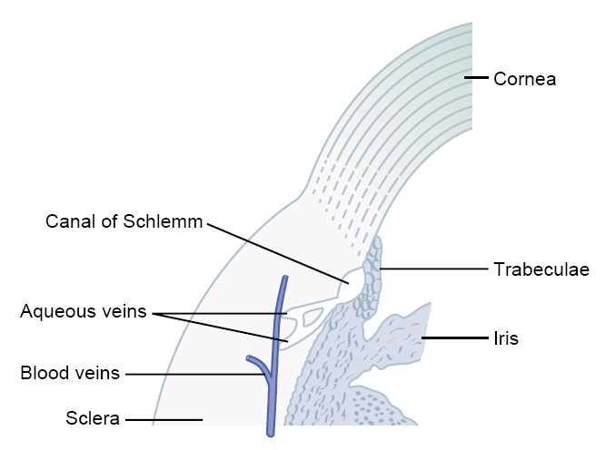
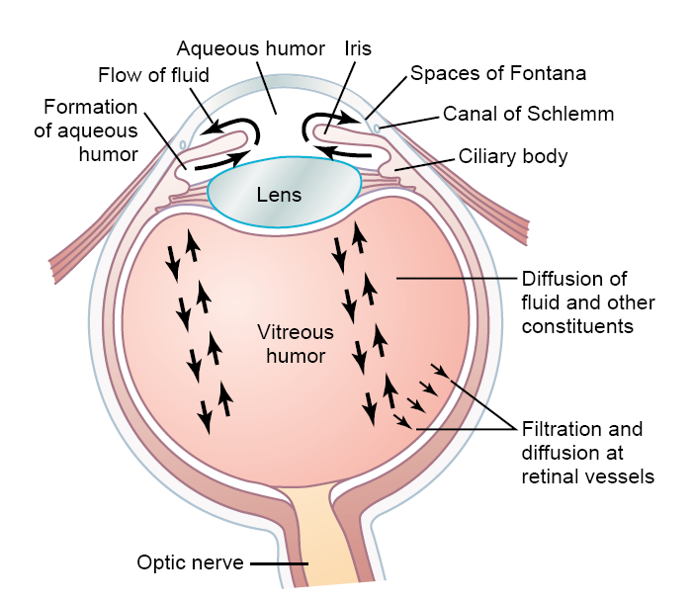
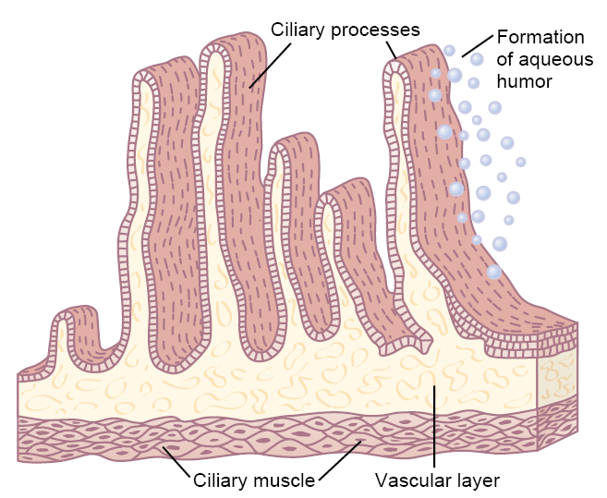
Intraocular Fluid
Glaucoma

Slide 8
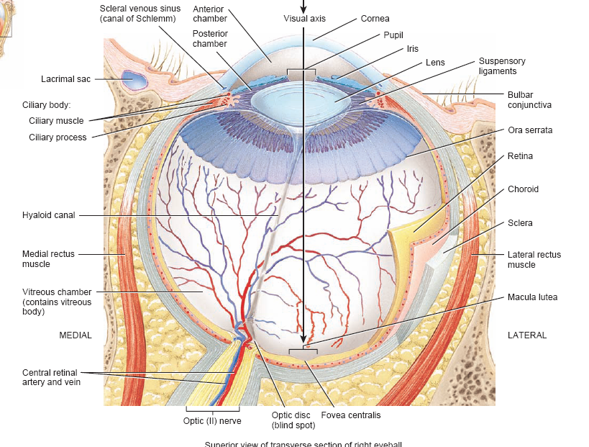

Slide 9
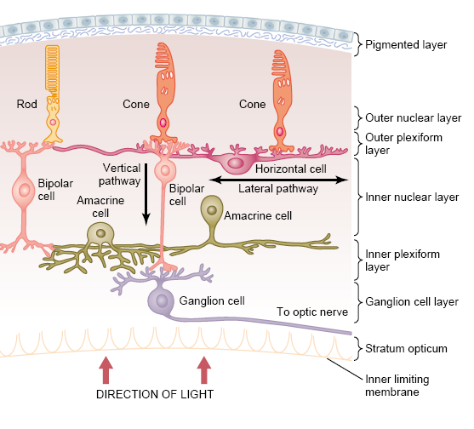
Retina
Pigmented layer
Photoreceptors
Bipolar cells
Ganglion cells
Horizontal cell
Amacrine cell

Slide 10
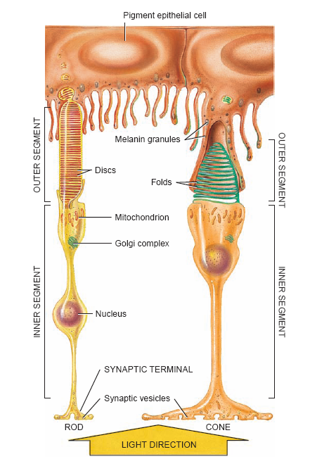
Photoreceptors
Cones
Rods

Slide 11
Photoreceptors
Cones
Rods

Slide 12
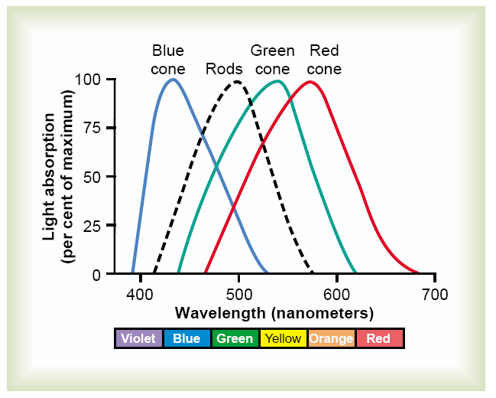
Photoreceptors
Cones
Rods

Slide 13
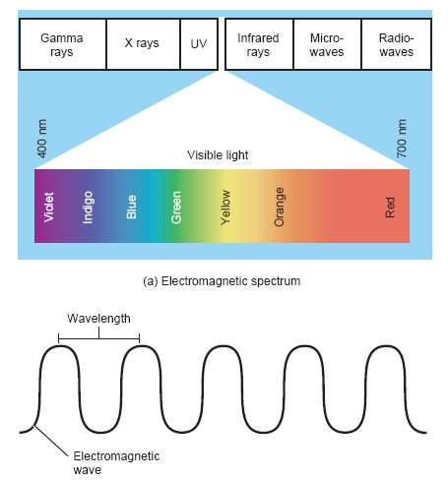
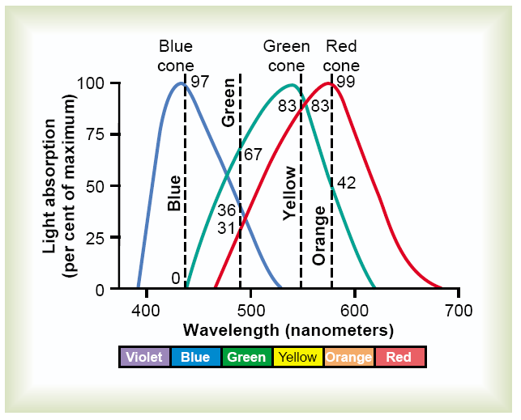

Slide 16
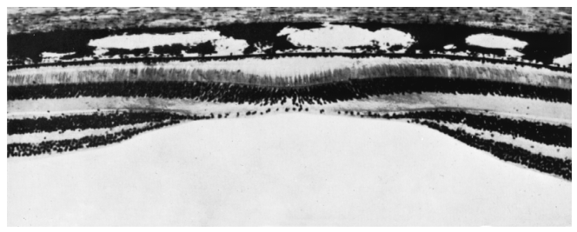

Slide 17
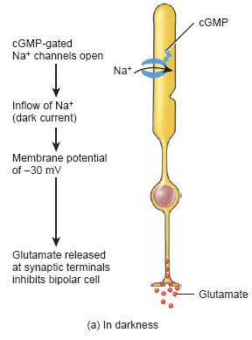
Light Detection

Slide 18
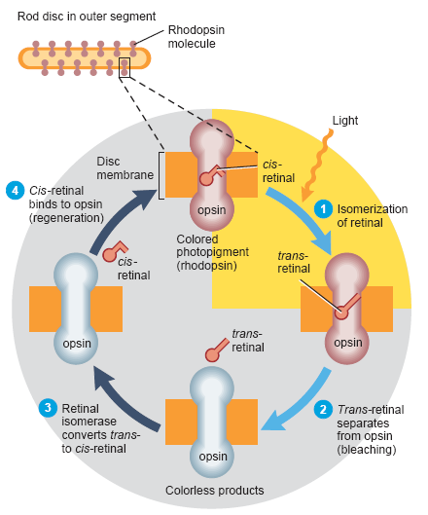
Light Detection

Slide 19
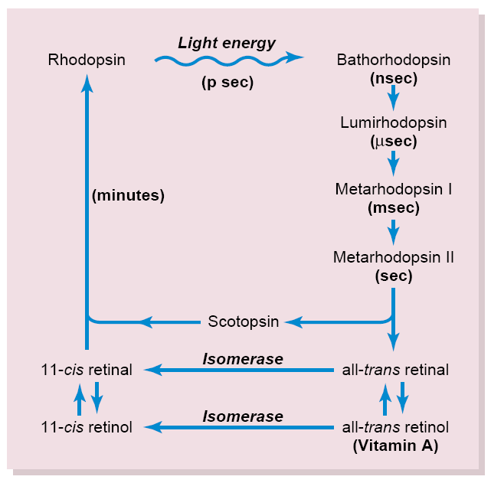
Light Detection

Slide 20
Light Detection

Slide 21
Light Detection

Slide 22
Light Detection

Slide 23
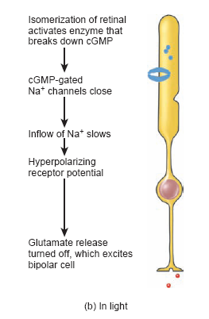
Light Detection

Slide 25
Photoreceptors
Cones
Rods
Cones
Rods
Photopsin : blue, green and red sensitive pigments

