Slide 1
Endodontic Materials:
Root canal irrigants and medicaments

Slide 2

The main objectives of root canal therapy are:
Removal of the pathologic pulp.
Cleaning and shaping of the root canal system.
Three dimensional obturation to prevent reinfection.

Slide 3
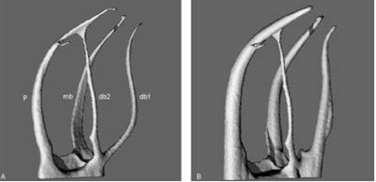

Slide 4
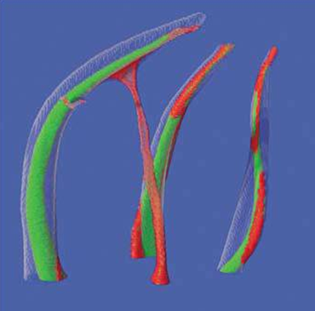

Slide 7
There is no definitive evidence in the literature to show that mechanical instrumentation alone will predictably result in bacteria-free root canal systems.
Irrigation is an essential part of root canal debridement because it allows for cleaning beyond what might be achieved by root canal instrumentation alone.

Slide 8
Disinfection of the root canal system is one of the primary aims of root canal treatment. This can be achieved through the use of various antimicrobial agents in the form of irrigants (only used for relatively short periods of time) and medicaments (days or several weeks).

Slide 9
Irrigants
Ideal properties:
  Lubricant
  Antimicrobial
  Dissolve organic debris
  Flushing
  Biocompatible
  Cheap

Slide 10
Functions of irrigants
Irrigants are used to clean the root canal and are used in association with the shaping instruments.
Functions of irrigants include:
Lubrication of instruments used to shape the canal.
Flushing out of gross debris.
Dissolution of organic and inorganic tissue.
Antimicrobial effect.

Slide 11
Classification of irrigants
Chemically inactive irrigants
  Water
  Saline
  Local anaesthetic solution
Chemically active irrigants
  Sodium hypochlorite (NaOCl).
  Oxidizing agents as Hydrogen peroxide (H₂O₂)
  Chelating agents as EDTA.

Slide 12

Sodium hypochlorite
0.5-5.25 %
Antibacterial and antifungal.
Excellent tissue dissolving ability.
Heat may enhance efficiency.
Has deteriorative effects on mechanical properties of dentine.
Apical reaction
Rubber dam

Slide 14
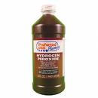
Hydrogen peroxide
3% +/- NaOCl
Production of O2 eliminate anaerobes
Bubbles may prevent adequate contact of irrigant with debris
Limited shelf life

Slide 15
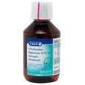
Chlorhexidine
Hibisrcub
Usually effective in 2% concentration.
Antibacterial and antifungal.
Substantivity up to 12 weeks.
Flushing
Lubricant
Does not dissolve organic debris.
Should be used as a final rinse.

Slide 16

Chelating agent
Ethylene Diamine Tetracetic Acid “EDTA” (File-eze, RC Prep)
Remove smear layer allowing
cleaning of tubules
Soften dentine
Not antibacterial
File-eze is water soluble unlike RC Prep which contains carbowax and is difficult to remove

Slide 17
BioPure (MTAD)
Introduced by Torabinejad et al. in 2003 .
Mixture of 3% doxycycline, 4.25% citric acid and a detergent (0.5% Polysorbate 80).
MTAD is able to remove the smear layer and is effective against E. faecalis.
Shows substantivity up to 4 weeks.

Slide 20
Irrigants
Sterile water
Local anaesthetic
Saline (0.9%)
They only provide lubrication and gross debris removal functions.

Slide 21
Irrigants have to be used in large volumes and to be confined to root canal space. Never to be delivered with excessive force.
Best Irrigation protocol is the alternating use of NaOCl with EDTA or BioPure. CHX can be used as a final rinse.

Slide 22
Irrigation Delivery and Agitation techniques:
A-Manual Techniques:
Syringe irrigation with needles: passively or with agitation. Irrigant delivered distally or laterally.
Brushes: for irrigant agitation and debridement of root canal wall.
Manual-dynamic irrigation: well-fitted gutta percha cone.

Slide 23
B-Machine-assisted Techniques:
Rotary brushes.
Continuous irrigation during rotary instrumentation.
Sonic irrigation.
Ultrasonic irrigation.

Slide 24
Intracanal medicaments
If root canal treatment can’t be finished in a single visit, root canals are dressed with medicaments.
A medicament is an antimicrobial agent that is placed inside the root canal between treatment appointments in an attempt to destroy remaining microorganisms and prevent reinfection.

Slide 25
Functions of intracanal medicaments:
  Primary function: antimicrobial activity
    Antisepsis
    Disinfection
  Secondary functions
    Hard-tissue formation
    Pain control
    Exudation control
    Resorption control

Slide 26
Intracanal medicament
Ideal properties
  Antibacterial
  Penetrates dentinal tubules
  Control exudation or bleeding
  Biocompatibile.
  Eliminates pain
  Induce calcific barrier
  No effect on temporary
  Radio-opaque
  Does not stain tooth

Slide 27
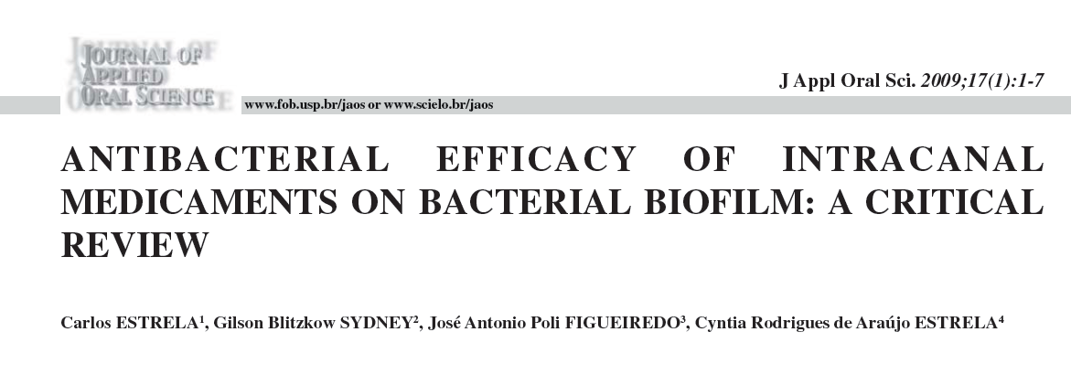
The clinical effectiveness of these agents must be evaluated in the light of the complexity of root canal anatomy and polymicrobial nature of root canal infections.

Slide 28
Root canal preparation, with careful disinfection and use of intracanal substances that provide good antimicrobial efficacy, tissue dissolution capacity, and acceptable biocompatibility, will definitely improve the prognosis of the treatment of apical periodontitis.
The antimicrobial efficacy of intracanal medicaments on bacterial biofilms still need to be confirmed.

Slide 29
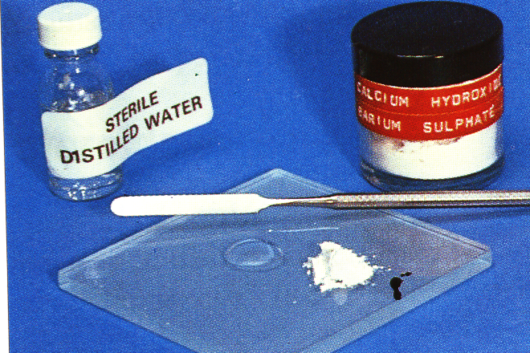

Calcium hydroxide
Hypocal
Antibacterial (pH>12)
Denatures protein
Synergestic with NaOCL
Cytotoxic-local necrosis, calcific barrier
Cheap
Dries weeping canals
Forms a calcific barrier

Slide 30
Antibiotics
Tetracyclines have been used to remove the smear layer from instrumented root canal walls, for irrigation of retrograde cavities during periapical surgical procedures , and as an intracanal medicament.
Combination of drugs required to be effective
Resistant strains becoming more difficult to treat
Allergies.

Slide 31

Steroids
Triamicinolone, prednisolone
Pain relief but no evidence of more effective than Ca(OH)2
?use in root resorption by inhibiting odontoclasts
?depresses the host inflammatory response
Not antibacterial but can be mixed with Ca(OH)2
Ledermix= triamicinolone+ tetracycline

Slide 32
CHX
Owing to the greater activity against Gram-positive than Gram-negative organisms, application of CHX as intracanal medicament is preferred in retreatment case compared with initial endodontic infections.

