Slide 1
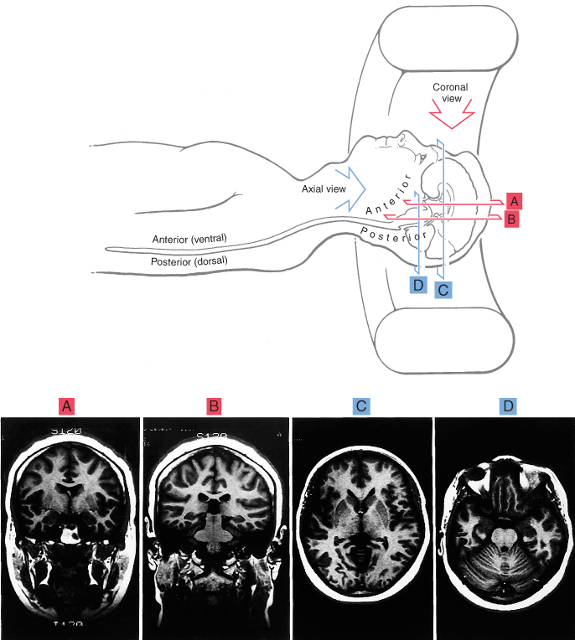
The Brain in MRI and CT
MRI are taken by a rotating magnetic field
CT scans are taken by rotating X-ray source

Slide 4
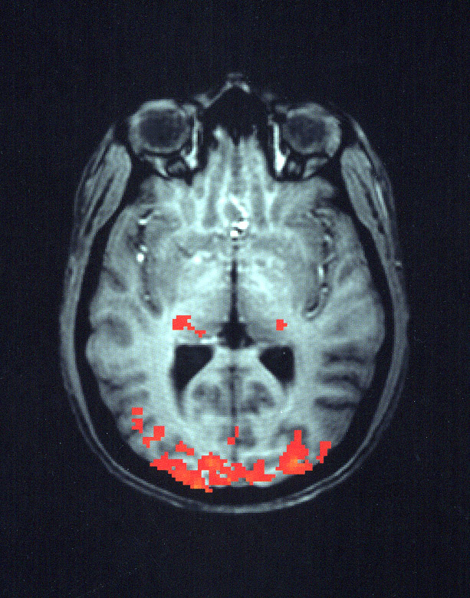

Slide 5
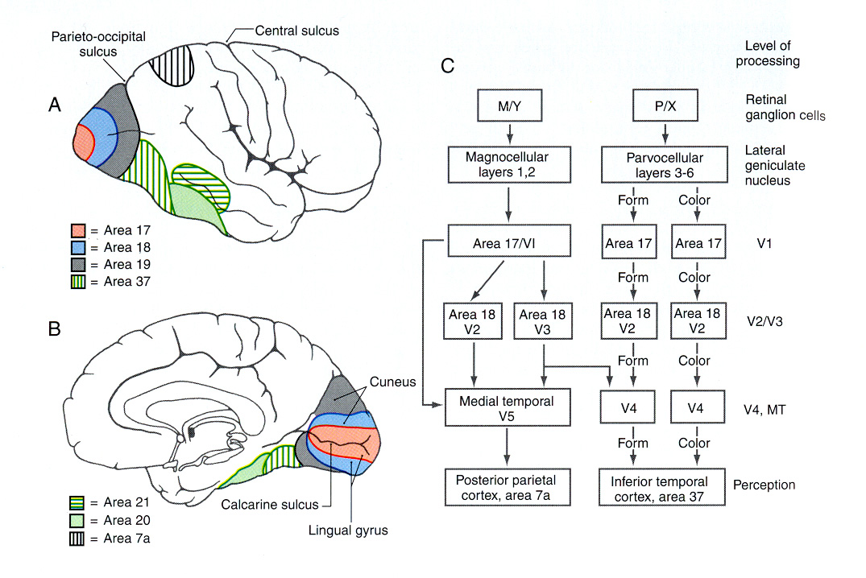
Ventral “What” pathway
Carries information about static object properties such as colour, luminance, stereopsis and pattern recognition.
Slow pathway from P-ganglion cells (through laminae 3-6 of LGN, V1) to V2, V4 and inferior temporal cortex

Slide 6
Dorsal “Where” pathway
Information about dynamic object properties- motion and spatial relationships
Fast pathway for transient visual signals
Pathway to V1, V2, MT, medial superior temporal and parietal lobe

Slide 8
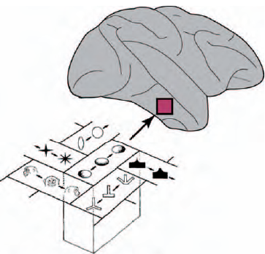

Slide 9
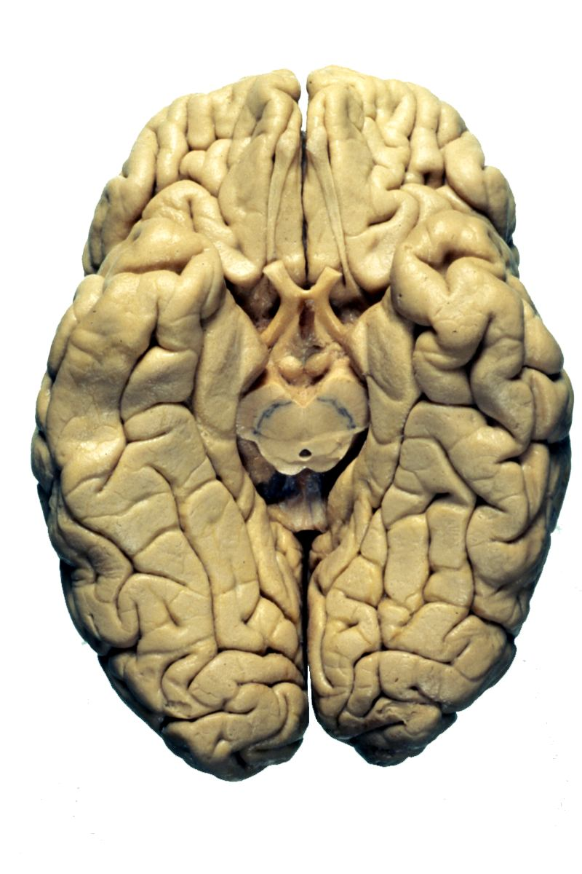
Occipitotemporal
gyri

Slide 10
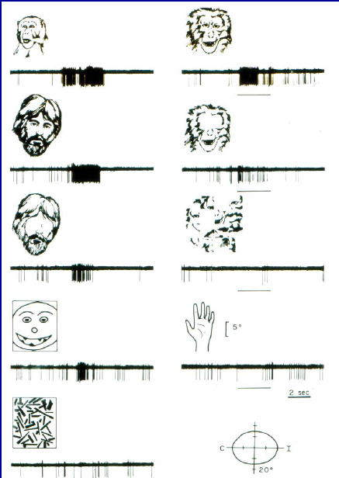

Slide 11
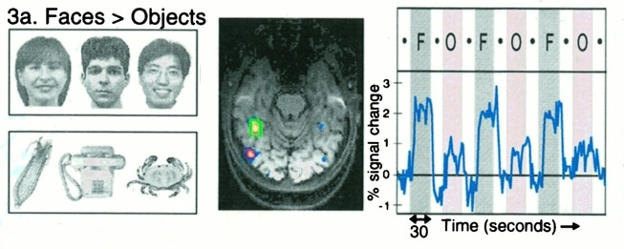
Kanwisher , McDermott, and Chun, 1997

Slide 12
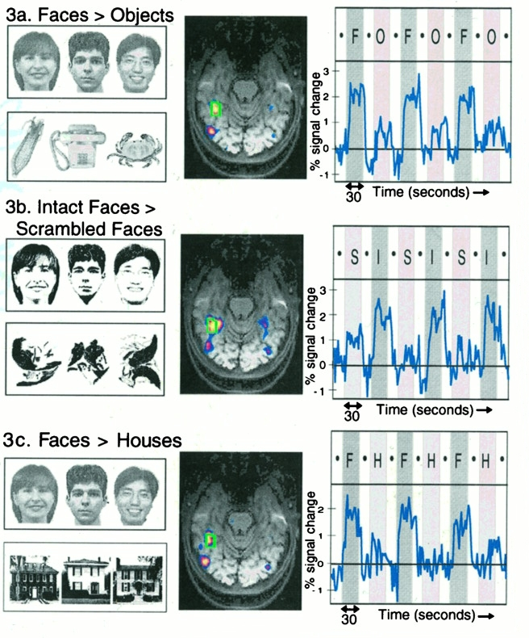
Kanwisher , McDermott, and Chun, 1997

Slide 13
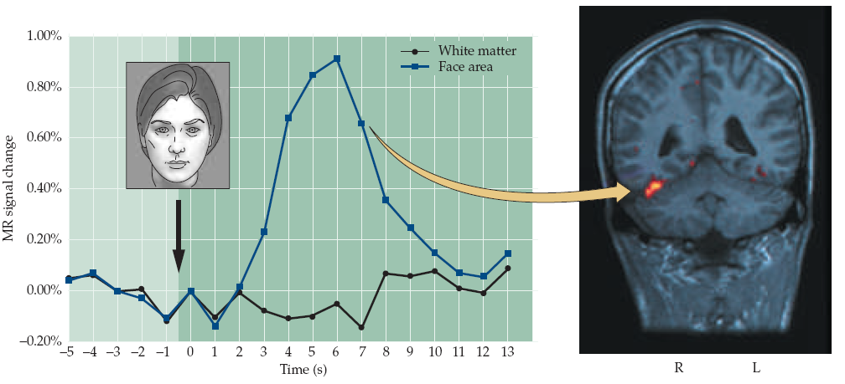

Slide 14
Prosopagnosia
Prosopagnosia-
Inability to recognize or learn faces
Identify people by other cues- gait, mannerisms or facial features- spectacles, gait

