Slide 1
Fissure sealant
Rawan ElKarmi
BDs, MSc, FFD RCSI

Slide 2
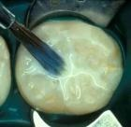
What is a fissure sealant?
Material placed in pits and fissures of teeth in order to prevent or arrest the development of caries.
(EAPD GUIDELINES)

Slide 3
History of fissure sealants
Buonocore 1955 :
First to describe technique of acid etch for bonding to enamel
Bowens Resin 1956:
Development of resin sealant materials
1970’s – now
Ongoing development of materials including use of glass ionomers

Slide 4
Types of fissure sealants
Resin based sealants
Glass Ionomer sealants

Slide 5
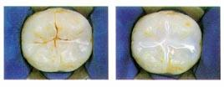
Resin based sealants
Composition: BIS-GMA
Bond by acid etch technique
Caries prevention is due to tight seal which prevents micro leakage
Polymerisation may be initiated chemically (auto cure) or by light (light cure)
Clear or opaque

Slide 6
Properties of resin based sealants
PHYSICAL PROPERTIES:
Inert (not toxic)
Low viscosity
High cohesive strength
CLINICAL PROPERTIES:
Long shelf life
Easy to handle and apply
Relatively long working time
Short setting time

Slide 7
Glass Ionomer sealants
Erupting teeth at risk of developing decay
Erupted teeth at risk where cooperation and/or isolation inadequate
Advantages
Bonds to enamel without acid etching – less moisture sensitive
Acceptable caries prevention
Active release of fluoride
Disadvantages
Retention rate poor compared to resin sealants

Slide 8
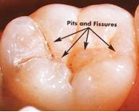
Why do we seal?
Occlusal surfaces are 12.5% of surface area of permanent teeth
80 to 90 % of all caries in permanent posterior teeth and 44% in primary teeth (Beauchamp et al.,2008)
Pits & fissures benefit less from fluoride

Slide 9
Sealants should be part of an overall preventive strategy used in conjunction with:
patient education – Diet, OH etc
effective oral hygiene practices
regular low-dose fluoride
regular dental visits

Slide 10
Who do we seal? Patient selection/Indications
The decision to apply a FS should be made on clinical grounds based on:
Clinical examination, supported by
Radiographs where appropriate,
and taking into account risk factors
caries experience of the patient,
fluoride history
fissure anatomy, and
plaque load (oral hygiene).

Slide 11
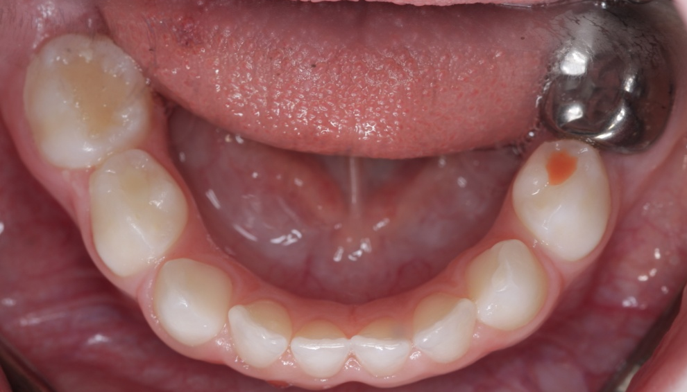
Who do we seal? Patient selection/Indications
1- Patients with dental decay
History of dental decay:
evidence of filled or missing teeth due to decay in primary or secondary teeth
Current decay:
involving the primary or permanent dentition

Slide 12
Who do we seal? Patient selection/Indications
2- Patients with no dental decay but high risk of developing decay
Siblings affected by decay
History of frequent sugar intake

Slide 13
Who do we seal? Patient selection/Indications
3- Medically compromised patients
Patients with Medical, Physical or Intellectual Impairment e.g.
Cardiac patients
Haematology patients
Diabetic patients
Patients with special healthcare needs

Slide 14
Remember!!
Sealant use must be based on personal, tooth, and surface risk
Caries risk may change at any time in the life of the patient
Sealant placement only within a few years of eruption?!
Sealants my be appropriate later in life due to changes in a patient’s habits, oral microflora or physical condition

Slide 15
Do we seal primary teeth?
Many primary teeth may be judged to be at risk
Primary enamel does not etch well!?
Clinical studies reporting success of fissure sealant in primary molars are rare
Bias about the success of sealants on children (patient cooperation and critical isolation)

Slide 16
Effectiveness of fissure sealant
Sealants placed on the occlusal surfaces of permanent molars in children and adolescents reduced caries up to 48 months when compared to no sealant (Ahovuo-Saloranta A, 2013)
Studies incorporating recall and maintenance have reported sealant success levels of 80 to 90 percent after 10 or more years (Simonsen 1991)

Slide 17
Factors improving effectiveness of fissure sealant
Proper isolation (rubber dam, cotton roll, 4 handed technique)
Tooth cleaning prior sealant application
Conflicting evidence to support mechanical preparation with a bur prior to sealant placement, (NO MORE RECOMMENDED)

Slide 18
Sealant improvement through dental material advancements
Fluoride containing sealants
Inclusion of a bonding primer and adhesive layer between etched enamel and the sealant (significantly increases retention rate (Bagherian et al., 2016))
Self etching adhesives (not superior to the etch and rinse adhesives (Botton et al., 2015; Bagherian et al., 2016))
Notes:
(anticaries advantage from the fluoride has not been demonstrated)
Self etching adhesives may lead to a dramatic simplification of the steps involved in sealant application with equivalent sealant retention

Slide 19
Sealing enamel caries
Arrested caries and elimination of viable microorganisms under sealants
Difficulty in accepting the concept

Slide 20
Sealing enamel caries
Any fissure lesion judged to be limited to enamel is a candidate for sealant therapy
Low sensitivity and specificity of current fissure diagnostic methods
Overdiagnosis and underdiagnosis
Judgment based on caries risk level of the population

Slide 21
Preventive resin restoration
Used when decay is confined to a part of the fissure system
Includes the removal of carious tissue, insertion of a resin filling and sealant application
Lesion would probably be visible on a bitewing radiograph

Slide 22
Types of PRR
Type A
Type B
Type C

Slide 23
Clinical examination
Radiographic examination
Diagnosis
Caries
No Caries
Enamel entry/biopsy
Fissure sealant
Observe cavity base
Type A PRR
Caries
No caries
Remove caries
Conventional restoration
Extensive
Observe caries extent
PRR type B
Minimal

Slide 24
Glass Ionomer sealants
ART
Indication (erupting molars, behaviour problems)
Not under “wet” conditions

Slide 25
Glass ionomer sealants
Retention rate of GI sealants is low
High viscosity vs. medium and low viscosity
Caries preventive effect of GI sealants is similar to that of Resin based sealants
Fluoride release
GI remnants observed in the deeper parts of the pit and fissure system

Slide 26
Concerns regarding resin based sealants
BPA and resin based materials
Possible oestrogenic effect
World Dental Association discourages its use in restorative materials
Importance of prevention
Alternatives

Slide 27
AAPD
Resin-based materials achieve better retention and, therefore, may be preferred as dental sealants,
BUT
Glass ionomer sealants could be used as transitional sealants when moisture control is not possible
(Ahovuo-Saloranta et al., 2013)

Slide 28
Armamentarium
Notes:
Helioseal
Light curing white shaded fissure sealant

Slide 29
Prepare patient (Tell, Show, Do)
EXPLAIN what is about to happen, in language appropriate to your particular patient’s level of understanding
SHOW your patient the cotton wool rolls, the brushes, the blue paint, the white paint and the bright light
DO

Slide 30
Isolation
Cotton rolls, saliva ejector and dry tips
Garmer cotton wool roll holder, saliva ejector and dry tips
Rubber dam and saliva ejector

Slide 31
Isolation
Isolation is CRITICAL
Enamel porosity compromised with any liquid or glycoprotein

Slide 32
Isolation
Rubber dam is ideal
Need local anaesthetic
Difficult with partial erupted teeth

Slide 33
Surface cleaning
Must remove organic debris
Use brush or cup
NO PROPHY
Wash thoroughly
Notes:
33
For removal of debris, plaque or pellicle
Brush or cup in latch-grip handpiece
NO need to use bur to remove enamel as retention is high without it

Slide 34
Etching
35% ortho phosphoric acid
Acidified gel
Continously agitated or 15 secs
Remember pits as well as fissures
Notes:
30-50% acid concentration makes no difference on retention after one year
Aqueous solns of etch are hard to control - an improvement is the production of acidified gels – may also include a pigment to further aid control.
Etching 15, 30, 45, or 60 secs makes no difference on retention (Duggal ’97)
No difference in retention rates in E’s or 6’s also in this same study

Slide 35
Acid etch technique
acid selectively removing crystalline phases of enamel
Vastly increases surface area for adhesion
At least three different types of etch pattern.

Slide 36
Honey comb etch pattern

Slide 37
Reverse honey comb etch pattern

Slide 38
Haphazard etch pattern

Slide 39
Washing
Wash thoroughly with pressurised water
For 15 secs
Dry with oil-free compressed air
Dry for 15 secs
Notes:
Waggoner and Siegal ’96 says times not important thorough washing until all etch is removed and thorough drying until chalky frosted appearance
At this stage can use layer of bond if difficult to isolate and this will produce a bond strength comparabile to that of an etched enamel sealant

Slide 40
Drying
Frosted appearance
If contaminated with water: re-dry
if contaminated by saliva, blood, oil etc: wash and re-etch for 15secs.

Slide 41
Seal
Place a small amount of sealant on fissure pattern with brush
Use a probe to draw it into all of the fissure pattern
Wait for 15secs
Notes:
Avoid bubbles
Amout only in fissure

Slide 42
Light Cure
Light activate for 20secs
Tip of light approximately 2mm from tooth
Light cure buccal/palatal surfaces separately
Use amber shield
Notes:
Emphasis buccal and palatal pits
LED curing lights are not as powerful as plasma arc curing (PAC) or quartz tungsten halogen (QTH) lights. wavelength
490nm

Slide 43
Checking occlusion
Check resin with a sharp probe
Dry tooth and check MIP with articulating paper
Adjust if necessary
Notes:
If adjustments are necessary, they can be quickly performed with diamond finishing burs (high speed and water spray). For adjustment of sealants, the appropriate shaped fine finishing bur is used (Komet yellow band, 15 μm). No further finishing is necessary.
Green “Polistones” (coarse Aluminium Oxide) stones may be used for gross adjustments. They are used with a latch-grip, slow handpiece and water-soluble gel lubricant (KY gel). When the occlusion is satisfactory, the sealant should be polished with white Polistones (of appropriate shape) and water-soluble gel. These are composed of fine Aluminium Oxide.

Slide 44
Preventive resin restoration
LA and application of rubber dam
Enamel removed to gain access to caries
Caries over the pulp removed

Slide 45
Preventive resin restoration
Composite restoration placed
Cavity and all of occlusal surface are etched
Notes:
Too much Ca(OH)2 has been used this is old
Take out caoh

Slide 46
Preventive resin restoration
Fissure sealant applied to occlusal surface
Occlusion checked

