Slide 1
Chromosomal Disorders
MGL-4
March 11th 2014
Mohammed El-Khateeb

Slide 2
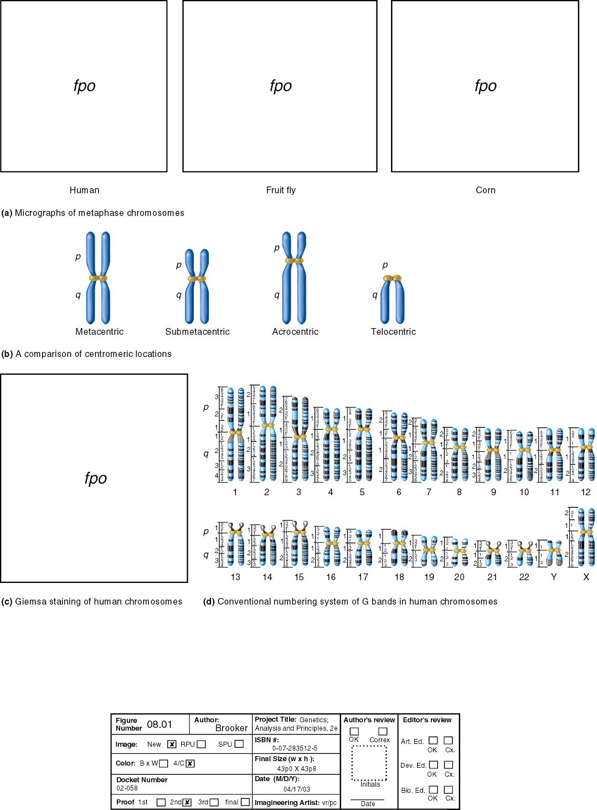
G-Banded Metaphase Chromosomes
A
B
C
D
E
F
G

Slide 3
Types of chromosome abnormalities
Numerical
  Aneuploidy (monosomy, trisomy, tetrasomy)
  Polyploidy (triploidy, tetraploidy)
Structural
  Translocations
  Inversions
  Insertions
  Deletions
  Rings
  Duplication
  Isochromosomes

Slide 4
Aneuploidy
Almost all been found in oocytes and early embryos, trisomies and monosomies
Most lethal (miscarriage)
Do not see in pregnancy or live born
Exceptions sex chromosomes and Down
Some aneuploidy is age related

Slide 5
Numerical Abnormalities
Polyploidy
  Triploidy (69,XXY)
  Tetraploidy (92,XXYY)
Aneuploidy
  Monosomy (45,X : Turner Syndrome)
  Trisomy (47,XY,+21 : Down Syndrome)
  Tetrasomy (48,XXXX)

Slide 6
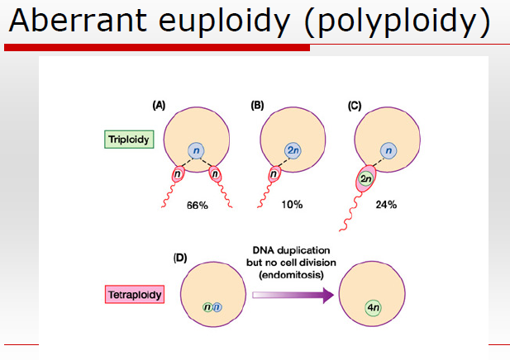

Slide 7
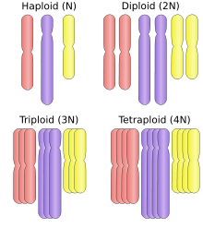
Haploid = n (in normal gametes)
Diploid=2n (in Normal somatic cell)
Euploid = An exact or multiple of n or of the monoploid number.
A human with abnormal, but integral multiple of the monoploid number, (69 chromosomes) would also be considered as euploid
e.g. ( 2n, 3n,4n etc)

Slide 8
POLYPLOID
Many organisms have more than two sets of homologous chromosomes and are called polyploid
A chromosome number that is a multiple of haploid number of 23 other than the diploid number eg. 69
True polyploidy rarely occurs in humans, although it occurs in some tissues (especially in the liver).

Slide 9
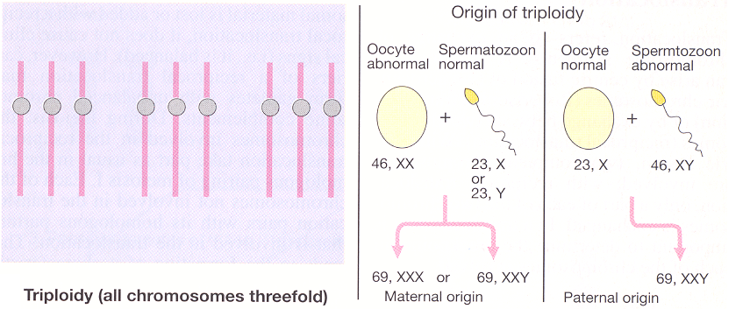
TRIPLOIDY
(all chromosomes threefold)

Slide 10
MEIOTIC NON DISJUNCTION
May involve autosomes or sex chromosomes
In females incidence increases with age 35yrs or more.
Meiosis I: Two members of homologous chromosomes fails to separate and both members of a pair move into one cell.
Meiosis II: When sister chromatids fail to separate.

Slide 11
MITOTIC NONDISJUNCTION
Mosaicism:
Some cells have abnormal chromosomal number and others have normal
Occurs in the earliest cell divisions
Affected individuals exhibit characteristics of a particular syndrome for e.g. down syndrome in1% cases

Slide 12
Aneuploidy Caused by
Non-disjunction
  Failure of homologous chromosomes to separate in anaphase I
  Failure of sister chromatids to separate at meiosis II
Anaphase lag
  Chromosomal loss via micronucleus formation caused by delayed movement of chromosome /chromatid during anaphase
    results in daughter cell deficient of that chromosome or chromatid

Slide 13
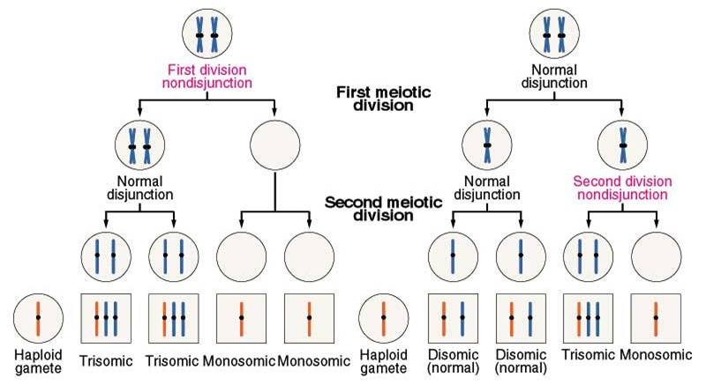
Meiotic Nondisjunction Generates Aneuploidies
abnormal gametes
Zygotic Ploidy
Zygotic Ploidy
Notes:
Figure: 07-01
Caption:
Nondisjunction during the first and second meiotic divisions. In both cases, some of the gametes formed either contain two members of a specific chromosome or lack that chromosome. Following fertilization by a gamete with a normal haploid content, monosomic, disomic (normal), or trisomic zygotes are produced.

Slide 14
Distribution of non-disjunction
Meiosis I
Meiosis II
Mitosis
Maternal
21, 15, 16
18
15, 18, 21, 8
Paternal
-
18, 21
18, 21

Slide 15
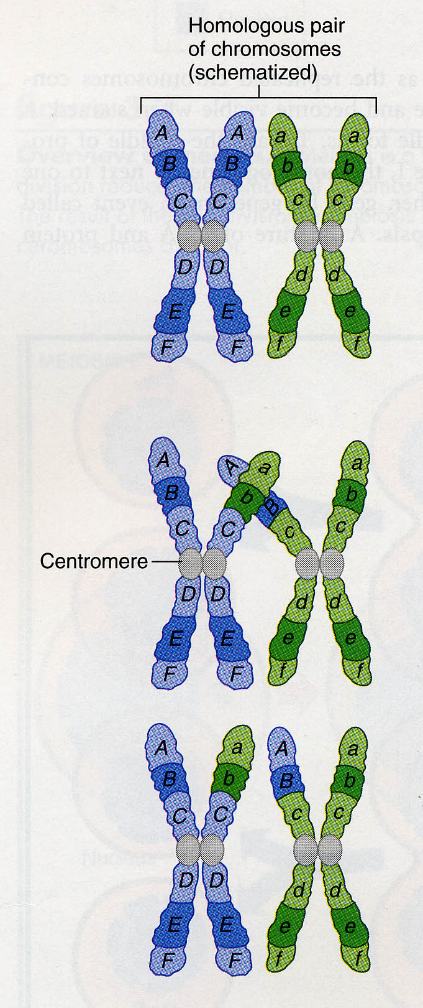
Genetic diversity
Crossing over in MI
  swap pieces of DNA between maternal and paternal homologous chromosomes
Independent assortment at end of MI
  paternally and maternally derived homologues assort randomly

Slide 16
Aneuploidy
Autosomal monosomy is rarely observed in spontaneously aborted fetuses or in live births.
Most autosomal trisomies are also lethal with one notable exception.
Trisomy 13 Patau syndrome
Trisomy 18 Edward syndrome
Trisomy 21 Down’s syndrome

Slide 17
Trisomy 21 (1 in 800 live births; incidence greater if mat. age >35)
Hypotonia
Short neck with loose skin at nape
Flat nasal bridge
Brushfield spots around edge of iris
Epicanthal folds
Short, broad hands with single transverse palmar crease
Congenital heart disease
Mental retardation
Increased risk for leukemia
Alzheimer-like dementia
Signs of hypothyroidism

Slide 18
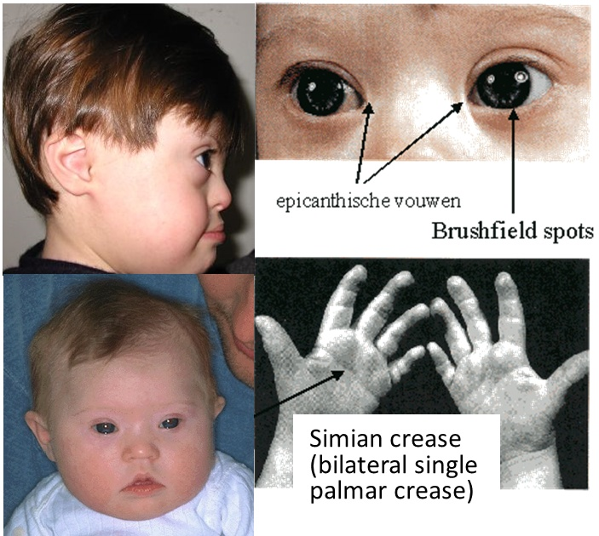
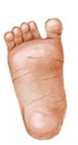
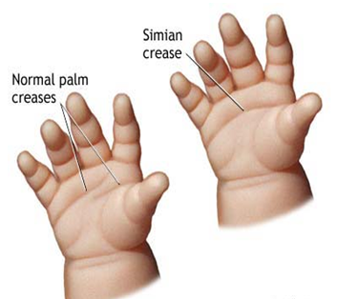
Down Syndrome
Wide “sandal”
gap
Simi

Slide 19
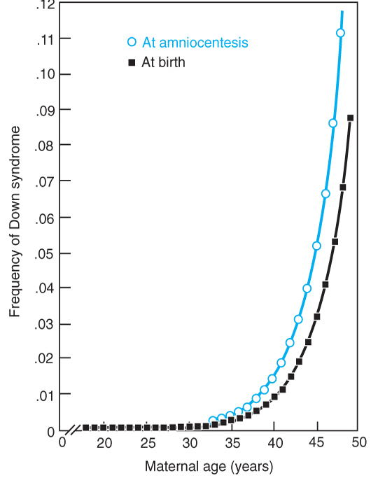
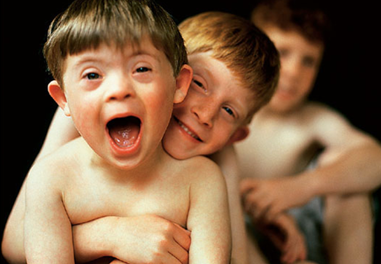
NON-DISJUNCTION FEATURES OF CHROMOSOME 21
Occurs in all populations approximately at the same rate
There is a significant loss of trisomy 21 pregnancy 1/150
The risk of having pregnancy affected with DS is increased with maternal age
  <25 y/o 1/1600
  30 to 34 y/o 1/800
  > 40 y/o 1/80

Slide 20
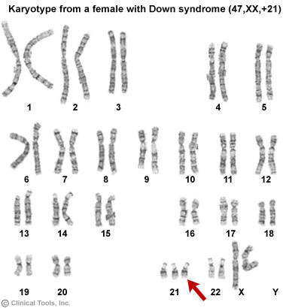
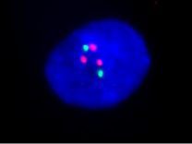
Changes in the Genome…
Trisomy:The zygote has three copies of a chromosome.

Slide 21
Recurrence Risks: Trisomy 21
Causes:
  Meiotic nondisjunction -95% (trisomy 21)
  Unbalanced translocation-4% b/w 21 and 13,14,15
  Mosaicism due to mitotic non dysjunction-1%
  46,i(21q) recurrence risk is low (if not a carrier)
  t(14;21)
    15% if female carrier
    <1% if male carrier

Slide 22
MITOTIC NONDISJUNCTION
Mosaicism:
Some cells have abnormal chromosomal number and others have normal
Occurs in the earliest cell divisions
Affected individuals exhibit characteristics of a particular syndrome for e.g. down syndrome in1% cases

Slide 23
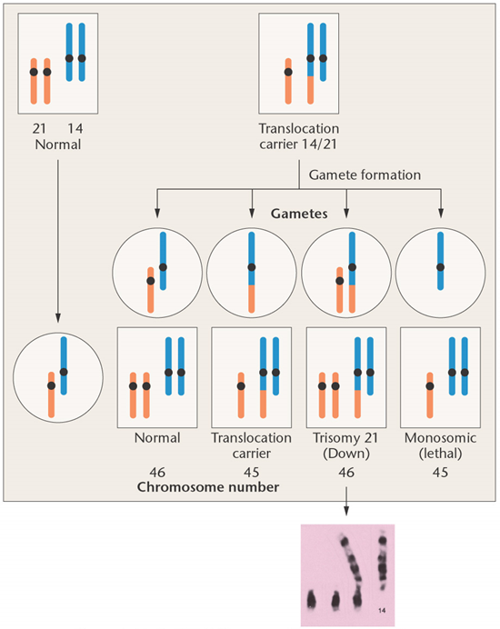
Chromosomal involvement and translocation in familial Down syndrome. The photograph shows the relevant chromosomes from a trisomy 21 offspring produced by a translocation carrier parent.
Notes:
Figure: 7.17
Title:
Translocation in Familial Down Syndrome
Caption:
Chromosomal involvement and translocation in familial Down syndrome. The photograph shows the relevant chromosomes from a trisomy 21 offspring produced by a translocation carrier parent. (Photo: Dr. Jorge Yunis)

Slide 24
Trisomy 13, Patau syndrome
Clinical Features (1 in 15 - 25,000 births)
Microcephaly and mental retardation,
scalp defect,
microphthalmia, often blind
Cleft lip/palate,
polydactyly,
rocker-botton feet,
abnormal ears,
apneic spells and myotonic seizures,
cardiac dextroposition and VSD,
extensive visceral defects
CNS malformations presence of a single forebrain hemisphere or lobe
Half of such individuals die within the first month-- the remainder by 1 year

Slide 25
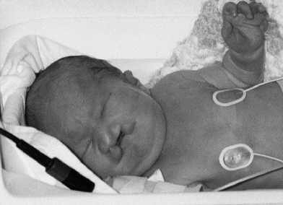
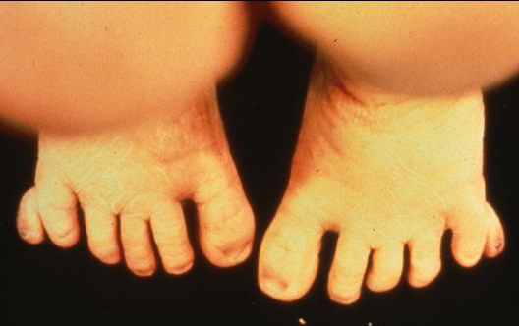
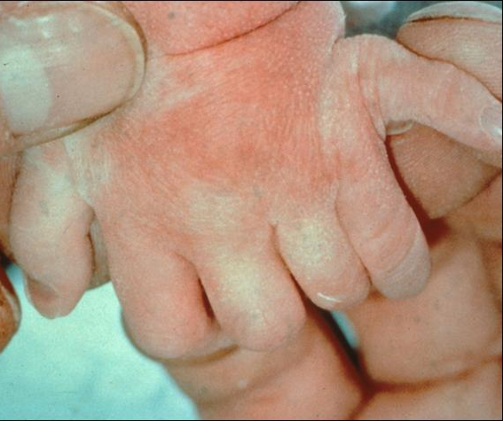
Cleft palate,
Aseptal defect, inguinal hernia
Postaxial polydactyly of the left hand.
Polydactyly, particularly of all extremities, strongly suggests trisomy 13.

Slide 26
Trisomy 13, Patau syndrome
Karyotype Incidence
Trisomy 13 47,XX,+13 >75%
R. Translocation 46,XX,der(13;14)+13) 20%
Mosaicism 47,XX,+13/46,XX 5%

Slide 27
Clinical Features: Trisomy 18
Clinical feature (1 in 7,500 births)
Clenched Hands
Renal anomalies
Cleft Lip/Palate
Hypoplastic thumbs
Dorsiflexed halus (hammer toe)
Renal Anomalies
Prominent occiput
Short palpebral fissures
Micrognathia
Low-set, malformed ears
Profound Mental Retardation
Rocker-Bottom Feet
Short Sternum
Small Pelvis

Slide 28
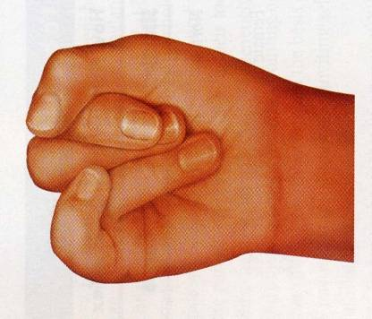
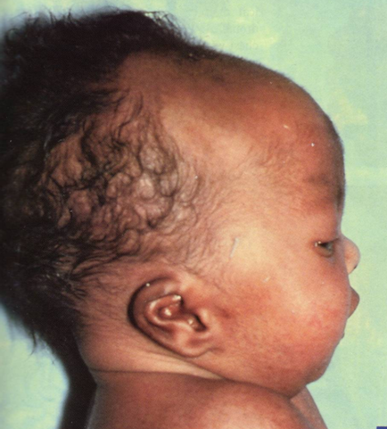
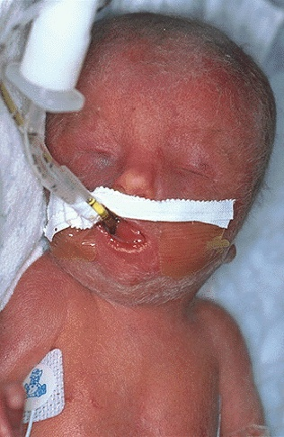
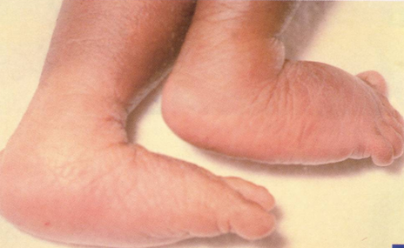
Trisomy 18 – Edwards syndrome
Karyotype: 47, XX (or XY), +18
Survival – 50% within 1 month, 50% within less than 1 year

Slide 29
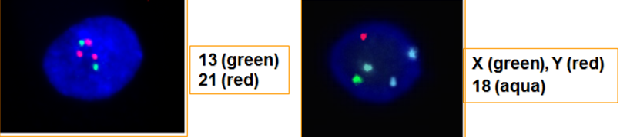
Edwards Syndrome (Trisomy 18)
        Karyotype Incidence
Trisomy 18 47,XX,+18 90%
Translocation 46,XX,+18,t(?;18q) rare
Mosaicism 47,XX,+18/46,XX 10%

Slide 30
Trisomy 8, Mosaicism
1/20,000 births
Long face, high prominent forehead, wide upturned nose, thick everted lower lip, microretrognathia, low-set ears, cleft palate
Osteoarticular anomalies common
Moderate MR

Slide 31
MONOSOMIES
One representative of a chromosome is present
Nondisjunction:
  One cell ends up with one copy (monosomic) and the other has 3 (trisomic)
Anaphase lag:
  chromosome fails to move into the new daughter cell
All complete autosomal monosomies- lethal
  Can survive in mosaic forms

Slide 32
Sex Chromosomes Abnormalities

Slide 33
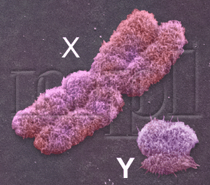
Sex Chromosome Aneuploidy
Sex Chromosome Aneuploidy is more common than Autosome Aneuploidy!
In order to survive and develop embryo needs at least one X chromosome.
In healthy females, one X chromosome will be inactivated in each somatic cell. The inactivated X chromosome is referred to as a “Barr body”.
An individual who has an intact Y-chromosome will be male, regardless of the number of X chromosomes he possesses.
In the absence of an intact Y chromosome an individual will be female.

Slide 34
X-Chromosomal Disorders
Imbalances of X-chromosomes are better tolerated than those of autosomes
Increased number of X-chromosomes in either males or females lead to mental retardation
Lyonization – Mary Lyon
  during 16th day of embryonic life one X-chromosome in females is randomly inactivated
  inactivation persists in all subsequent cells

Slide 35
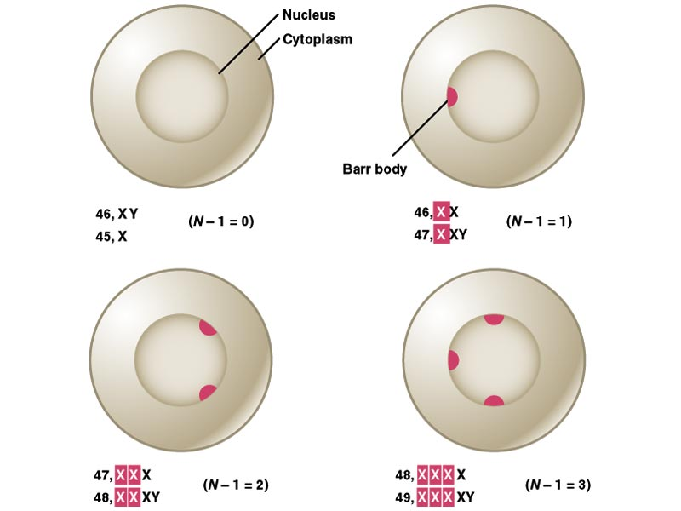
A woman with the chromosome constitution 47, XXX should have 2 Barr bodies in each cell.
XXY individuals are male, but have a Barr body.
XO individuals are female but have no Barr bodies.

Slide 36
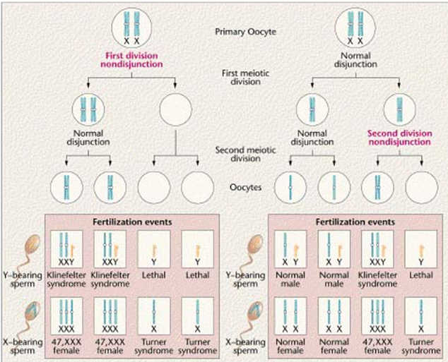
Nondisjunction of X chromosome

Slide 37
Sex Chromosome Aneuploidy
Situation | Oocyte | Sperm | Consequence
Normal | X | Y | 46, XY normal male
 | X | X | 46, XX normal female
Female Nondisjunction | XX | Y | 47, XXY Klinefelter syndrome
 | XX | X | 47, XXX triplo-X
 |  | Y | 45, Y nonviable
 |  | X | 45, X Turner syndrome
Male Nondisjunction (meiosis I) | X |  | 45, X Turner syndrome
 | X | XX | 47, XXX triplo-X
Male nondisjunction (meiosis II) | X | YY | 47, XYY Jacobs syndrome
 | X |  | 45, X Turner syndrome

Slide 38
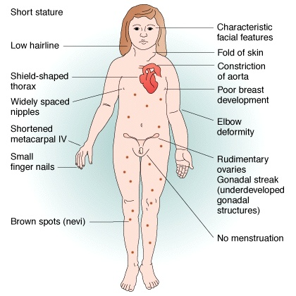
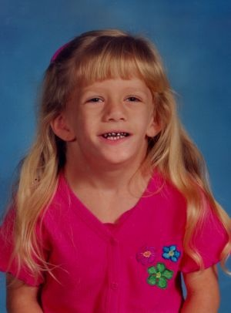
Turner syndrome
Monosomy X or X0
  1 in every 5000 births
  varied degree of effects
  webbed neck
  short stature
  sterile
KARYOTYPING:
  Classical 45X
  46,X,i(Xq)
  46XXq-
  46XXp-
  46,X r(X)
  45,X/46,XX
Notes:
How many Barr bodies would you expect?

Slide 39
Turner Syndrome
Results from complete or partial monosomy of the X-chromosome in females
Most common sex chromosome abnormality in females, incidence 1 in 1000 live births
Classical cytogenetics
  45,X (57%)
  Structural abnormalities of X-chromosomes (14%)
  Mosaics (29%)

Slide 40
Mosaicism in Turner Syndrome
99% of conceptuses with 45,X are nonviable
FISH and PCR studies show much higher incidence of mosaics than conventional studies
Some authorities believe that there are no truly nonmosiac Turner syndrome patients
Patients with a high proportion of 45,X cells are more severely affected

Slide 41
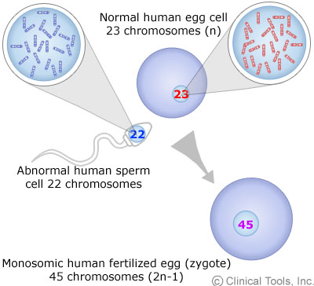
TURNER SYNDROME
KARYOTYPING:
Classical 45X
Isochromosome 46,X,i(Xq)
Deletion 46XXq-
Deletion 46XXp-
Ring 46,X r(X)
Mosaic e.g. 45,X/46,XX

Slide 42
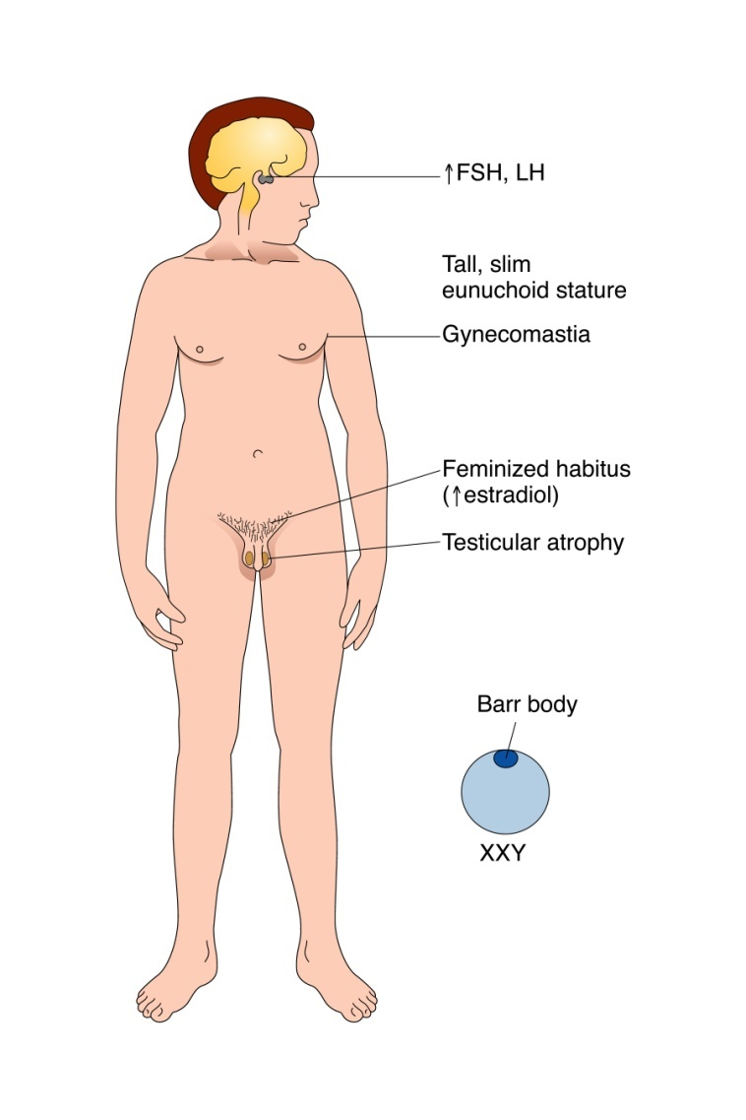
47,XXY - Klinefelter syndrome
Clinical Features
Tall, thin, long legs, hypogonadism, underdeveloped secondary sex characteristics, gynecomastia- excessive development of the male mammary glands. usually infertile
Verbal comprehension and ability slightly lower than average
Increased risk of learning difficulties, esp. in reading
KARYTYPING:
60% are of maternal nondisjunction and maternal age increases the possibilities
47 XXY
Mosaics XY / XXY
XXXY, XXYY, XXXXY. Severely mental
retarded
1/1000 male births

Slide 43
Klinefelter Syndrome
A male hypogonadism that occurs when there are two or more X-chromosomes and one or more Y-chromosomes
Incidence is 1 in 500 male births
Usually (82% of cases) 47,XXY
  maternal (60%) or paternal (40%) nondisjunction during meiotic divisions
15% are mosaics, usually 46,XY/47,XXY

Slide 44
Clinical Features
Testicular abnormality does not develop before puberty
  seminiferous tubules are atrophic resulting in reduced spermatogenesis, infertility, small firm testes, and increased FSH
  testosterone levels are reduced
    impotence and increased LH
    lack of secondary male sexual characteristics
Mental retardation is unusual but IQ may be below normal
Mosaics are less severely affected

Slide 45
47,XYY
Clinical Features
  Not obviously abnormal
  No marked physical or behavioral phenotype
  Tall, fertile, may have severe acne during adolescence
  Incidence 1/1000
  Increased risk of educational or behavioral problems
  IQ scores about 10 pts below average
    Attention deficits
    Hyperactivity
    Impulsiveness

Slide 46
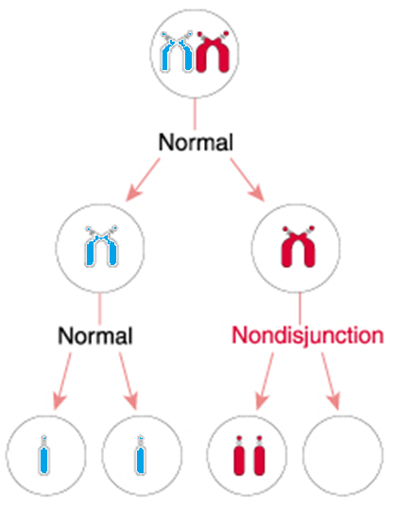
47,XYY
Origin of the error that leads to XYY karyotype must be paternal nondisjunction
at meiosis II producing YY sperm.
X
Y
Fertilization of this sperm by an egg will lead to Turner
syndrome
YY

Slide 47
Sex Chromosome Tetrasomy
Males: 48,XXXY
Clinical Features
Reduction in intellectual functioning – IQ between 20-80
Coarse facial appearance, gonadal hypoplasia common
As a rule: additional X chromosomes cause a more abnormal phenotype-more defective sexual development and mental impairment.

Slide 48
Sex Chromosome Tetrasomy
Males: 48,XXXY
Clinical Features
Reduction in intellectual functioning – IQ between 20-80
Coarse facial appearance, gonadal hypoplasia common
As a rule: additional X chromosomes cause a more abnormal phenotype-more defective sexual development and mental impairment

Slide 49
Sex Chromosome Pentasomy
49,XYYYY
Clinical Features
Tall stature
Aberrant behavior (impulsivity, low frustration tolerance)
Low-normal or subnormal intelligence
Developmental delay
Testicular abnormalities
Some craniofacial dysmorphisms (more common for 49,XYYYY)

Slide 50
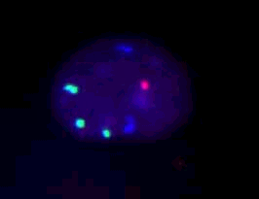
48,XXXY: X (green), Y (red), 18 (blue),

Slide 51
INSTABILITY
OF
CHROMOSOMES

Slide 52
Chromosome breaks
Once chromosome broken by some means
Unstable situation as telomeres not at end
Usually join up to other piece

Slide 53
Defects in DNA Repair or Replication
All are associated with a high frequency of chromosome and gene (base pair) mutations; most are also associated with a predisposition to cancer, particularly leukemias
Xeroderma pigmentosum
  caused by mutations in genes involved in nucleotide excision repair
  associated with a >1000-fold increase of sunlight-induced
  skin cancer and with other types of cancer such as melanoma

Slide 54
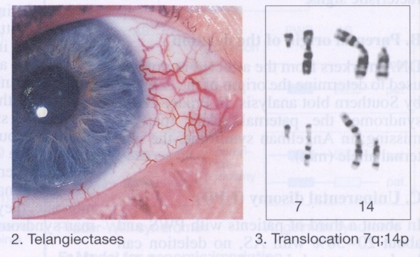
Main Features Ataxia Telangiectasia
Cerebellar ataxia
Immune defects
Telangiectases of the conjunctivae
Predisposition to tumors (lymphoma, leukemia)
Extreme radiation sensitivity
Autosomal recessive
Several gene loci
Ataxia telangiectasia
  caused by gene that detects DNA damage
  increased risk of X-ray
  associated with increased breast cancer in carriers

Slide 55
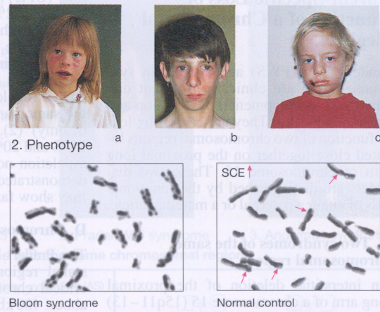
Main features of Bloom syndrome (BS)
Extreme intrauterine and postnatal growth retardation
Chromosomal instability
Predisposition to leukemias, lymphomas,and other tumors
Immune defects
Sunlight-induced erythema of the face
Hypo- and hyper-pigmented skin areas
Autosomal recessive
Gene locus on chromosome 15

Slide 56
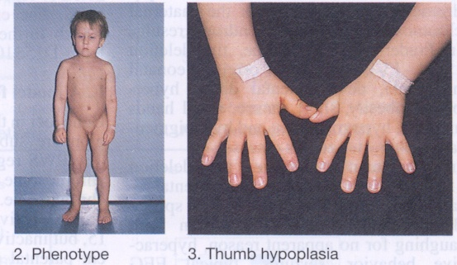
Main features of Fanconi Anemia (FA)
Growth retardation Skeletal defects
(e.g., radius and thumb)
Bone marrow failure
Skeletal and kidney malformation
Localized pigment changes
Autosomal recessive
Several gene loci.
  caused by a gene involved in DNA repair
  increased risk of X-ray and sensitivity to sunlight

Slide 57
Defects in DNA Repair or Replication
Cockayne syndrome
  caused by a defect in transcription-linked DNA repair
  sensitivity to sunlight
Werner’s syndrome
  caused by mutations in a DNA helicase gene
  premature aging
Notes:
.

Slide 58
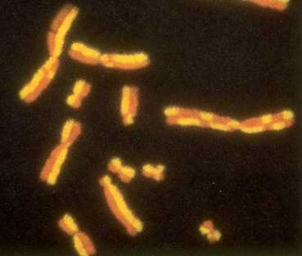

Slide 59
Structural Chromosomal Abnormalities

Slide 60
Types of chromosome abnormalities
Numerical
  Aneuploidy (monosomy, trisomy, tetrasomy)
  Polyploidy (triploidy, tetraploidy)
Structural
  Translocations
  Inversions
  Insertions
  Deletions
  Rings
  Duplication
  Isochromosomes

Slide 61
Chromosome Abnormalities
Numerical Autosomal Disorders
AGE OF ONSET OF GENETIC DISORDERS
chromosomal
multifactorial
number of affected individuals
single-gene
(Mendelian)
birth puberty adult

Slide 62
The Karyotype: an international description
Total number of chromosomes,
Sex chromosome constitution,
Anomalies/variants.
46,XY
47,XX,+21 Trisomy 21 (Down syndrome)
47,XXX Triple X syndrome
69,XXY Triploidy
45,XX,der(13;14)(p11;q11) Robertsonian translocation
46,XY,t(2;4)(p12;q12) Reciprocal translocation
46,XX,del(5)(p25) Deletion tip of chromosome 5
46,XX,dup(2)(p13p22) Duplication of part of short arm Chr 2
46,XY,inv(11)(p15q14) Pericentric inversion chromosome 11
46,XY,fra(X)(q27.3) Fragile X syndrome
46,XY/47,XXY Mosaicism normal/Klinefelter syndrome

Slide 63
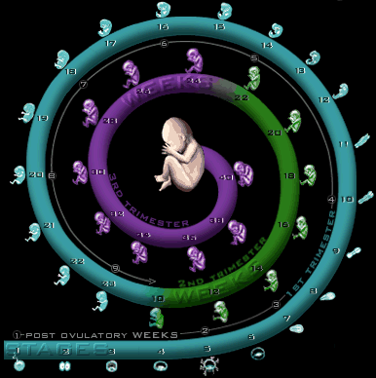
Prenatal diagnosis
cordocentesis
amniocentesis
Chorion villi
sampling
Preimplantation
genetic diagnosis

Slide 64
Spontaneous Abortion Products
15% of first trimester pregnancies are lost
+16
50% abnormal
50% normal
Other
autosomal
trisomy
45,X
Triploidy
Other
46,N

Slide 65
Chromosomal Findings in Early Miscarriages
40% apparently normal
60% abnormal:
Trisomy (47 chromosomes – one extra) 30%
45,X (45 chromosomes – one missing) 10%
Triploidy (69 chromosomes – three sets) 10%
Tetraploidy (92 chromosomes – four sets) 5%
Other chromosome anomalies 5%
(e.g. structural anomalies)

Slide 66
Most frequent numerical anomalies in liveborn
Autosomes
Down syndrome (trisomy 21: 47,XX,+21)
Edwards syndrome (trisomy 18: 47,XX,+18)
Patau syndrome (trisomy 13: 47,XX+13)
Sex chromosomes
Turner syndrome 45,X
Klinefelter syndrome 47,XXY
All chromosomes
Triploidy (69 chromosomes)

Slide 67
Chromosome abnormalities and maternal age
Notes:
This is backed up by all major studies. This is a typical one showing a massive increase in the proportion of trisomic pregnancies among older women.

Slide 68
Chromosome abnormalities
Chromosome abnormalities seen in adults referred for:
Infertility
mostly sex chromosome aneuploidy rearrangements involving sex chromosomes
Recurrent miscarriage
balanced chromosome rearrangements
e.g. translocations and inversions
2.5%
6%
However, up to 50% of first trimester loss is due to foetal chromosome abnormality – mostly de novo

