Slide 1
Mouth Preparation for removable partial dentures
Dr. Nadia Ereifej

Slide 2
Indications for RPD therapy Vs Fixed prosthodontics
- Replacement of teeth and tissue (aesthetics are of prime concern
- Long span edentulous space not suitable for fixed Prosthodontics (Ante’s law)
- Absence of distal abutments
- Abutments with poor periodontal support
- The need for cross-arch stabilisation

Slide 3
- Patients who can not tolerate long dental procedures
- Financial constraints and patients’ desires
- Age of the patients: Risk of pulp exposure in patients <18 Y
Immediate need to replace missing teeth

Slide 4
Conditions favoring RPD than implants
- Unfavorable regional anatomy
- Uncontrolled systemic disease or high-dose head and neck radiation
- Extreme surgical risk
- Financial incapability

Slide 5
Conditions favouring complete dentures over RPD
- Poor abutments
- Rampant caries
- Periodontal disease
- Poor alignment of abutments
- Individuals who will not allow you to prepare their teeth for RPD clasp assemblies

Slide 6
Stages of Co/Cr RPD construction
Success of any prosthodontic treatment is dependant on good collaboration between the clinician and the laboratory. The prescription on the laboratory card must be clear and comprehensive.

Slide 7
The first diagnostic appointment
1- A thorough general examination and medical history.
2- Dental history, evaluation of oral hygiene and caries susceptibility.
3- Taking radiographs.
4- Primary Impressions
· Selection of stock tray.
· Modification of the tray with impression compound or autopolymerising acrylic as appropriate.
· Normally a high viscosity alginate should be used as this will compensate for the lack of fit of the stock tray. A thin layer of adhesive should be applied to the tray before starting to mix the alginate.
- All casts at this stage should be poured in dental stone.

Slide 8
The second diagnostic appointment
- Occasionally, the second visit will be for tooth preparation and master impressions if the preliminary casts were mounted and a design determined. If preliminary casts could not be mounted, the second visit will be devoted to recording the jaw relationship prior to mounting casts on the articulator and developing a design.
- For the purpose of jaw relationships, partially dentate patients can be divided into two categories:-
· Patients without an occlusal stop to indicate the correct intercuspal position or vertical dimension of occlusion. For those steps of jaw relation records follow those preformed for complete denture construction taking into consideration any tooth interference.

Slide 9
. Patients with occlusal contact in the intercuspal position. For those patients, upper and lower occlusal rims are adjusted to maintain natural tooth contacts and records are taken using any bite registration material.
- If an occlusal stop is present, you must determine whether the associated intercuspal position is acceptable. If there is horizontal (antero-posterior or lateral) deviation of the mandible after the initial occlusal contact, it may be necessary to correct the deflective occlusal contact by tooth modification, extraction or (rarely) orthodontic treatment. If there is loss of vertical dimension of occlusion (OVD), the appropriate increase will have to be determined by adjusting occlusal rims in relation to the rest vertical dimension (RVD).

Slide 10
- Facebow transfer is recommended, followed by mounting the casts on the articulator.
- A definitive oral examination is then performed including:
. Evaluation of carious lesions and existing restorations.
. Evaluation of pulpal tissues.
. Evaluation of sensitivity to percussion.
. Evaluation of tooth mobility.
. Evaluation of periodontium.
. Evaluation of oral mucosa (pathologic changes..)
. Evaluation of hard tissues abnormalities (Tori, exostoses, undercuts).
. Evaluation of soft tissue abnormalities (freni, gingivae)
. Evaluation of quantity and quality of saliva
. Evaluation of space for mandibular major connector.
. Evaluation of radiographic survey.

Slide 11
When the second appointment is ended, the following are usually performed:
- Radiographic assessment of potential abutment teeth.
. Root length, size and form
. Crown/root ratio
. Lamina dura
. Periodontal ligament space
- Evaluation of mounted diagnostic casts:
. Interarch distance
. Occlusal planes
. Jaw relationship
- Diagnostic wax up (Especially if multiple crowns and bridges are planned).
- Medical or dental consultation is obtained.
- Development of treatment plan.

Slide 12
Mouth preparation must be accomplished before the impression procedures that will produce the master cast on which the denture will be constructed

Slide 13
Tooth preparation and master impression
- Tooth preparation is undertaken to obtain:
1- Guiding planes.
2- Rest seats
3- Changing unfavourable survey lines
4- Enhance retentive undercuts

Slide 14
- Wax stops should be placed on the fitting surface of the individual trays before modifying the peripheral extension if necessary. Any over-extension of the tray should be corrected and any under-extension should be corrected with the addition of self curing acrylic resin. When mandibular free-end saddle areas are present, border moulding of the tray in the retro-mylohyoid areas should be undertaken routinely. A thin layer of adhesive is applied to the whole of the inner surfaces of the tray. A low viscosity alginate is used to record the impression. In some cases silicone based or rubber based materials may be used.
- If the impression is satisfactory a cast should be poured in either dental stone (for acrylic dentures) or improved dental stone (for cobalt chromium dentures) as soon as possible. All individual trays must be retained until treatment is completed.

Slide 15
Framework construction
- The cast is retripodised to maintain the zero tilt, and the alternative chosen tilt and the design is drawn on the cast as received from the dentist.
- Undercut are blocked out.
- Cast is duplicated to produce the refractory cast.
- Framework is waxed up.
- Framework is sprued.
- Refractory cast is invested.
- Wax is burnout or eliminated
- Framework is cast
- Cast framework is recovered
- Framework is finished and polished and occlusion is adjusted

Slide 16
Metal framework try in
- Metal framework is tried in
- Altered cast impression technique is undertaken (Class I, II).
- Bite registration is performed.
- Determination of shade and form of artificial teeth.
- Upper and lower casts are mounted on the articulator.
- Artificial teeth are set.

Slide 17
Wax try in and fitting of the dentures
- Wax try in of the dentures is performed.
If satisfactory, dentures are waxed up, invested, wax is eliminated, acrylic resin is packed and cured, deflasking, finishing and polishing of the dentures are performed.
- Processed dentures are fitted.
- Review.

Slide 18
Mouth Preparation
for
RPD Treatment

Slide 19
Removable partial dentures should evolve out of a thorough and systematic diagnosis, planning and careful preparation of the hard and soft structures of the mouth.

Slide 20
Carefully planned and executed mouth preparation contributes to the objectives of:
1- Preservation of the remaining structures.
2- Replacement of the missing tissues.

Slide 21
Mouth preparation procedures may include:
1- Relief of pain and infection
2- Oral surgical preparation
3- Conditioning of abused and irritated tissues
4- Periodontal preparation
5- Orthodontic preparation
6- Conservative preparation
7- Correction of occlusal plane discrepancies and correction of malalignment
8- Provision of interim prostheses and repair of existing prostheses

Slide 23
Relief of pain and infection
This involves all procedures undertaken to eliminate discomfort as soon as possible.
- Endodontic treatment.
- Surgical treatment.
- Treatment of carious lesions that might cause pain.
- Gingival treatment to decrease the chances for periodontal abscesses.
- Prophylactic antibionics and oral hygiene instructions.

Slide 24
Oral surgical preparation

Slide 25
Surgical removal of impacted teeth

Slide 27
Removal of cysts by apicoectomy

Slide 30
Removal of interfering tori

Slide 31
Hemisection for removal of hopeless roots

Slide 33
Extraction of hopeless teeth

Slide 35
Surgical preparation might also involve:
- Elimination of bony exostoses that might complicate treatment.
- Implant placement
- Ridge augmentation
- Vestibular extension.
All surgical treatment should be performed early during the treatment to allow time for healing.

Slide 36
CONDITIONING OF ABUSED AND IRRITATED TISSUES

Slide 38
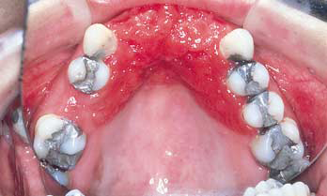

Slide 40
PREPARATION
PERIODONTAL

Slide 41
This may include procedures such as:
1- Removal of plaque and calculus
2- Elimination of plaque retentive areas (poor margins of crowns and overhanging fillings)
3- Root planing
4- Periodontal surgery
5- Splinting of mobile teeth

Slide 44
Periodontal surgical intervention for elimination of pockets and granulation tissues together with root planning

Slide 47
Treatment of periodontal damage caused by poorly designed RPD causing stripping of gingival tissues away from abutment teeth

Slide 48
Orthodontic treatment of mal-aligned teeth

Slide 50
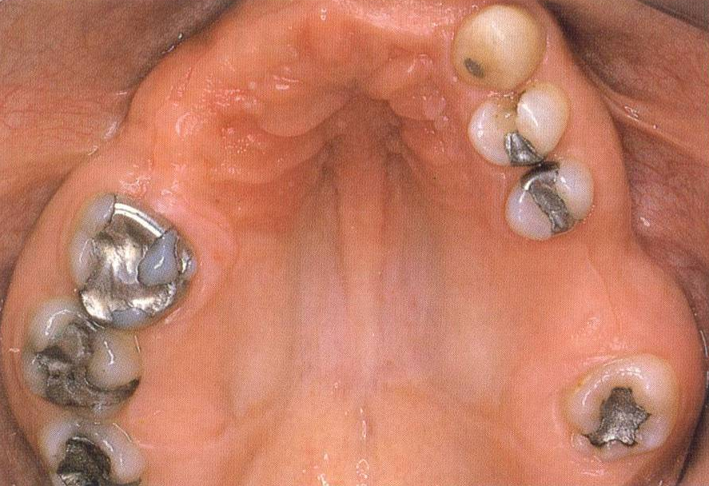

Slide 51
TREATMENT
CONSERVATIVE

Slide 52
It is important that teeth which serve as abutments for a partial denture should be carefully evaluated.

Slide 53
Root canal treatment and crowning of heavily restored teeth

Slide 56
The buccal cusp of the right mandibular second premolar has recently fractured and been restored with a large pin-amalgam restoration. As an abutment there is a risk of fracture from the load by the denture components.
A full veneer crown is necessary. The completed crown incorporates a seat for an occlusal rest that will provide support for the partial denture.

Slide 57
Full veneer crowns may be used to reduce the degree of undercut on the buccal aspect of upper molars and to provide a better contour for clasping.

Slide 58
Crowns are required for correction of lingually tilted molars that may prevent the insertion of a rigid lingual connector.

Slide 59
Correction of occlusal discrepancies and mal-alignments

Slide 60
. Minor supereruption of unopposed teeth can be corrected by recontouring, moderate cases with cast restorations and severe cases by extraction. Surgical reduction of maxillary tuberosities might be needed.
. Tipped teeth can be re-aligned orthodontically.
If this is not possible, enameloplasty, crowns, or extraction according to severity.
. Severe discrepancies might need invasive maxillo-mandibular surgeries.

Slide 61
Temporary adjustment of current prostheses

Slide 62
- Temporary relining of existing prostheses might be carried out to relieve mucosal trauma caused by ill-fitting prostheses
- Occlusal adjustments can be made on present dentures (e.g to raise the OVD) as an adaptive measure before construction of new RPD

Slide 63
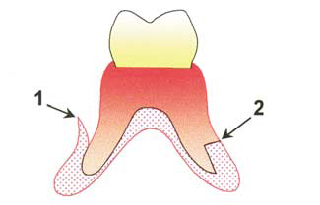
Denture Relining
A diagnostic alginate impression taken in the old denture to assess the fit of the denture and identify pressure points that require adjustment before adding the reline material.
If the denture is to be relined at the chairside any areas of underextension should first be corrected by border moulding with a direct application of a chairside cold-curing resin. This resin may not have a very strong bond to the acrylic denture base and should form a butt joint (2) to prevent pealing of the new resin.

Slide 64
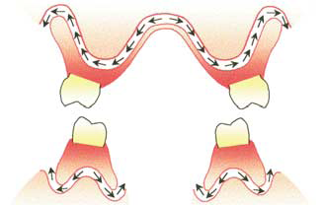
During direct relining with a temporary material it is easy to fail to seat the denture correctly, especially with maxillary dentures altering both vertical and horizontal occlusal relationships. It will also result in thickening of the connector leading to problems of patient tolerance . These changes are likely to make the denture unwearable.
In a maxillary denture, the escape channel for any excess reline material is long and tortuous and therefore the choice of a low-viscosity material is important. In the mandible, and in individual saddles, the escape channel is much shorter and so a higher viscosity material may be used.

Slide 65
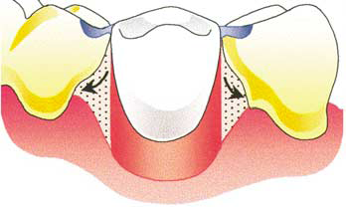
Alternatively, escape of the excess lining material from a maxillary denture can be helped by drilling holes into the palatal connector and sometimes the flanges.
If a hard reline material is used it is important to appreciate that it may flow into undercut areas around the teeth and that consequently the timing of removal of the denture from the mouth is critical. Failure to remove the denture before curing is complete will result in the denture being locked into place.

Slide 66
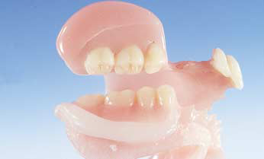
Any excess material must be removed from the polished surfaces and teeth and the borders are trimmed and polished.
The patient should be given specific instructions on how to clean the lining.

Slide 67
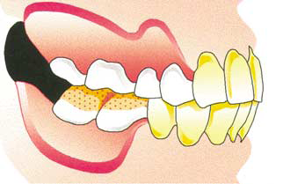
Loss of occlusal contact results from a
combination of occlusal wear and sinking of the denture following alveolar resorption. Correction of the occlusion is desirable before constructing replacement dentures to correct mandibular posture and avoid mucosal inflammation resulting from this deterioration.
Contact can be reestablished by the addition of acrylic resin to the posterior teeth. The fluid resin is allowed to reach the dough stage before the denture is inserted into the mouth. Petroleum jelly is applied to any opposing denture teeth and the mandible is gently guided along the retruded arc of closure until even occlusal contact is made at the appropriate vertical dimension. The denture is then removed from the mouth and the resin allowed to cure before refining the occlusion by selective grinding.

Slide 68
Provision of interim prostheses
An interim prosthesis may be constructed before the definitive denture for the following reasons.
• Space maintenance and aesthetics.
• Improving patient tolerance.
• Preparation for advanced restorative treatment.
• Modifying jaw relationships.

Slide 71
The missing teeth may be replaced by an immediate appliance made of acrylic as a temporary measure

Slide 73
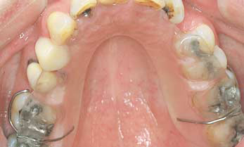
The loss of an anterior tooth may require rapid replacement with an interim denture, both for social reasons and to prevent reduction of the space by drifting and tilting of the adjacent teeth.
The provision of a thin acrylic training base, which in the maxilla may be of horseshoe design, is useful in overcoming pronounced retching reflex. The patient wears the base for increasing periods each day until tolerance is good enough to indicate that conventional treatment can proceed. The palatal extension can be increased in stages to allow progressive adaptation to palatal coverage which is as close as possible to the optimum.

Slide 74
Preparation for advanced prostehses
Modifying jaw relationships
Planning of restorations for severely worn teeth is complicated by the uncertainty as to whether or not the increase in occlusal vertical dimension will be tolerated. An interim prosthesis is constructed to an occlusal height that appears appropriate. It may then be progressively adjusted over several appointments. This allows a period in which the patient can gradually adapt to progressive, modest increases in occlusal height and finally confirms a height on which future treatment planning can be based.

Slide 75
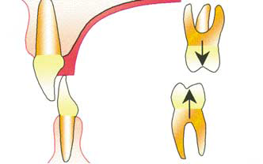
An interim denture can be helpful in patients exhibiting gingival trauma as a result of a deep incisal overbite. A simple appliance with a palatal table can provide instant relief while a decision is being taken on the definitive solution whether it be orthodontic, restorative, periodontal or surgical. In the young patient the palatal table may also improve the situation by allowing further eruption of the posterior teeth and causing some intrusion of the mandibular anterior teeth.

