Slide 1
ARTHRITIS

Slide 2
Osteoarthritis
is a degenerative joint disease
is the most common joint disorder.
It is a frequent part of aging and is an important cause of physical disability in persons older than 65 years of age.
The fundamental feature of osteoarthritis is degeneration of the articular cartilage
structural changes in the underlying bone are secondary.
It is not an inflammatory disease
the chondrocytes respond to biomechanical and biologic stresses that results in breakdown of the matrix.

Slide 3
Types of osteoarthritis
Primary osteoarthritis (95% of cases):
Old age
Usu. is oligoarticular (affecting only a few joints)
joints of hands, knees, hips, and spine are most common
Secondary osteoarthritis (less than 5% of cases):
young people
There is a predisposing condition➔ previous trauma; congenital deformity; systemic disease ,or marked obesity.
It often involves one or several joints.

Slide 4
Clinical Course
predominantly affects pts in their 50s and 60s.
Characteristic symptoms and signs:
deep, aching pain exacerbated by joint use
morning stiffness
crepitus (grating or popping sensation in the joint)
limitation in range of movement.
nerve root compression with radicular pain
muscle spasms and atrophy.
Commonly involved joints: Hips, knees, lower lumbar and cervical vertebrae, proximal and distal interphalangeal joints of the fingers, first carpometacarpal joints, and first tarsometatarsal joints of feet
Heberden nodes in the fingers, represent prominent osteophytes at the distal interphalangeal joints, are characteristic in women.

Slide 5
Osteoarthritis-induced changes

Slide 6
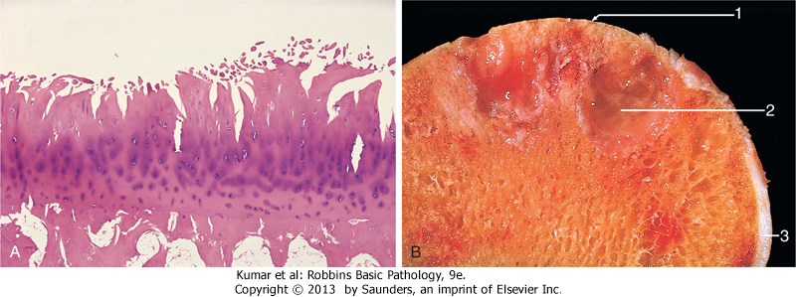
Osteoarthritis. A, Histologic demonstration of the characteristic fibrillation of the articular cartilage. B, Severe osteoarthritis, with eburnated articular surface exposing subchondral bone (1), subchondral cyst (2), and residual articular cartilage (3).

Slide 7
Rheumatoid arthritis (RA)
is a systemic, chronic inflammatory autoimmune disease affecting many tissues, most commonly the joints.
non-suppurative proliferative synovitis that destroy articular cartilage and underlying bone with resulting disability
Extra-articular involvement: may include the skin, heart, blood vessels, muscles, and lungs.
A common condition (prevalence 1%)
(3 to 5)x more common in women than in men.
The peak incidence 2nd-4th decades of life

Slide 8
Pathogenesis:
cytokine-mediated inflammation (e.g., IL-1, TNF), mainly produced by CD4+ T cells
80% of pts ➔ serum IgM autoantibodies= rheumatoid factor that bind to the Fc portions of their own (self) IgG (form immune complexes in joints and other tissues, leading to inflammation and tissue damage)
Inflammation→ activation of chondrocytes, fibroblasts and synovial cells→enzymes that destroy cartilage and cause fibrosis

Slide 9
Pathogenesis of rheumatoid arthritis

Slide 10
Rheumatoid arthritis. A, A joint lesion. B, Synovium demonstrating papillary hyperplasia caused by dense inflammatory infiltrate. C, Hypertrophied synoviocytes with numerous underlying lymphocytes and plasma cells

Slide 11
Clinical features
symmetric arthritis, principally of small joints of the hands and feet, ankles, knees, wrists, elbows, and shoulders.
proximal IP and MCP joints are affected, but distal IP joints are spared.
Axial and hip involvement is extremely rare
Constitutional symptoms: weakness, malaise, and low-grade fever➔ IL-1, TNF
chronic, remitting-relapsing course
Treatment: immuno-suppressive therapy, including biologic agents that antagonize TNF.
Complications of RA:
Progressive joint destruction and disability
Secondary amyloidosis (5% to 10% of cases, esp. with long-standing severe disease)

Slide 12
Infectious Arthritis
Routes of infection:
hematogenous dissemination
direct inoculation
contiguous spread from osteomyelitis or a soft tissue abscess.
Infectious arthritis is serious because it can cause rapid joint destruction and permanent deformities

Slide 13
Suppurative Arthritis
Haemophilus influenzae m/c in children <2 yrs
S. aureus m/c in older children and adults
gonococcus is prevalent in older adolescents and young adults.
Patients with sickle cell disease are prone to Salmonella infection at any age.
gonococcal arthritis is symptomatic mainly in sexually active women.
immunodeficiency of certain complement proteins (C5, C6, and C7) → disseminated gonococcal infections and hence arthritis.

Slide 14
The classic presentation:
1- sudden onset of pain, redness, swelling of the affected joint(s), with restricted range of motion.
2- Fever, leukocytosis, and elevated ESR.
Gonococcal arthritis →more subacute course.
90% of non-gon. arthritis→ a single joint
Most common in knee, hip, shoulder, elbow, wrist, and StC joints (in descending order).
Joint aspiration →a purulent fluid (culture +ve)
Treatment: antibiotics and joint aspiration

