Slide 1
Trauma from Occlusion
Omar Alkaradsheh
6/4/2015

Slide 2
Nonsurgical therapy
Patient education & OHI
Scaling & root planing
Removal of local factors and carious lesions
Anti-infective therapy
Host modulation therapy
Adjunctive aids
Occlusal adjustments
Managing undesired consequences of periodontal diseases
Orthodontic modalities
Re-evaluation

Slide 4
Adaptive Capacity of the Periodontium to Occlusal Forces
Occlusal forces
Magnitude Direction Duration Frequency

Slide 5
Adaptive Capacity of the Periodontium to Occlusal Forces
Magnitude:
When the magnitude of occlusal forces is increased,
The periodontium responds with a widening of the periodontal ligament space,
An increase in the number and width of periodontal ligament fibers,
An increase in the density of alveolar bone.

Slide 6
Adaptive Capacity of the Periodontium to Occlusal Forces
Occlusal forces
Magnitude Direction Duration Frequency

Slide 7
Direction:
Changing the direction of occlusal forces causes a reorientation of the stresses and strains within the periodontium.
The principal fibers of the periodontal ligament are arranged so that they best accommodate occlusal forces along the long axis of the tooth.
Lateral (horizontal) and torque (rotational) forces are more likely to injure the periodontium.

Slide 8
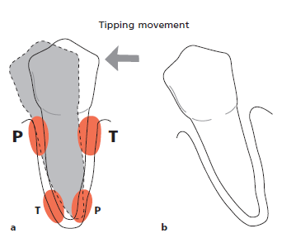
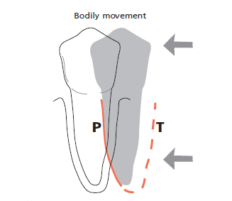
Areas of Pressure & tension as a result of several movements

Slide 9
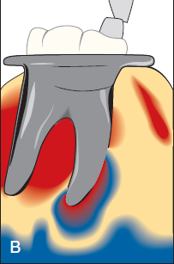
.
Notes:
Stress patterns around the roots changed by shifting
the direction of occlusal forces (experimental model using photoelastic
analysis). A, Buccal view of an ivorine molar subjected to an axial force. The shaded fringes indicate that the internal stresses are at the root apices.
B, Buccal view of an ivorine molar subjected to a mesial tilting force. The shaded fringes indicate that the internal stresses are along the mesial surface and at the apex of the mesial root

Slide 10
Adaptive Capacity of the Periodontium to Occlusal Forces
Occlusal forces
Magnitude Direction Duration Frequency
Duration:
Constant pressure on the bone is more injurious intermittent forces.
Frequency:
The more frequent, the more injurious the force is to the periodontium.

Slide 11
Trauma from Occlusion
Synonyms : “Occlusal trauma” or “Traumatism”
Excessive occlusal forces →injury to periodontium.
Furcations →most susceptible to excessive forces
Excessive occlusal forces may also:
disrupt function of masticatory musculature cause painful spasms,
injure the temporomandibular joints,
or produce excessive tooth wear.
Notes:
trauma from occlusion refers to the tissue injury rather than the occlusal force. An occlusion that produces such an injury is called a traumatic occlusion

Slide 12
Occlusal Trauma
The criterion that determines if an occlusion is traumatic is whether it produces periodontal injury; this criterion is not how the teeth occlude.
Any occlusion that produces periodontal injury is traumatic. Malocclusion does not necessary produce trauma;
Periodontal injury may occur when the occlusion appears normal.
Traumatic occlusal relationships are referred to by such terms as occlusal disharmony, functional imbalance, and occlusal dystrophy.
These terms refer to the effect of the occlusion on the periodontium rather than to the position of the teeth.
Because trauma from occlusion refers to the tissue injury rather than the occlusion, an increased occlusal force is not traumatic if the periodontium can accommodate it.
Notes:
The dentition may be anatomically and aesthetically acceptable but functionally injurious. Similarly, not all malocclusions are necessarily injurious to the periodontium

Slide 13
Types of Occlusal Trauma
Acute or Chronic
Primary or Secondary

Slide 14
Acute Occlusal trauma
Aetiology:
Results from an abrupt occlusal impact such as that produced by biting on a hard object (e.g., olive pit).
Restorations or prosthetic appliances that interfere with or alter the direction of occlusal forces on the teeth may also induce acute trauma.
Clinical signs:
tooth pain,
sensitivity to percussion,
and increased tooth mobility.
.

Slide 15
Acute Occlusal Trauma
Resolution
Healing Necrosis/ perio abscess Chronic trauma
(widening of PDL
at the expense of bone)
Notes:
If the force is dissipated by a shift in the position of the tooth or by the wearing away or correction of the restoration, then the injury heals, and the symptoms subside.
Otherwise, periodontal injury may worsen and develop into
necrosis accompanied by periodontal abscess formation, or it may persist as a symptom-free chronic condition

Slide 16
Acute trauma can also produce cementum tears

Slide 17
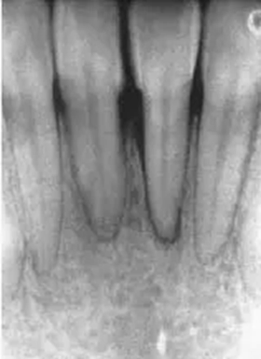
Chronic Occlusal Trauma
Is more common than the acute form and is of greater clinical significance.
It most often develops from gradual changes in occlusion produced by tooth wear, drifting movement, and extrusion of teeth, combined with parafunctional habits such as bruxism and clenching,

Slide 18
Chronic Occlusal Trauma
Chronic forces →destruction outpace repair →remodelling
The ligament is widened at the expense of the bone, which results in angular bone defects without periodontal pockets, and the tooth becomes loose.

Slide 19
Primary and Secondary Trauma from Occlusion
Trauma from occlusion may be caused by alterations in occlusal forces, a reduced capacity of the periodontium to withstand occlusal forces, or both.
When trauma from occlusion is the result of alterations in occlusal forces, it is called primary trauma from occlusion.
When it results from the reduced ability of the tissues to resist the occlusal forces, it is known as secondary trauma from occlusion.

Slide 20
Trauma from occlusion may be caused by
alterations in occlusal forces
a reduced capacity of the periodontium
to withstand occlusal forces
Both

Slide 21
Primary Occlusal Trauma
Occurs when alterations in occlusal forces causes periodontal injury around teeth with a previously healthy periodontium (no previous bone loss or AL)
Examples:
Insertion of a “high filling”
Insertion of a prosthetic replacement that creates excessive forces on abutment and antagonistic teeth
The drifting movement or extrusion of the teeth into spaces created by unreplaced missing teeth
The orthodontic movement of teeth into functionally unacceptable positions

Slide 22
Primary Occlusal Trauma
Changes produced by primary trauma do not alter the level of connective tissue attachment and do not initiate pocket formation.
This is probably because the supracrestal gingival fibers are not affected and therefore prevent the apical migration of the junctional epithelium.

Slide 23
Traumatic forces can occur on:
A, normal periodontium with normal height of bone; or,
B, normal periodontium with reduced height of bone; or, C, periodontitis with reduced height of bone.
Notes:
The first case is an example of primary trauma from occlusion,
whereas the last two represent secondary trauma from occlusion.

Slide 24
Notes:
Two mandibular premolars with normal periodontal tissues (a) are exposed to jiggling forces (b) as illustrated by the
two arrows. The combined tension and pressure zones (encircled areas) are characterized by signs of acute inflammation including collagen resorption, bone resorption, and cementum resorption. As a result of bone resorption the periodontal
ligament space gradually increases in size on both sides of the teeth as well as in the periapical region.
(c) When the effect of the
force applied has been compensated for by the increased width of the periodontal ligament space, the ligament tissue shows no sign of inflammation. The supra-alveolar connective tissue is not affected by the jiggling forces and there is no apical
downgrowth of the dentogingival epithelium. (d) After occlusal adjustment the width of the periodontal ligament becomes normalized and the teeth are stabilized.

Slide 25
Secondary Occlusal Trauma
Occurs when occlusal forces cause damage in teeth with reduced periodontium (attachment loss present)
Caused by reduced adaptive capacity due to:
1) bone and attachment loss
2) systemic diseases can also affect adaptive capacity of supporting tissues.
This reduces the periodontal attachment area and alters the leverage on the remaining tissues. The periodontium becomes more vulnerable to injury, and previously well-tolerated occlusal forces become traumatic.

Slide 26
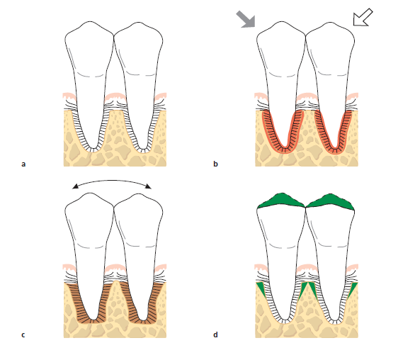
Notes:
(a) Two mandibular premolars are surrounded by a healthy periodontium with reduced height. (b) If such premolars
are subjected to traumatizing forces of the jiggling type a series of alterations occurs in the periodontal ligament tissue. (c) These
alterations result in a widened periodontal ligament space and in an increased tooth mobility but do not lead to further loss of
connective tissue attachment. (d) After occlusal adjustment the width of the periodontal ligament is normalized and the teeth
are stabilized.

Slide 27
Notes:
Illustration of a tooth where subgingival plaque has mediated the development of an infi ltrated soft tissue (shadowed area) and an infrabony pocket. (b) When trauma from occlusion of the jiggling type is inflicted (arrows) on the
crown of this tooth, the associated pathologic alterations occur within a zone of the periodontium which is also occupied by the inflammatory cell infiltrate (shadowed area). In this situation the increasing tooth mobility may also be associated with an enhanced loss of connective tissue attachment and further downgrowth of dentogingival epithelium; compare arrows in (c) and
(d). Occlusal adjustment will result in a narrowing of the periodontal ligament, less tooth mobility, but no improvement of the
attachment level (d) (Lindhe & Ericsson 1982).

Slide 28
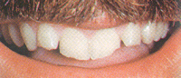
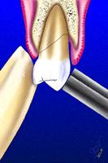
Clinical signs of OT
1) Mobility (most common sign)
2) Pain on chewing or percussion
3) Fremitus
4) Occlusal prematurities/discrepancies
5) Wear facets & abfractions in the presence of other clinical indicators
6) Tooth migration
7) Chipped or fractured tooth (teeth)
8) Thermal sensitivity
Notes:
Although this tooth mobility is greater than the so-called normal
mobility, it cannot be considered pathologic, because it is an adaptation
and not a disease process. If it does become progressively
worse, it can then be considered pathologic.

Slide 29
Radiographic signs of OT
Increased width of PDL space (funnel-shaped coronally).
Thickening of lamina dura.
Vertical or angular bone loss.
Radiolucency in furcation areas.

Slide 30
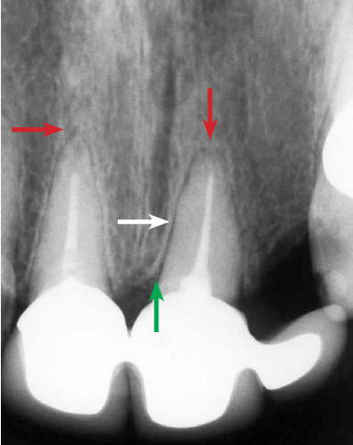
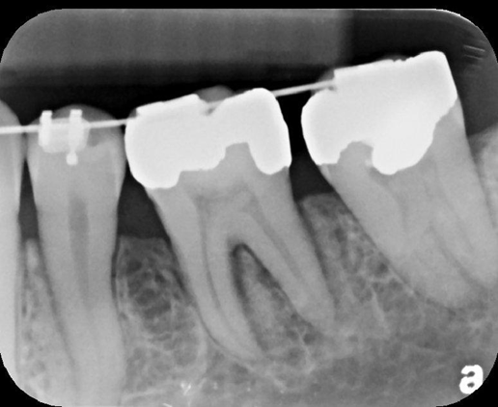
Radiographic signs of OT
Increased width of PDL space (funnel-shaped coronally).
Thickening of lamina dura.
Vertical or angular bone loss.
Radiolucency in furcation areas.
Root resorption

Slide 31
Effects of Insufficient Occlusal Force
Insufficient occlusal force may also be injurious to the supporting periodontal tissues.
Insufficient stimulation causes thinning of the periodontal ligament, atrophy of the fibers, osteoporosis of the alveolar bone, and a reduction in bone height.
Hypofunction can result from an open-bite relationship, an absence of functional antagonists, or unilateral chewing habits that neglect one side of the mouth.

Slide 32
Reversibility of Traumatic Lesions
Trauma from occlusion is reversible. When the impact of the artificially created force is relieved, the tissues undergo repair.
Although trauma from occlusion is reversible under such conditions, it does not always correct itself, and therefore it is not always temporary or of limited clinical significance.
The injurious force must be relieved for repair to occur.
If conditions in humans do not permit the teeth to escape from or adapt to excessive occlusal force, periodontal damage persists and worsens.
The presence of inflammation in the periodontium as a result of plaque accumulation may impair the reversibility of traumatic lesions

Slide 33
Effects of Excessive Occlusal Forces on Dental Pulp
The effects of excessive occlusal forces on the dental pulp have not been established.
Some clinicians report the disappearance of pulpal symptoms after the correction of excessive occlusal forces.
Pulpal reactions have been noted in animals subjected to increased occlusal forces, but these did not occur when the forces were minimal and occurred over short periods.

Slide 34
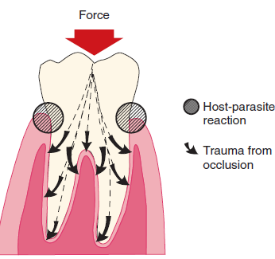
Influence of Trauma from Occlusion on the Progression of Marginal Periodontitis
Plaque → affects gingiva and progress into periodontal pockets.
Occlusal trauma → only PDL & Bone because gingival blood supply is not affected by excessive forces.
“Trauma from occlusion does not cause pockets or gingivitis” and that it also does not increase gingival fluid flow.

Slide 35
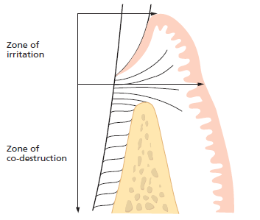
When does OT influence periodontal disease?
As long as inflammation is confined to the gingiva, the inflammatory process is not affected by occlusal forces. When inflammation extends from the gingiva into the supporting periodontal tissues (i.e., when gingivitis becomes periodontitis), plaque-induced inflammation enters the zone that is influenced by occlusion, which Glickman has called the zone of co-destruction.

Slide 36
Glickman’s Concept
The inflammatory lesion in the zone of irritation can, in teeth not subjected to trauma, propagate into thealveolar bone (open arrow), while in teeth also subjected to trauma from occlusion, the inflammatory infiltrate spreads directly into periodontal ligament (filled arrow)

Slide 37
How would these facts affect management?
When trauma from occlusion is eliminated, a substantial reversal of bone loss occurs, except in the presence of periodontitis. This indicates that inflammation inhibits the potential for bone regeneration.
Treating periodontal disease and elimination of inflammation should be undergone before occlusal adjustments.
It has also been shown in experimental animals that trauma from occlusion does not induce progressive destruction of the periodontal tissues in regions that are kept healthy after the elimination of pre=existing periodontitis.

Slide 38
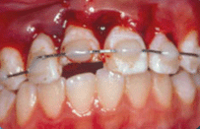
Treatment
In order to maintain periodontal health and function, occlusal evaluation and therapy is an essential part of non-surgical periodontal therapy, including any of the following:
Occlusal adjustment
Parafunctional habits
Temporary, provisional or long-term stabilization of mobile teeth with removable or fixed appliances
Orthodontic tooth movement
Occlusal reconstruction
Extraction of selected teeth

Slide 39
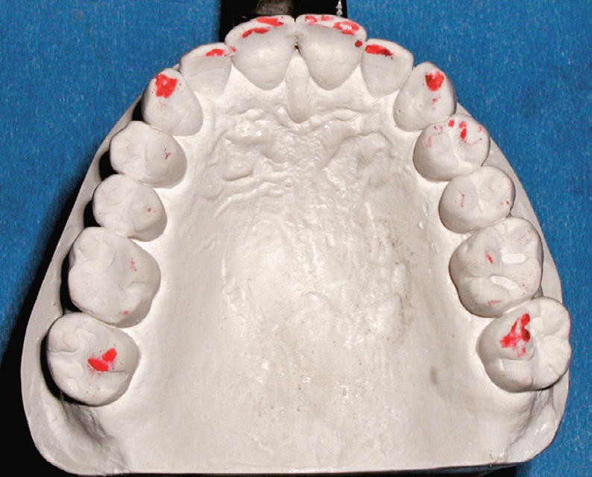
A, Teeth marked clinically in maximum intercuspation and in excursions while clenching. B, Teeth marked in centric relation and maximum intercuspation on a diagnostic cast mounted in centric relation. Marks only on the second molars indicate that they were mobile and that they moved to permit the contact of other teeth.

Slide 40
Summary
Trauma from occlusion does not initiate gingivitis or periodontal pockets, but it may constitute an additional risk factor for the progression and severity of the disease.
An understanding of the effect of trauma from occlusion on the periodontium is useful during the clinical management of periodontal problems.
Mobility caused by OT is not pathological but adaptive.
It is important to eliminate the marginal inflammatory component in cases of trauma from occlusion, because the presence of inflammation affects bone regeneration after the removal of the traumatizing contacts.

Slide 41
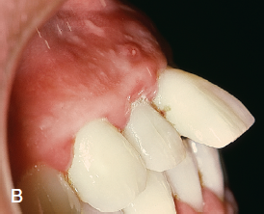
Pathological Tooth Migration

Slide 42
Pathologic Tooth Migration
Pathologic migration refers to tooth displacement that results when the balance among the factors that maintain physiologic tooth position is disturbed by periodontal disease.
Relatively common.
It may be an early sign of disease, or it may occur in association with gingival inflammation and pocket formation as the disease progresses.
anterior region > posterior
migration is usually accompanied by mobility and rotation.
Pathologic migration can happen in any direction; all degrees of pathologic migration are encountered, and one or more teeth may be affected
Detection at early early stages and to prevent more serious involvement by eliminating the causative factors.

Slide 43
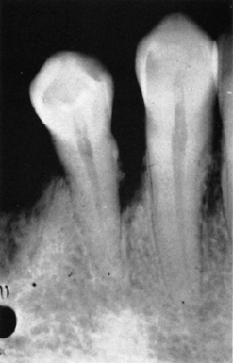
Pathogenesis
Two major factors play a role in maintaining the normal position of the teeth:
the health and normal height of the periodontal attachment apparatus.
the forces exerted on the teeth (forces of occlusion and pressure from the lips, cheeks and tongue).

Slide 44
Pathological Tooth Migration
Factors that are important in relation to the forces of occlusion include the following:
(1) tooth morphologic features and cuspal inclination;
(2) the presence of a full complement of teeth;
(3) a physiologic tendency toward mesial migration;
(4) The nature and location of contact point relationships;
(5) proximal, incisal, and occlusal attrition; and
(6) the axial inclination of the teeth.
Alterations in any of these factors start an interrelated sequence of changes in the environment of a single tooth or group of teeth that may result in pathologic migration.
Thus, pathologic migration occurs under conditions that weaken the periodontal support, that increase or modify the forces exerted on the teeth, or both.

Slide 45
Weakened Periodontal Support.
The tooth with weakened support is unable to maintain its normal position in the arch and moves away from the opposing force unless it is restrained by proximal contact
Forces that are acceptable to an intact periodontium become injurious when periodontal support is reduced, as in the tooth with abnormal proximal contacts.
Abnormally located proximal contacts convert the normal anterior component of force to a wedging force that moves the tooth occlusally or incisally. The wedging force, which can be withstood by the intact periodontium, causes the tooth to extrude when the periodontal support is weakened by disease. As its position changes, the tooth is subjected to abnormal occlusal forces, which aggravate the periodontal destruction and the tooth migration.
Pathologic migration may continue after a tooth no longer contacts its antagonist. Pressures from the tongue, the food bolus during mastication, and the proliferating granulation tissue provide the force.
Pathologic migration is an early sign of localized aggressive periodontitis (Diastemata)

Slide 47
No drifting or extrusion is present here, despite 4 years’ absence of the mandibular teeth.

Slide 48
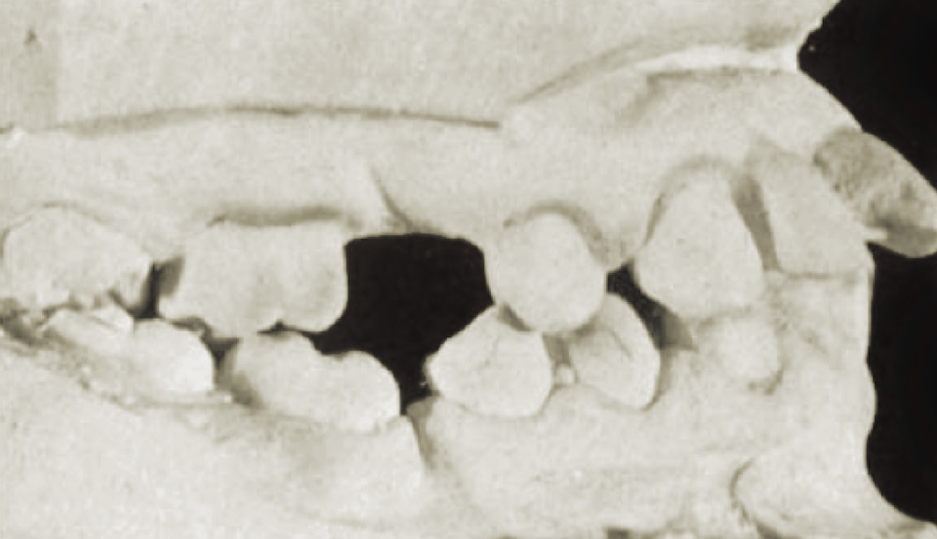
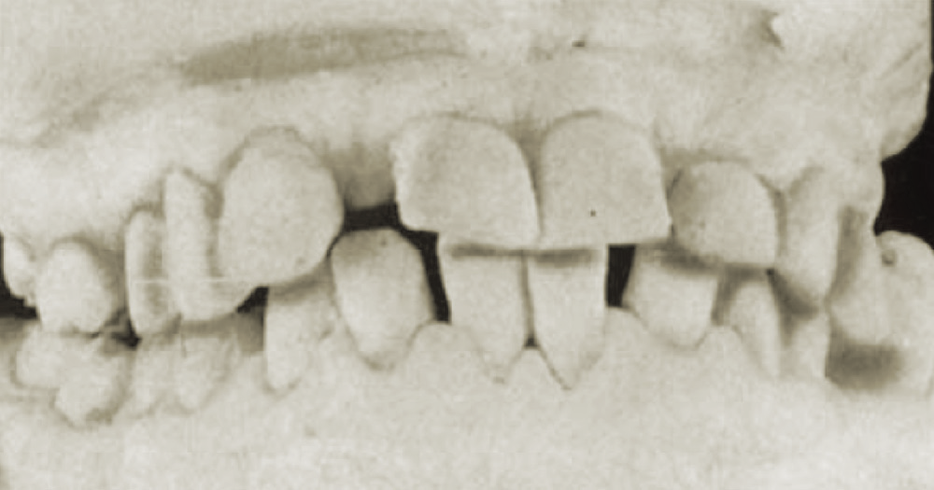
Examples of the mutilation of occlusion associated with unreplaced missing teeth.
Note pronounced pathologic migration,
disturbed proximal contacts, and functional relationships with closing of the bite.

Slide 49
Maxillary incisors pushed labially in a patient with bilateral unreplaced mandibular molars. Note the extrusion of the maxillary molars.

Slide 50
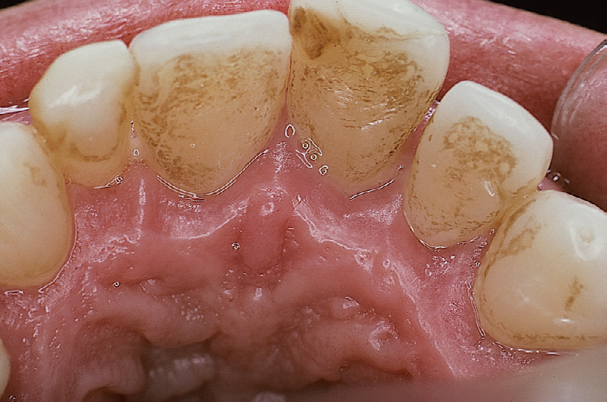
Pathologic migration associated with tongue pressure.

Slide 51
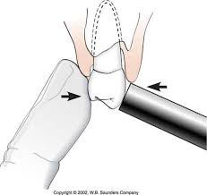
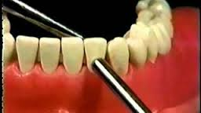
Mobility
The continuous loss of the supporting tissues during periodontal disease progression may result in increased tooth mobility.

Slide 52
Miller Classification (1950) of Increased Tooth Mobility
Degree 0: “physiological” mobility measured at
the crown level. The tooth is mobile within the alveolus to approximately 0.1–0.2 mm in a horizontal direction.
Degree 1: increased mobility of the crown of the tooth to at the most 1 mm in a horizontal direction.
Degree 2: increased mobility of the tooth exceeding 1 mm in a horizontal direction.
Degree 3: severe mobility of the crown of the tooth
both in horizontal and vertical directions impinging
on the function of the tooth.

Slide 53
Mobility
Aetiology:
Advanced bone loss (periodontal disease),
Inflammation of the periodontal ligament of periodontal or periapical origin,
Some systemic causes (e.g., pregnancy),
The destruction of surrounding alveolar bone, such as occurs with osteomyelitis or jaw tumours,
Overloading of teeth and occlusal trauma,
Increased Immediately following periodontal surgery.
Root resorption
Root fractures

Slide 54
Management
From a therapeutic point of view it is important to assess not only the degree of increased tooth mobility but also the cause of the observed hypermobility.
Management aims to reducing mobility, achieve health, function and comfort. This can be done by a combination of the followings:
removal of causative factors (scaling and root planing, RCT, Occlusal adjustments).
Extraction (Grade III mobility with severe bone loss)
Splinting (Grade I-II on multiple adjacent teeth only when causing discomfort or dysfunction to the patient)

Slide 55
Periodontal splints
Teeth stabilisers
Advantages:
Improve masticatory function and comfort of teeth
Reduce inadvertent extractions or unintended orthodontic treatment during normal function.
Improve long-term survival and function of teeth that would have not survived without a splint.
Stabilise mobile teeth after periodontal surgery until healing achieved and inflammation resolved (temporary splint)
Disadvantages: Plaque control, bulkiness

Slide 56
Indications:
good OH
Inflammation – free teeth with moderate attachment loss and Grade I or II mobility
Why splint teeth if no further attachment loss is expected?
Prevent pain and occlusal trauma on teeth with reduced periodontium by sharing the load on several teeth
Inadvertent excessive functional load lead to extraction or tear in PDL of a compromised tooth
Many patient tend to increase parafunction on mobile teeth due to reduced propioception
Avoid orthodontic teeth movement resulting in migration, spacing which might cause unaesthetic outcomes.
Pre-root planing splinting to avoid accidental extractions.
Stabilisation prior to regeneration

Slide 57
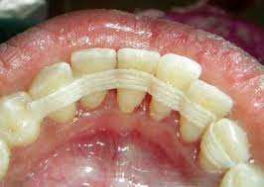
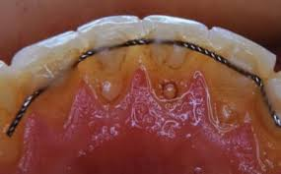
Types
Fixed :
1) Etch-retained composite splints with or without:
Glass fiber
SS wire
Metal mesh
2)Extracoronal restorations (bridges)
3)Maryland type adhesive cast bridges
Removable PD (rare)

Slide 58
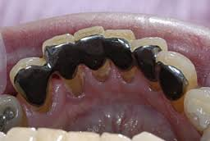

Slide 59
Diagram showing preparation of teeth to receive fiberglass splint

Slide 60
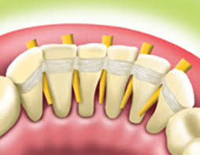

Slide 62
Thank you

