Slide 1
Oral Hygiene Instructions, Smoking Cessation Advice, Diet Analysis & counselling
By Dr. Omar Alkaradsheh
B.D.S, MFD RCSI, D.Ch.Dent, FFD RCSI, EFP.

Slide 2
Outline
Introduction
Plaque control
Rationale
Plaque control methods:
Mechanical
Chemical
Tooth brushes:
Manual
Powered
Manual Vs. Powered
How to brush?
Interdental cleaning
Dentifrices
Smoking cessation advice
5 As model
NRT
Diet analysis & counselling
Diet sheet/diary
tips

Slide 3
Introduction
Most dental and periodontal problems are associated with dental plaque accumulation
1883: Miller found bacterial involvement in development of plaque
1965: Loe et al. experimental gingivitis study confirmed the direct association between plaque accumulation and gingival inflammation.

Slide 4
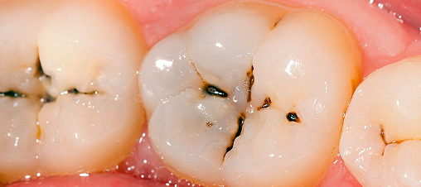
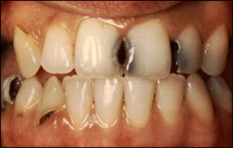
Dental Caries

Slide 6
Periodontal Disease

Slide 9
Plaque Control

Slide 10
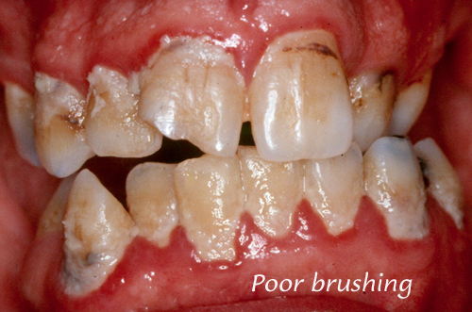
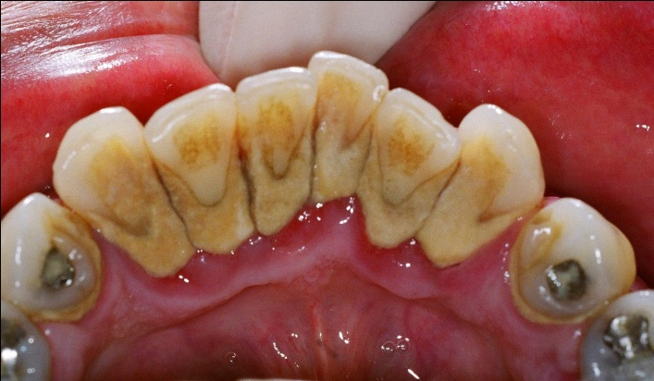
Rationale for plaque control
Constantly removing plaque from tooth surfaces by tooth brushing in addition to using Fluoridated toothpaste have been proven to reduce risk and recurrence of dental caries.
Plaque control remove and prevent plaque accumulation around gingival margins and interdental areas thereby preventing periodontal disease and maintains health.
The removal of plaque also decreased the rate of formation of calculus and stains.

Slide 11
Plaque Control methods
Mechanical
Chemical

Slide 12
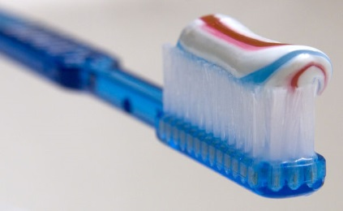
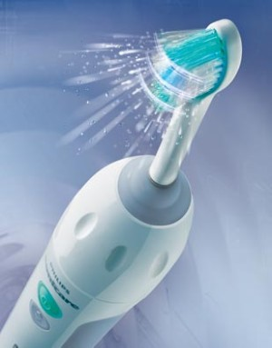
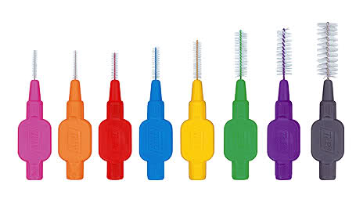
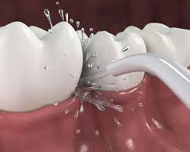
Plaque Control Methods
Mechanical methods
Toothbrush
Manual
Powered
Interdental Aids
dental floss
toothpick
interproximal brush
Dentifrices
Oral Irrigation
supragingival
subgingival

Slide 13
Tooth Brushes

Slide 14
Tooth brushes
Different sizes, designs
Bristle: material, length, stiffness, orientation
Slight difference in plaque removal
No significant difference in inflammation reduction and resolution.

Slide 15
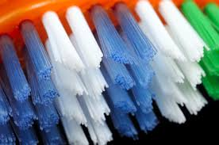
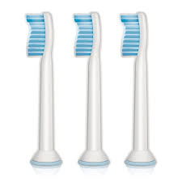
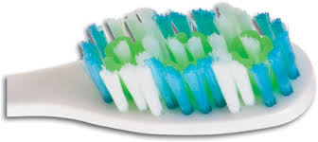
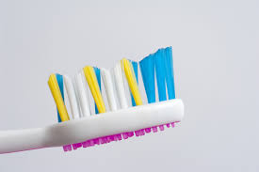
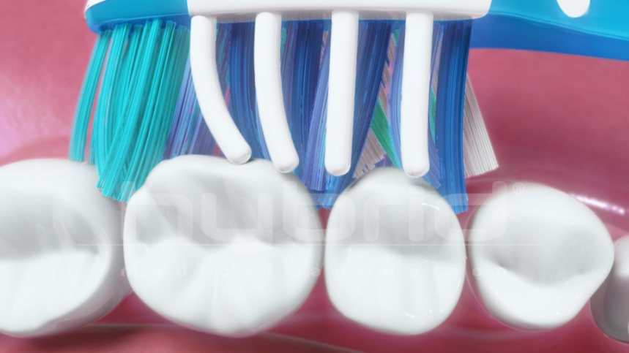
Tooth Brushes
Bristles & tufts

Slide 16
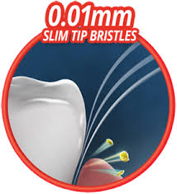
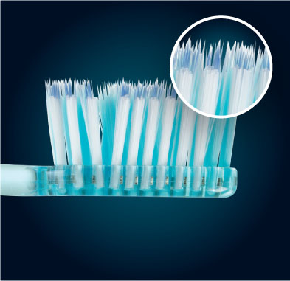
Bristles & tufts
Rounded or flat Ends
Material:
natural bristles from hogs
synthetic: nylon
Bristle hardness α (D)^2/L
Soft: 0.2mm in diameter
Medium: 0.3 mm
Hard: 0.4 mm: more wear effect on enamel and gingival recession.

Slide 17
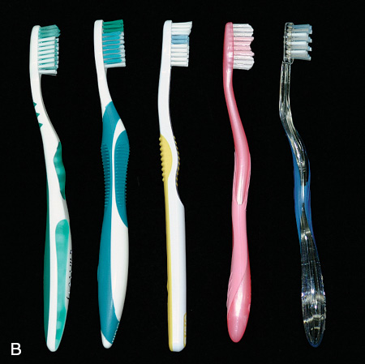
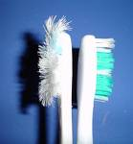
Recommendations
Soft, nylon bristle toothbrushes clean effectively when used properly, remain effective for a while and tend not to traumatize the gingiva or root surfaces.
Toothbrushes need to be replaced every 3-4 months.
If patients perceive a benefit from a particular brush design, they should use it

Slide 18
Oral Hygiene methods
Circular: Fones technique
Vertical: Leonard technique
Horizontal: Scrub technique
Vibratory: Stillman, Charters, and Bass techniques
Roll: Roll or modified Stillman technique

Slide 19
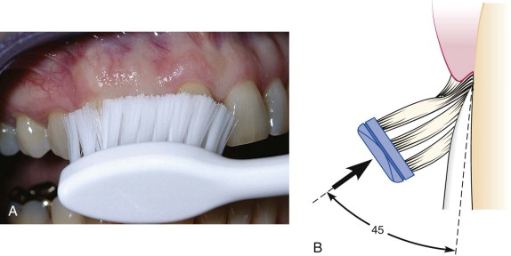
Bass /Modified Bass
Bass method. A, Proper position of the brush in the mouth aims the bristle tips toward the gingival margin. B, Diagram shows the ideal placement, which permits slight subgingival penetration of the bristle tips.

Slide 20
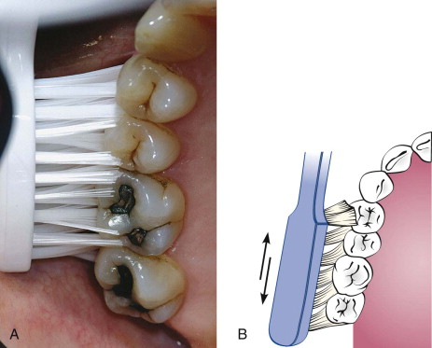
Bass/Modified Bass
Place the head of a soft brush parallel with the occlusal plane, with the brush head covering three to four teeth, beginning at the most distal tooth in the arch.
2. Place the bristles at the gingival margin, pointing at a 45-degree angle to the long axis of the teeth.
3. Exert gentle vibratory pressure, using short, back-and-forth motions without dislodging the tips of the bristles. This motion forces the bristle ends into the gingival sulcus area, as well as partly into the interproximal embrasures. The pressure should be firm enough to blanch the gingiva

Slide 22
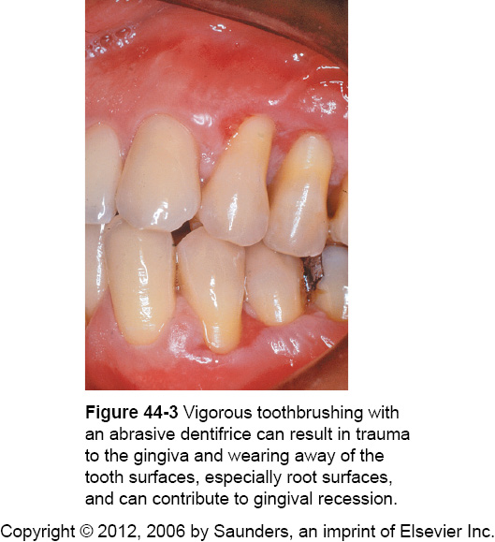
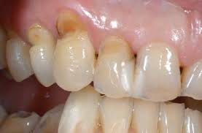
Tooth Brushing Trauma
The brushing technique ,amount of force and the abrasiveness of the dentifrices affect abrasion to a greater degree than bristle hardness.
Force:
cervical wedge-shaped defects
recession
painful ulcerations

Slide 23
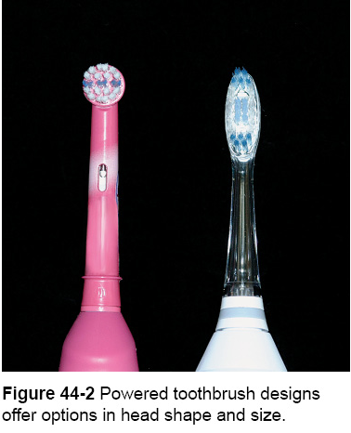
Powered Tooth Brushes
Oscillating and rotating motions
Low-frequency acoustic energy generates dynamic fluid movement and provides cleaning away from the bristle tips also vibrations interfere with bacterial adherence to oral surfaces.
Additional interproximal plaque removal → hydrodynamic shear forces

Slide 24
Powered Toothbrushes
Recommendations:
Powered toothbrushes with oscillating and rotating motions remove plaque and reduce gingival bleeding slightly better than manual toothbrushes.
Patients need to be instructed to the proper use of powered devices.
Patients who are poor brushers, children, and caregivers may particularly benefit from using powered brushes.

Slide 25
tx.english-ch.com

Slide 26
Manual Vs powered
A recent Cochrane review showed that only powered brushes with oscillating and rotating motions reduced microbial plaque by 11% and gingival bleeding by 6% compared to manual brushes.
High patient acceptance
Powered brushes improved oral health in:
Children and adolescents
children with physical or mental disability
Hospitalised patients includes older patients with caregivers.
Patients with fixed orthodontic appliances

Slide 27
www.electrictoothbrushking.com

Slide 28
Powered Toothbrushes
The various mechanical motions built into powered toothbrushes do not require special techniques.
The patient needs only place the brush head next to the teeth at the gingival margin, using a targeted hygiene approach, and proceed systematically around the dentition.
A routine method of brushing all the teeth, similar to the method described for manual brushing, should also be used with powered toothbrushes.

Slide 29
Powered Toothbrushes
Positioning the powered toothbrush head and bristle tips so that they reach the gingival margin is critical to achieving the most effective cleaning results. A, Straight-head placement. B, Round-head placement.

Slide 30
Recommendations
Targeted hygiene focuses brushing efforts on the cervical and interproximal portions of the teeth, where microbial plaque accumulates first.
Brushing with either a manual or a powered toothbrush requires a systematic routine to clean all the accessible areas.
Patients will modify any technique to their needs but must achieve the goal of brushing until the teeth are free of plaque.

Slide 31
Dentifrices
Dentifrice: a term used to describe a powder, paste or gel used with a toothpaste to aid in removal of plaque and stains.
Purpose
Cleaning
polishing
stain removal
reduce tooth decay

Slide 32
Tooth Paste Components
Abrasive: silica, alumina, dicalcium phosphate, and calcium carbonate make up 20% to 40% of a dentifrice. Tooth powders contain about 95% abrasives and are five times more abrasive than pastes.
Water: 20-40%
Humectants: 20-35% glycerine and sorbitol
Detergent: sodium lauryl sulfate
Thickeners: silica and gums
Sweeteners: saccharine
Flavors: mint, peppermint
Active agents: 0-2% e.g. fluorides, triclosan and stannous fluoride

Slide 33
Therapeutic agents
Anticaries: Fuorides: Sodium Flouride, Sodium monoflourophosphate, Stannous Flouride
Desensitizing pastes: Potassium salts
Antiplaque: SLS, Triclosan, Zinc and Stannous ions
Anti-calculus: pyrophosphate
Anti-gingivitis: Triclosan
Whitening pastes: abrasives, papaine, dimethicon, peroxides.

Slide 34
Chemical Plaque Control
Antibiotics
enzymes
Metal ions
Fluorides
Natural products
Bisguanides antiseptics
Oxygenating agents
Amine Alchohols
Phenols and essential oils
Mouth rinse
Irrigation
Gel
Slow releasing device

Slide 35
Interdental Cleaning

Slide 36
Interdental Cleaning aids
Dental Flossing (floss, floss holders, powered floss)
Interdental brushes
Wooden or plastic tips
Rubber tip stimulators

Slide 37
Rationale
Any toothbrush, regardless of the brushing method used, does not completely remove interdental plaque.
Daily interdental plaque removal is crucial to augment the effects of toothbrushing because most dental and periodontal diseases originate in interproximal areas.
Tissue destruction associated with periodontal disease often leaves large, open spaces between teeth and long, exposed root surfaces with anatomic concavities and furcations. These areas are both difficult for patients to clean and poorly accessible to the toothbrush

Slide 38
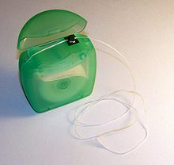
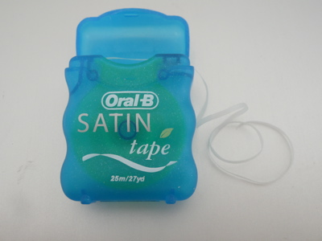
Dental Floss
Most widely recommended tool for removing plaque from proximal tooth surfaces.
Nylon filaments or plastic monofilaments
waxed or unwaxed
Thick or thin
Flavoured or unflavoured

Slide 39
No significant differences in the ability of the various types of floss to remove dental plaque; they all work equally well
Recommendations about type of floss should be based on ease of use and personal preference.
Factors influencing the choice of dental floss include:
The tightness of tooth contacts.
Roughness of proximal surfaces.
The patient's manual dexterity.
It was reported that floss was effective at removal of subgingival interproximal plaque up to a depth of 2 mm.

Slide 40
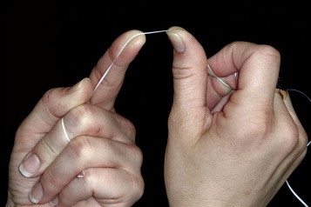
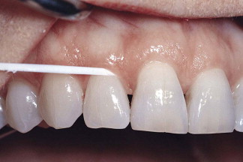
Dental Flossing
Dental floss should be held securely in the fingers or tied in a loop.
Pass it gently through each contact area with a firm back-and-forth motion. Do not snap the floss past the contact area because this may injure the interdental gingiva
The floss is slipped between the contact area of the teeth, is wrapped around the proximal surface, and removes plaque by using several up-and-down strokes. The process must be repeated for the distal surface of tooth

Slide 41
Dental flossing
www.willowpointdental.com

Slide 42
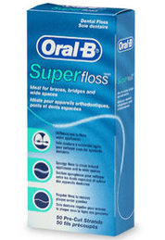
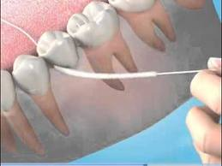
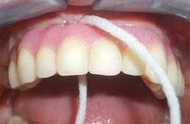
Superfloss
Bridges
Orthodontic retainers/braces
Areas with more open embrasures
Implant-supported prostheses

Slide 43
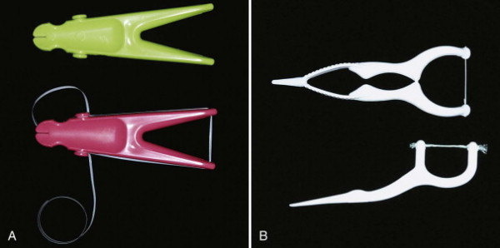
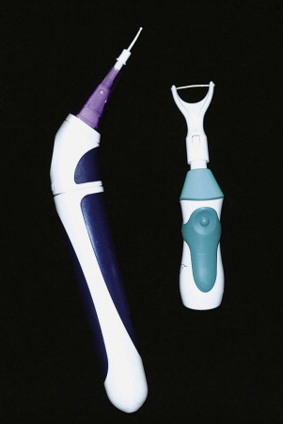
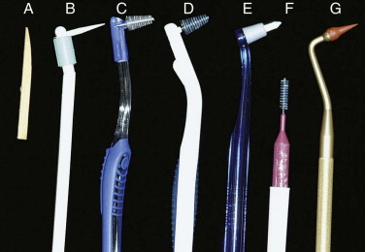
Flossing Tools

Slide 44
Recommendations
The benefits of interproximal cleaning using dental floss are undisputed.
Flossing tools work as well as flossing with the traditional method.
The flossing habit is difficult to establish.

Slide 45
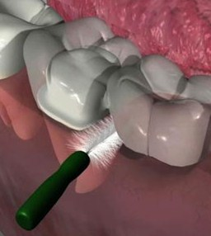
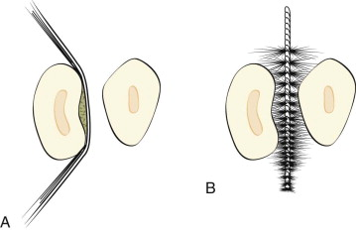
Interdental Brushes
Technique
inserted through interproximal spaces and moved back and forth between the teeth with short strokes.
For the most efficient cleaning, the diameter of brush should be slightly larger than the gingival embrasures to be cleaned (this permits bristles to exert pressure on both proximal tooth surfaces, working their way into concavities on the roots)

Slide 47
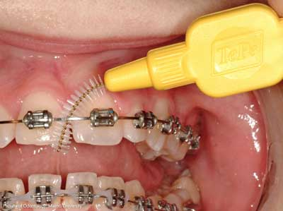

Slide 48
Toothpicks
Toothpicks are common devices and readily available in most homes.
They can be used around all surfaces of the teeth when attached to commercially available handles.
Once mounted on the handle, the toothpick is broken off so that it is only 5- or 6-mm long. The tip of the toothpick is used to trace along the gingival margin and into the proximal areas from both the facial and the lingual surface of each tooth.
Toothpicks mounted on handles are efficient for cleaning along the gingival margin.
Can penetrate into periodontal pockets and furcations.

Slide 49
Toothpicks
Wooden toothpick. A, The tip is a common wooden toothpick held in a handle and broken off. It is used to clean subgingivally and reach into periodontal pockets. B, The tip can also be used to clean along the gingival margins of the teeth and reach under the gingiva.

Slide 50
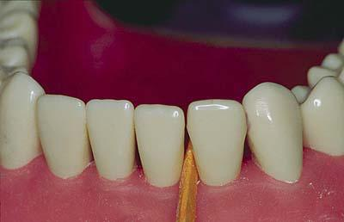
Wooden tips
Triangular wooden tips are also popular with patients. The tip is inserted between the teeth, with the triangular portion resting on the gingival papilla. The tip is moved in and out to remove plaque; however, it is very difficult to use on posterior teeth and from the lingual aspect of all teeth.

Slide 51
Recommendations
Often a toothbrush and dental floss are not sufficient to clean interdental spaces adequately, so it is extremely important to find an interdental device that the patient likes and will use.
Many interdental cleaning aids are available for patients. The patient might need to try several devices before finding one that is acceptable and cleans adequately.
In general, the largest brush or device that fits into a space will clean most efficiently

Slide 52
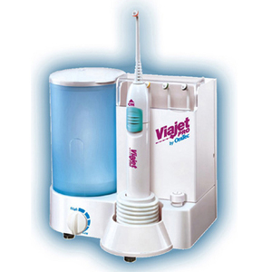
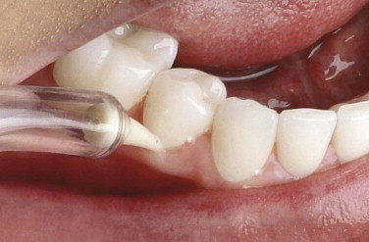
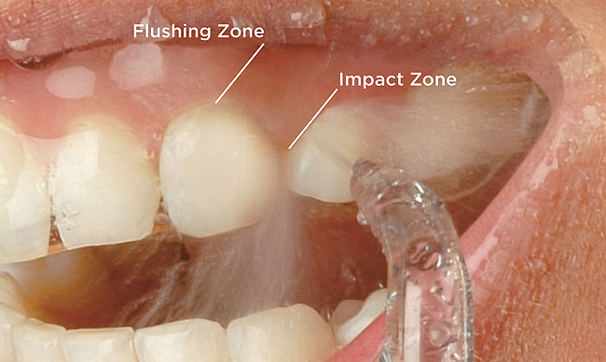
Irrigation
Work by directing a pulsating stream of water through a nozzle to the tooth surface
Subgingival Irrigation
Supragingival Irrigation

Slide 53
Subgingival Irrigation

Slide 54
Recommendations
Supragingival irrigation reduces gingival inflammation and is easier for some patients than using mechanical interdental aids.
Subgingival irrigation with specialized tips for deep pockets and furcation areas is effective when used daily as part of the home care routine.
Patients requiring antibiotic premedication for dental procedures should use supragingival techniques.

Slide 55
How to brush?
Add Pea-size toothpaste
Patient is instructed to start with molar region of one arch around the opposite side than continue back around the lingual or facial surfaces of the same arch
Last surface to be brush is occlusal.
Patient instructed to stroke each area ten time of spend 10 seconds per area then move on to next area.
Time : 2 minutes ( 30 sec per quadrent )
Frequency: Brushing Twice a day, Interdental cleaning once a day.

Slide 56
Patient Education & motivation
Disclosing agents:
to improve the efficiency of plaque control procedures staining bacterial deposits on the surfaces of teeth, tongue, and gingiva.
plaque control instruction in the office and dispensed for home use to aid periodontal patients in evaluating the effectiveness of their oral hygiene routines.
educational and motivational tools

Slide 57
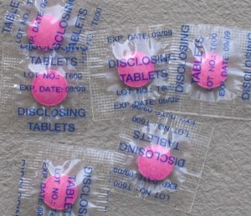
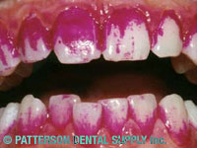
Plaque Disclosing tablets

Slide 58
Smoking

Slide 59
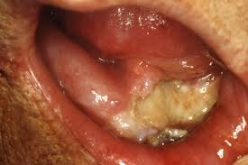
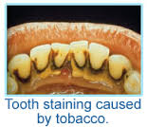
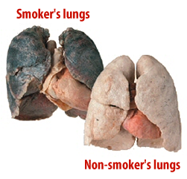
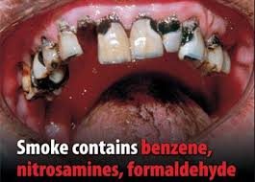
Effects of Smoking
Increases the risk of several types of cancers (Oral, lung)
Cardiac and respiratory problems
Aggravate periodontal condition by acting locally and systemically.
Effect on response to periodontal treatment
Staining & Aesthetics
Dental caries
Wound healing
Bad breath
Dental implants
Dry sockets
Anti-social behaviour

Slide 60
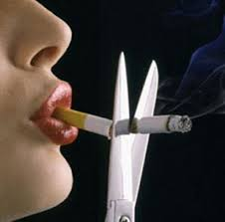
Smoking Cessation
5 A’s Model
Ask
Advise
Assess
Assist
Arrange

Slide 61
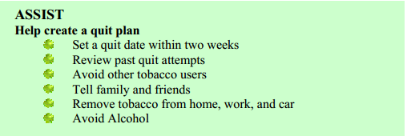
Smoking Cessation

Slide 62
Smoking Cessation

Slide 63
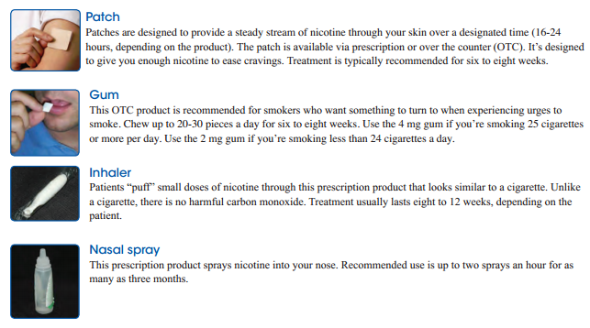
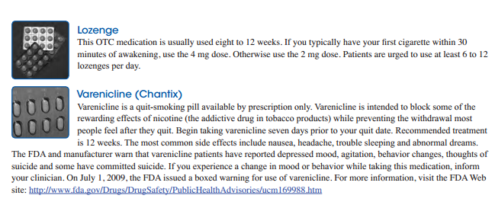
Nicotine Replacement therapy
Unlike the high risk of addiction to tobacco use, the risk of addiction to NRT is very low.

Slide 64
NRT
Precautions for all Nicotine Replacement Therapy:
Use caution in patients within 2 weeks post-MI, arrhythmias, or serious or worsening angina pectoris.
Studies show nicotine replacement therapy is safe and effective in post-MI patients.
Combinations of patch, gum, and nasal spray are generally safe and effective.
Combination of bupropion and nicotine replacement is more effective than either alone.

Slide 65
NRT
Who Should Receive Pharmacotherapy?
Pharmacotherapy can be a valuable adjunct to cessation treatment for most patients making a quit attempt.
The exceptions to this recommendation include, but are not limited to:
• Patients with medical contraindications, such as an MI or stroke within the last 2 weeks
• Women who are pregnant or breastfeeding.
The efficacy of these drugs has not been established for use with adolescents.
Generally, pharmacotherapy is not indicated in individuals who use less than 10 cigarettes in one day.

Slide 66
Dentist Role in Smoking Cessation
The dental team role is to diagnose tobacco use, advise and offer referral into smoking cessation services.
Normally these services will lie outside the dental practice although some trained dental teams will be able to provide these services.
Trained members of the dental team need to be allowed to prescribe nicotine replacements.

Slide 67
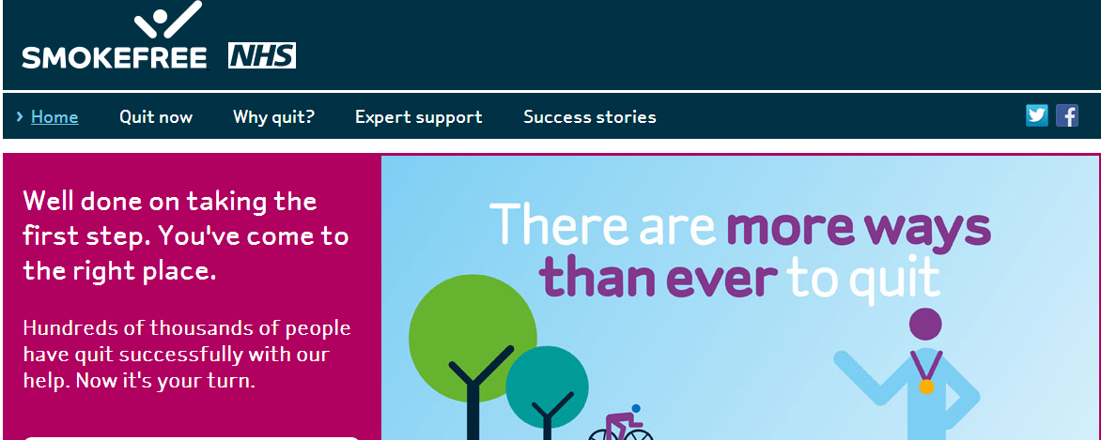

Slide 68
Patient Education Materials

Slide 70
Diet Analysis & Counselling

Slide 71
Diet Analysis
High caries risk
Erosion
Sugared Medications

Slide 72
Councelling
The counselling visit:
Step 1- Pursue diet diary
Step 2- Determine daily routine
Step 3- Explain cause of decay
Step 4- Isolate sugar factor
Step 5- Analyse sweets intake
Step 6- Determine adequacy of diet
Step 7- Diet prescription and suggested menu
Step 8-Re-inforcement by follow-up revaluation

Slide 73
Diet Sheet/Diary
Instructions on completing a diet diary:
Please write down everything you/your child eats and drinks and the time during the day when consumed. This will help us to advise you on how best to improve your diet.
Choose one weekend day and two week days.
Please bring the diet diary with you to the next appointment

Slide 74
Diet Tips
Don’t snack in between meals.
If you have to snack the best foods are savoury such as: raw carrots, cucumber, celery and peppers, chunk of cheese, plain cheese biscuit such as oat cakes, bread sticks, rice cakes, plain crisps, crumpets, pitta bread.
Drink plain tap water or tea/coffee without sugar in between meals.
Don’t eat sugary foods between meals and within an hour of bedtime.
Chewing sugar free gum after eating may help to increase the salivary flow which helps the teeth to repair themselves.

Slide 75
Thank you

