Slide 1
Management of hospitalised Patients
Dr Hazem Al-Ahmad
BDS, MSc (Lon), F.D.S. R.C.S.(Eng)
Associate Professor
Maxillofacial surgeon
Dental School
University Of Jordan

Slide 2
A dentist in a hospital:
Give consultations
Emergency room consultation
Inpatient consultation
Does procedures best done in hospitals

Slide 3
Hospitalising patients for dental care:
Behavioural management
Children
Mental retardation
Medical problems
Needs sedation or G.A
Day surgery

Slide 4
Preoperative patient evaluation:
Preoperative medical examination and medical history
Contact operating room staff
Instruments
Operating time and list

Slide 5
Preparation of the Patient
Admit 24 hours before the operation
general health and fitness
investigations
informed consent
anxiety
Food and drink
Premedication

Slide 9
Operating rooms protocols
Get an assistant
Anesthesiologist
Scrub nurse- gowned & gloved
Circulating nurse

Slide 10
Local / sedation
Day-case surgery
G.A / admission

Slide 12
Operating rooms protocols
Route of intubation
Length of procedures: > 4 hours Foley’s catheter
Eyes protected
Scrubbing, painting, drapping
Moist throat pack

Slide 13
Operating rooms protocols
Surgeons:
Surgical scrub uniform
Shoe cover
Cap
Surgical hand and arm scrub
Pressure gauze with tail

Slide 14
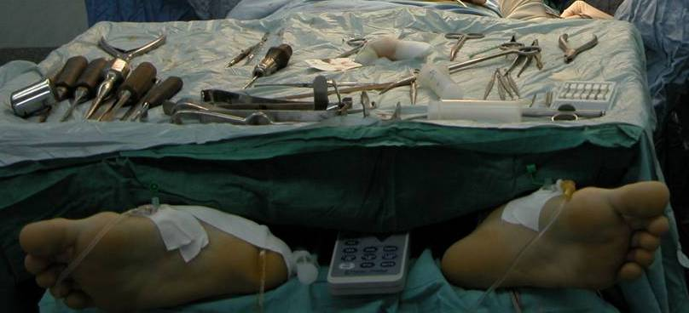
-Instruments

Slide 15
Preparation and isolation of Operation Area :

Slide 17
The Operation Record
Postoperative Care:
Potoperative orders
recovery ward or intensive care unit
general care of the patient and local care of the operation site.
intermaxillary fixation
postoperative pain control and sedation.

Slide 18
discharge
Oral hygiene
Wound care
Diet instructions
Activity levels
Follow up visits
prescription

Slide 19
Postoperative complications:
Airway obstruction or laryngeal oedema
Throat discomfort
Nausea and vomtting – antiemetic drugs- IMF and wire cutters
Fever oral > 37.2, rectal >38

Slide 20
Fluids and electrolytes
Daily intake 2.5-3 L
Dextrose 5%
Normal saline
Lactate ringer’s solution

Slide 21
Blood transfusion
Hypotensive anesthesia
Low blood loss in oral surgery
Autogenous blood transfusion

Slide 22
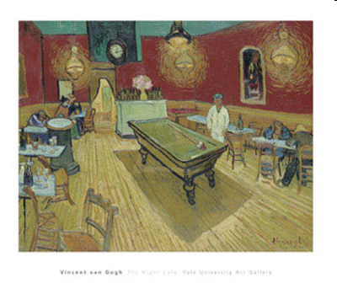
Thank you
Thank you

