Slide 1
DISEASES OF THE ENDOCRINE SYSTEM
DR HEYAM AWAD
FRCPATH

Slide 2
THYROID GLAND TUMOUS
FOLLICULAR ADENOMA:
SOLITARY
ENCAPSULATED
MAJORITY NONFUNCTIONING
TOXIX ADENOMA= PRODUCES THYROID HORMONES

Slide 3
THYROID GLAND CARCINOMA
UNCOMMON
LESS THAN 1% OF CANCER RELATED DEATH
TYPES:
PAPILLARY CARCINOMA = 75 – 85%
FOLLICULAR CARCINOMA = 10 – 20%
MEDULLARY
ANAPLASTIC

Slide 4
PAPILLARY CARCINOMA
HISTOLOGY ……………..
BEHAVIOUR …………

Slide 5
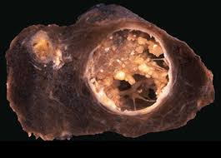
PAPILLARY THYROID CARCINOMA

Slide 6
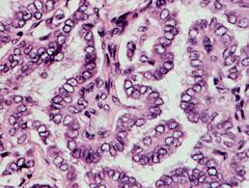
PAPILLARY CARCINOMA

Slide 7
FOLLICULAR CARCINOMA
OLDER AGE GROUP THAN PAPILLARY
CAN METASTASIZE TO LUNGS , BONE AND LIVER

Slide 8
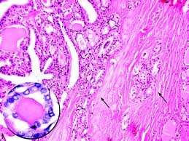
FOLLICULAR CARCINOMA

Slide 9
MEDULLARY CARCINOMA
CELL OF ORIGIN
SECRETE CALCITONIN
HISTOLOGY
BEHAVIOUR

Slide 10
PARATHYROID GLAND
DERIVED FROM PHARYNGEAL POUCHES
FOUR GLANDS LOCATED IN CLOSE PROXIMITY TO THE UPPER AND LOWER THYROID LOBES
ACTIVITY OF THE PARATHROID GLADS IS RELATED TO THE LEVEL OF FREE CALCIUM
DECREASED CALCIUM STIMULATES PTH SECRETION

Slide 11
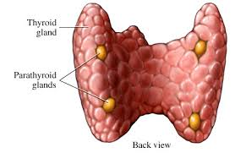
PARATHYROID GLANDS

Slide 12
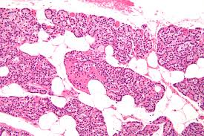

Slide 13
FUNCTIONS OF PTH
ACTIVATE OSTEOCLASTS
INCREASE RENAL TUBULAR REABSORPTION OF CALCIUM
INCREASE CONVESION OF VITAMIN D TO ITS ACTIVE FORM IN THE KIDNEY
INCREASE URINARY PHOSPHATE EXCRETION
INCREASE GI CALCIUM ABSORPTION

Slide 14
HYPERPARATHYROIDISM
PRIMARY = AUTONOMOUS SPONTANEOUS PRODUCTION OF PTH
SECONDARY AND TERTIAR = DUE TO CHRONIC RENAL FAILURE

Slide 15
PRIMARY HYPERPARATHYROIDISM
CAUSES HYPERCALCEMIA
DUE TO PARATHYROID ADENOMA OR PRIMARY HYPERPARATHYROIDISM
< 1% OF CASES DUE TO PSRATHYROID CARCINOMA

Slide 16
ADEOMA
SOLITARY
OTHER GLANDS NORMAL OR ATROPHIC
NO ADIOPSE TISSUE

Slide 17
HYPERPLASIA
MULTIGLANDULAR
10 – 20% OF CASES OF PPRIMARY HYPERPARATHYROIDISM

Slide 18
CARCINOMA
FIRM OR HARD TUMOURS
> 5GRAMS
HISTOLOGICAL CRITERIA FOR MALIGNANCY… INVASION AND METASTASIS

Slide 19
MORPHOLOGIC CHANGES IN OTHER ORGANS
SKELETAL SYSTEM: PROMINENT OSTEOCLASTS THAT ERODE BONE MATRIX
KIDNEY : URINARY TRACT STONES, CALCIFICATIONS OF RENAL INTERSTITIUM.
METASTAIC CALCIFICATIONS IN STOMACH, LUNGS, MYOCARDIUM AND BLOOD VESSELES.

Slide 20
CLINICAL FEATURES OF PRIMARY HYPERPATHYROIDISM
INCREASED CALCIUM

Slide 21
CLINICAL FEATURES OF HYPERPARTHYROIDISM
INCEASED SERUM CALCIUM
PRIAMARY HYPERPARATHYROIDISM IS THE MOST COMMON CAUSE OF CLINICALLY SILENT HYPERCALCEMIA
MALIGNANCY IS THE MOST COMMON CAUSE OF SYMPTOMATIC HYPERCALCEMIA
HOW TO DIFFERENTIATE IF HYPERCALCEMIA IS CAUSED BY PARATHYROID OR OTHER CAUSES

Slide 22
SYMPTOMS OF HYPERPARATHYROIDISM
PAINFUL BONES
RENAL STONES
ABDOMINAL GROANS
PSYCHIC MOANS

Slide 23
PAIN DUE TO FRACTURES OF BONES WEAKENED BY OSEOPOROSIS
GI DISTURBANCES…CONSTIPATION, PEPTIC ULCER, PANCREATITIS, GALLSTONES
CNS.. DEPRESSION ,LETHARGY AND SEIZURES
POLYURIA SECONDARY TO POLYDIPSIA

Slide 24
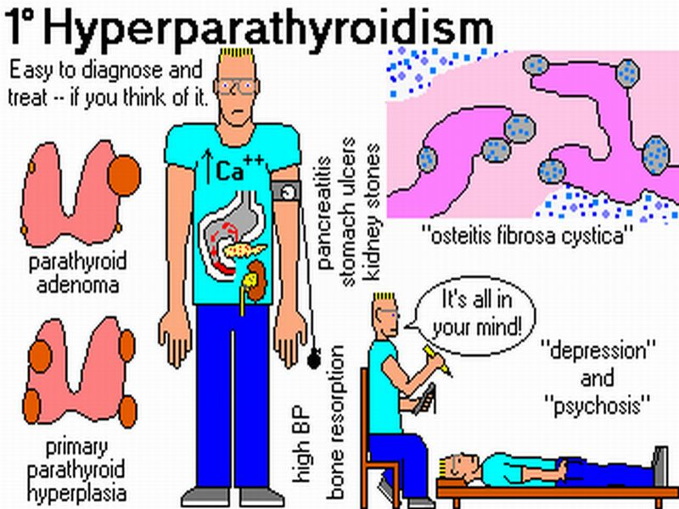

Slide 25
SECONDARY HYPERPARATHYROIDISM
CAUSED BY CHRONIC DECREASE IN SERUM CALCIUM
LOW CALCIUM CAUSES COMPENSATORY OVERACTIVITY OF THE PARATHYROIDS
RENAL FAILURE IS THE MOST COMMON CAUSE
HYPERPLASIA OF THE PARATHYROID GLANDS

Slide 26
SYMPTOMS
BONE ABNORMALITIES
SERUM CALCIUM REMAINS NEAR NORMAL
IN SOME PATIENTS THE PARATHYROID ACTIVITY BECOMES AUTONOMOUS CASING HYPERCALCEMIA .THIS IS CALLED TERTIARY HYPERPARATHYROIDISM

Slide 27
HYPOPARATHYROIDISM
LESS COMMON THAN HYPERPARATHYROIDISM
CAUSES:
SURGICAL ABLATION DURING THYROID SURGERY
CONGENITAL ABSENCE
AUTOIMMUNE HYPOthyroidism

Slide 28
CLINCAL MANIFESTATIONS
HYPOCALCEMIA
INCREASED NEUROMUSCULAR IRRITABILITY
CARDIAC ARRYTHMIAS
SEIZURES

