Slide 1
HEAD AND NECK FOR DENTISTRY LECTURE 2 , SALIVARY GLANDS
DR HEYAM AWAD
FRCPATH

Slide 2
SALIVARY GLANDS
THREE MAJOR SALIVARY GLANDS
PAROTID.
SUBMANDIBULAR.
SUBLINGUAL.
MINOR SALIVARY GLANDS THROUGHOUT ORAL MUCOSA.

Slide 3
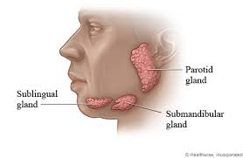

Slide 4
DISEASES OF SALIVARY GLANDS
INFLAMMATORY.
NEOPLASTIC.

Slide 5
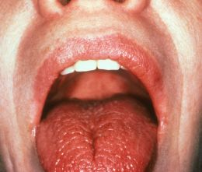
XEROSTOMIA
DRY MOUTH.
DECREASED SALIVA.

Slide 6
XEROSTOMIA
20% OF POPULATION OVER 70 YEARS.
CAUSES:
DRUGS: DIURETICS, ANTIHYPERTENSIVE, ANALGESICS….
SJOGREN SYNDROME.
DADIOTHERAPY.

Slide 7
XEROSTOMIA CLINICAL FEATURES
DRY MUCOSA.
ATROPHY OF TONGUE PAPILLAE.
FISSURING .
ULCERATION.

Slide 8
XEROSTOMIA COMPLICATIONS
DENTAL CARIES.
CANDIDA.
DIFFICULTY IN SWALLOWING AND SPEAKING.

Slide 9
SIALADENITIS
INFLAMMATION CAUSED BY:
TRAUMA.
VIRUSES.
BACTERIA.
AUTOIMMUNE DISEASES.

Slide 10
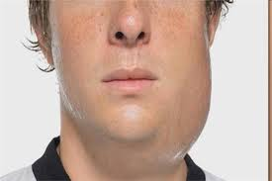
VIRAL SIALADENITIS

Slide 11
MUMPS
CAN CAUSE ENLARGEMENT OF ALL SALIVARY GLANDS, BUT MOSTLY PAROTIDS.
MUMPS VIRUS IS A PARAMYXOVIRUS.
PRODUCES INTERSTITIAL MONONUCLEAER INFLAMMATORY INFILTRATE.

Slide 12
MUMPS
SELF LIMITED IN CHILDREN .
ADULTS: CAN CAUSE PANCREATITIS OR ORCHITIS.
ORCHITIS CAN CAUSE STERILITY.

Slide 13
BACTERIAL SIALADENITIS
MOSTLY SUBMANDIBULAR GLAND.
STAPH AUREUS, STREPT VIRIDANS
PREDISPOSING FACTORS: SIALOLITHIASIS, IMPACTED FOOD OR DEBRIS, INJURY.
DECREASED SALIVA ALSO PREDISPOSES TO BACTERIAL INFECTIONS.

Slide 14
AUTOIMMUNE SIALADENITIS
= SJOGREN SYNDROME.
DRY EYES AND DRY MOUTH DUE TO IMMUNE MEDIATED LACRIMAL AND SALIVARY GLAND DESTRUCTION.
40% OCCUR IN ISOLATION. 60% ASSOCIATED WITH OTHER AUTOIMMUNE DISESASES LIKE RHEUMATOID ARTHRITIS, SLE, SCLERODERMA.

Slide 15
MUCOCELE
THE MOST COMMON INFLAMMATORY LESION OF SALIVARY GLANDS.
DUE TO BLOCKAGE OR RUPTURE OF SALIVARY GLAND DUCT WITH LEAKAGE OF SALIVA INTO SURROUNDING CONNECTIVE TISSUE STROMA.

Slide 16
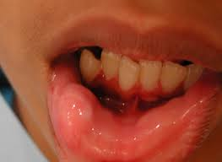
MUCOCELE
FLUCTUANT SWELLING OF LOWER LIP.

Slide 17
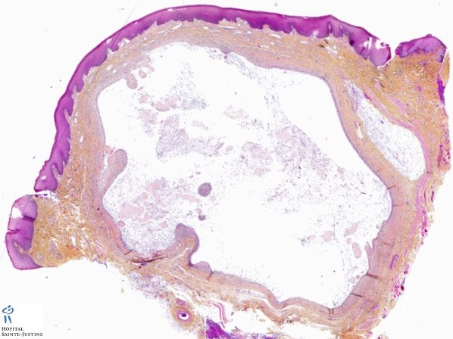
MUCOCELE

Slide 18
NEOPLASMS
A LARGE VARIETY OF BENIGN AND MALIGNANT NEOPLASMS.
30 TYPES!!
RAER… LESS THAN 2% OF ALL HUMAN TUMOURS.
65 – 80 % ARISE WITHIN THE PAROTID, 10% IN THE SUBMANDIBULAR.

Slide 19
NEOPLASMS
15-30% OF PAROTID TUMOURS ARE MALIGNANT.
40% OF SUBMANDIBULAR ONES MALIGNANT.
50% OF MINOR SALIVARY TUMOURS MALIGNANT.
70-90% OF SUBLINGUAL MALIGNANT.

Slide 20
PLEOMORPHIC ADENOMA
THE MOST COMMON SALIVARY GLAND NEOPLASM.
PRESENT AS PAINLESS, SLOW GROWING, MOBILE MASSES.
ARISE IN THE PAROTID, SUBMANDIBULAR GLAND OR IN THE BUCCAL CAVITY.

Slide 21
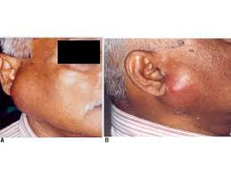
pleomorphic

Slide 22
MACROSCOPIC FEATURES OF PLEOMORPHIC ADENOMA
ROUNDED, WELL DEMARCATED MASSES.
CUT SURFACE IS GREY- WHITE

Slide 23
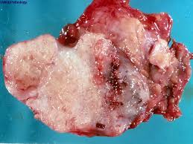
Pleomorphic adenoma

Slide 24
PLEOMORPHIC ADENOMA HISTOLOGICAL FEATURES
MIXTURE OF EPITHELIAL AND MYOEPITHELIAL CELLS IN A MYXOID, HYALINE AND CHONDROID MATRIX.
RATIO BETWEEN EPITHELIAL AND MESENCHYMAL ELEMENTS VARIES…….. DOES THIS AFFECT BEHAVIOUR?

Slide 25
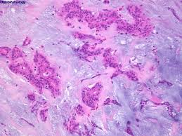
PLEOMORPHIC ADENOMA

Slide 26
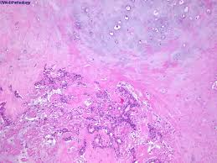
PLEOMORPHIC ADENOMA

Slide 27
PLEOMORPHIC ADENOMA
TREATMENT: COMPLETE EXCISION.
CAN RECUR IF NOT WELL EXCISED.
25% RECURRENCE IF ENUCULATED, 4% RECURRENCE IF WIDE RESECTION.
MALIGNANT TRANSFORMATION IN 10% OF CASES PRESENT FOR 15 YEARS …… ADENOCARCINOMS OR UNDIFFERENTIATED CARCINOMA. BOTH AGGRESSIVE

Slide 28
MUCOEPIDERMOID CARCINOMA
15% OF ALL SALIVARY GLAND TUMOURS.
MAINLY IN THE PAROTID.
THE MOST COMON MALIGNANT SALIVARY GLAND NEOPLASM.

Slide 29
MUCOEPIDERMOID CARCINOMA
CORDS OR SHEETS OF SQUAMOUS , MUCOUS OR INTERMEDIATE CELLS .
CAN BE LOW, INTERMEDIATE OR HIGH GRADE.
LOW GRADE: INVADE LOCALLY AND RECUR IN 15% OF CASES.
HIGH GRADE: RECUR IN 25% AND HAVE 50% CHANCE OF 5 YEAR SURVIVAL

Slide 30
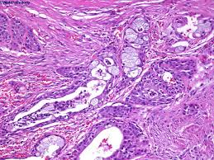
mucoepidermoid

