Slide 1
Spinal cord tracts
Clinical applications

Slide 2
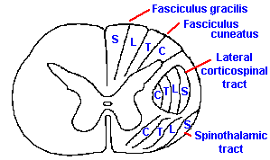
Clinical significance of lamination of the ascending tracts
Any external pressure exerted on the spinal cord in the region of the spinothalamic tracts will first experience a loss of pain and temperature sensations in the sacral dermatome of the body
If pressure increases the other higher segmental dermatomes will be affected
Remember that in the spinothalamic
tracts the cervical to sacral
segments are located medial to lateral

Slide 3
Lateral spinothalamic
Destruction of this tract produces contralateral loss of pain and thermal sensation below the level of the lesion

Slide 4
Clinical application
destruction of LSTT
loss of
pain and thermal sensation
on the contralateral side
below the level of the lesion
patient will not
respond to pinprick
recognize hot and cold

Slide 5
Anterior spinothalamic
Clinical application
destruction of ASTT
loss of light touch and pressure sense
below the level of lesion
on the contralateral side of the body
Remember that discriminative touch will still present (because this information is carried by the posterior white column pathway)

Slide 6
Fasciculus gracilis and cuneatus
Loss of conscious muscle and joint loss
The patient does not know about the position and movement of the ipsilateral limbs below the level of the lesion
Loss of vibration sense and tactile discrimination of the ipsilateral side below the level of the lesion
The sense of light touch wont be affected …why!!!!!!!

Slide 7
Clinical application
destruction of
fasciculus gracilia and cuneatus
loss of muscle joint sense, position sense, vibration sense and tactile discrimination
on the same side
below the level of the lesion
(extremely rare to have a lesion of the spinal cord to be localized as to affect one sensory tract only )

Slide 8
It is extremely RARE for a lesion in the spinal cord to be so localized as to affect one sensory tract only,,,,its more usual to have several ascending and descending tracts involved

Slide 9
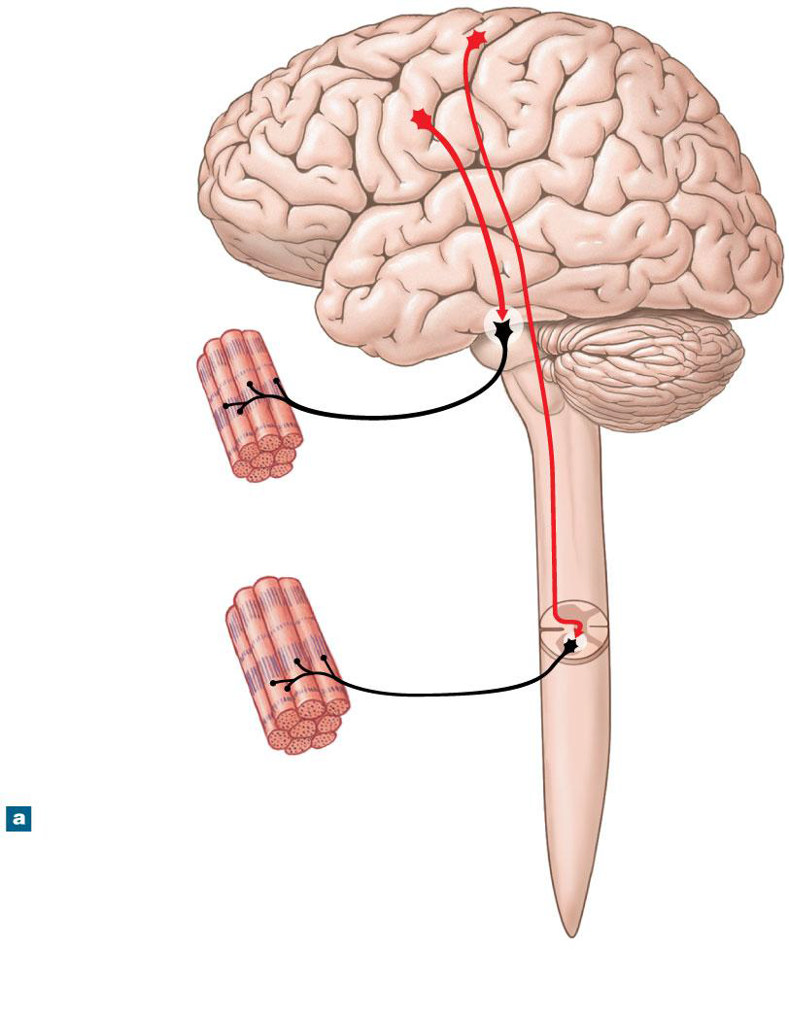
upper motor neuron lesion is a lesion of the neural pathway above the anterior horn cell of the spinal cord or motor nuclei of the cranial nerves
lower motor neuron lesion : affects nerve fibers traveling from the anterior horn of the spinal cord or the cranial motor nuclei to the relevant muscle

Slide 10
COMPARISON BETWEEN UMN AND LMN
Features | Upper motor neuron lesions(UMN) | Lower motor neuron lesion(LMN)
 | UMN starts from motor cortex to the cranial nerve nuclei in brain and anterior horn cells in spinal cord | LMN is the motor pathway from anterior horn cell(or Cranial nerve nucleus)via peripheral nerve to the motor end plate
Bulk of muscles | No wasting | Wasting of the affected muscles (atrophy)
Tone of muscles | Tone increases (Hypertonia) | Tone decreases (Hypotonia)
Power of muscles | Paralysis affects movements of group of muscles Spastic/ clasp knife | Individual muscles is paralyzed Flaccid ( flaccid paralysis)
Reflexes | Exaggerated. (Hyperreflexia) | diminished or absent. (Hyporeflexia)
Fasciculation | Absent | Present
Babinski sign | Present | Absent
clasp-knife reaction | Present | Absent

Slide 11
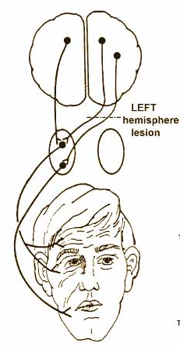
Corticobulbar pathway (corticonuclear):
From cerebral cortex to motor nuclei of certain cranial nerves ( 5th, 7th, 9th, 10th, 11th ,12th)
The corticobulbar input is bilateral to :
1- 5th
2- Part of 7th ( which supplies UPPER facial muscles)
3- 9th,10th,11th
4- 12th !!!!
the corticobulbar input to the part of facial nucleus supplies LOWER facial muscles is from the contralateral hemisphere only (unilateral input)
Hypoglossal nucleus receives corticonuclear fibers from both cerebral hemisphere (bilateral input) however, the cells responsible for supplying the genioglossus muscle only receive corticonuclear fibers from the opposite cerebral hemisphere (unilateral input)

Slide 12
Types of paralysis:
1- hemiplegia : paralysis of one side of the body ( includes the upper limb,
one side of the trunk and the lower limb
2- monoplegia : paralysis of one limb only
3- paraplegia : paralysis of the two lower limbs
4- quadriplegia : paralysis of all four limbs

