Slide 1
The Impacted Canine
Dr Ashraf Abu Karaky
Faculty of Dentistry
The University of Jordan

Slide 2
Definition
The upper canine is the second most common tooth after the wisdom teeth to become impacted in the roof of the mouth.
The canine tooth is crucial in the dental arch and plays an important role occlusion.
Canine guidance: They are the first teeth that touch when jaws close together, they guide the rest of the teeth into the proper bite.
They also form the corners of your smile.
Normally, the upper canines are the last of the front teeth to erupt into place around age 12.

Slide 3
Early Management
This can cause damage to the roots of the upper front teeth or formation of cysts in the bone around the canine. If a canine tooth gets impacted, every effort is made to allow it erupt into its proper position.
Early detection of teeth that may become impacted is very important. The American Association of Orthodontists recommends an evaluation with a orthodontic exam and a panoramic x-ray for all patients before age 8 in order to determine if there are problems with eruption of the adult teeth. By this time, the angulation of the upper canines can be seen and we can predict if there is a chance that they may become impacted. If detected early, impaction can be prevented in 70-95% of cases. Usually, extraction of the baby canine tooth or treatment with a palatal expander is all that is needed to ensure proper eruption

Slide 4
Management
Surgical Removal
Surgical Exposure
Follow-up

Slide 5
Surgical Removal of Impacted Canines
Associated with a Pathology or adjacent roots resorption
Patient preference
Occlusion
Dental Implants or Bridge
Poor prognosis for Ortho traction:
Ankylosis, and abnormal anatomy
Difficult position

Slide 6
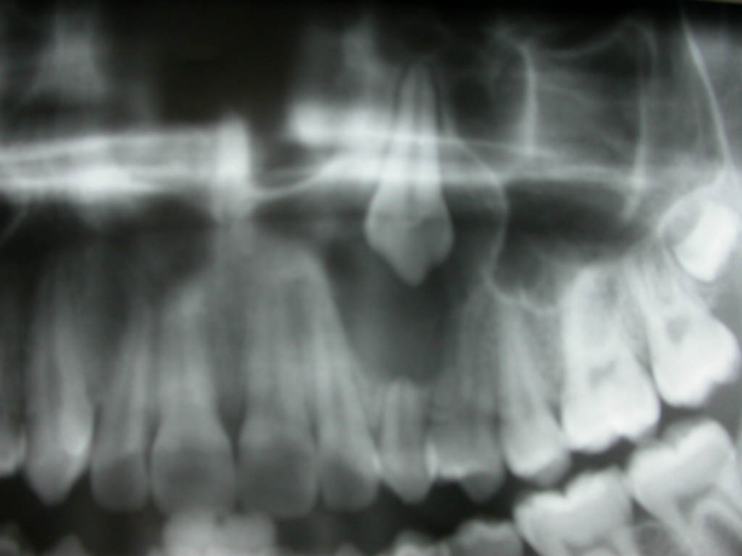

Slide 7
Surgical Removal of Impacted Canines
Location
Flap
Bone removal
Tooth sectioning
Tooth removal
Closure of flap
Post-operative instructions

Slide 8
Surgical Removal of Impacted Canines Location
Palpation
Angle of lateral incisors
X-rays
Parallex technique
Cone Beam 3D CT Scan

Slide 9
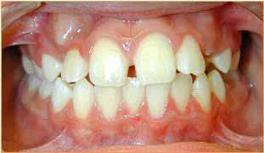
Lateral Incisors Inclination

Slide 10
Parallex Technique

Slide 11
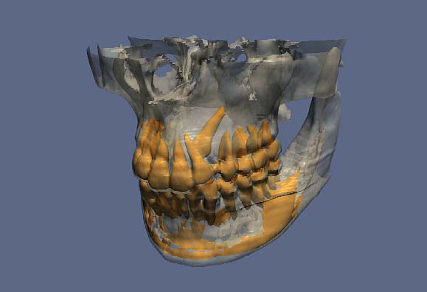
Cone Beam CT Scan

Slide 13
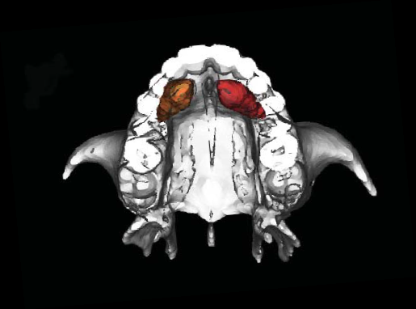
CBCT Scan

Slide 14
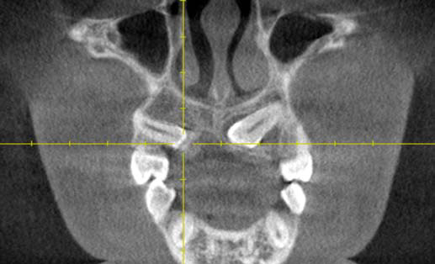

Slide 16
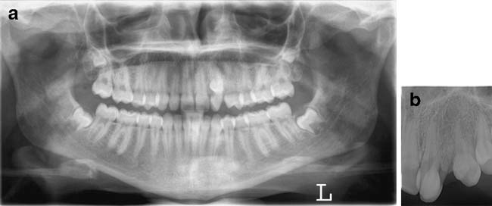

Slide 17
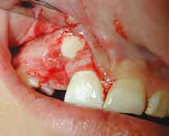
Surgical Removal of Impacted Canines Labial Position
3 or 2 sided Mucoperiosteal Flap
Gingival flap

Slide 18
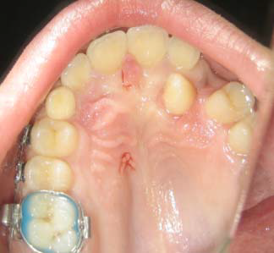
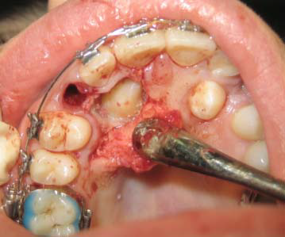
Surgical Removal of Impacted Canines Palatal Position
Palatal Mucoperiosteal Flap

Slide 19
SURGICAL EXPOSURE OF
IMPACTED CANINES

Slide 20
Surgical Exposure
Indications
Eruption

Slide 21
Surgical Exposure Labial
Window flap
Apical Repositioned Flap

Slide 25
Surgical Exposure Palatal
Window technique
Full Palatal Flap.

Slide 27
Follow Up

Slide 28
Complications of Impacted Maxillary Canines Surgical Extraction
Trauma to adjacent teeth
Oro-nasal and Oro-antral comunications
Bleeding
Nerve injury
Fractures

Slide 29
Other Impacted Teeth
Anatomical structures
Mental foramen, Maxillary sinus, adjacent roots.. Etc

Slide 30
Thank You

