Slide 1
Invasive Procedures

Slide 2
Amniocentesis
Timeframe: 15-17 weeks post-LMP
(Can be done at 10-14 weeks)
20-30 ml amniotic fluid is collected transabdominally or transcervically with a needle - contains supernatant & fetal cells.
Cells cultured & examined for chromosome structure/number and/or direct DNA testing
The amniotic fluid is analyzed for AFP levels

Slide 3
Amniocentesis
Used when
Advanced maternal age
History of chromosomal disorder
Parent with chromosomal abnormality
Mother carrier of X-linked disorder
Amniotic fluid withdrawn

Slide 4
Amniocentesis
Advantages:
Can examine AFP levels for spinal defects
Can be performed by an Ob/Gyn vs. perinatologist
Fetal loss rate very low (0.5%) - for late Amniocenteses
Disadvantages
Early amniocentesis has a higher risk of miscarriage (5%)
Longer wait time for patients than CVS – 1-2 weeks
Also have some risk of mosaicism

Slide 5
Invasive Testing Chorionic Villus Sampling (CVS)
Timeframe: 8-10 weeks post-LMP
Essentially a placental biopsy
Tissue biopsy from the villous area of the chorion is aspirated transcervically or transabdominally
Cells are cultured and analyzed either for chromosomes or direct DNA mutations or direct assays for biochemical activity

Slide 6
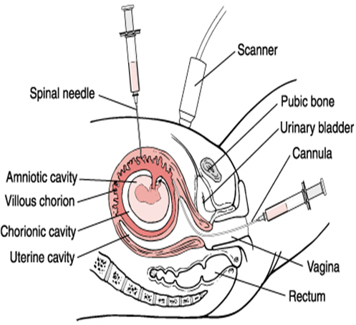
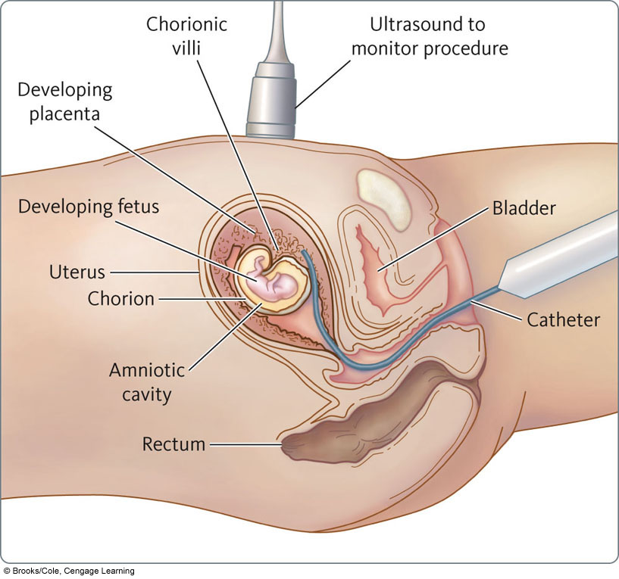
Review of CVS Procedures

Slide 7
Chorionic villus sampling (CVS)
Advantages:
first trimester diagnosis
diagnostic results provided
99% of the time
post-CVS fetal loss rate low (1%)
results usually obtained in 5-7 days
Disadvantages
looks only at extraembryonic material - will not detect a defect arising after embryonic material partitioned off
confined placental mosaicism may be a problem (2%)
only gathers cells, not fluid - can’t measure AFP
Can’t identify NTDs

Slide 8
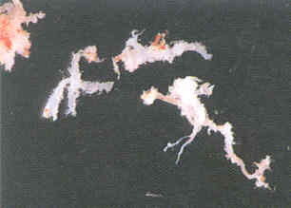
Molecular
Testing
Chorionic
Villus
Material

Slide 9
Cordocentesis
Timeframe: 19-21 weeks post-LMP
Advantages:
Rapid diagnosis time, fetal blood cells only need to be cultured for a few days to provide good chromosomes
Disadvantages
Must be performed by a perineonatologist because of difficulty in accessing the umbilical vein
Higher fetal loss than with CVS or Amnio (2-3%)
Fetoscopy
Timeframe: 15-18 weeks post-LMP
Structural abnormalities, skin bx for (epidermolysis bullosa)

Slide 10
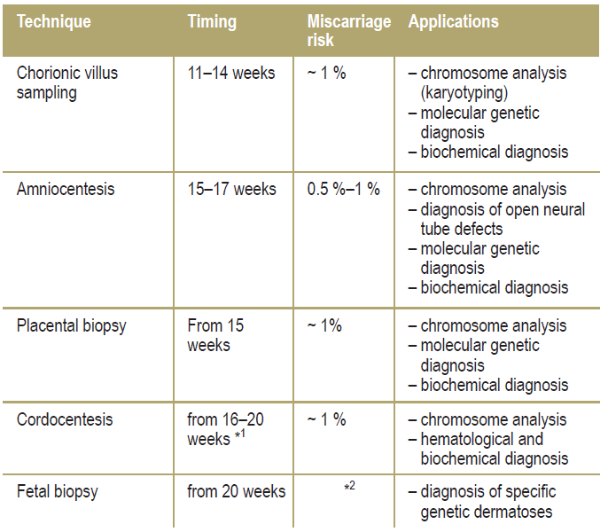
Invasive prenatal diagnostic methods

Slide 11
Prenatal Diagnosis
What technique do you use?
Depends upon what you are looking for
Chromosomal abnormalities - need to look at chromosomes - need live fetal cells obtained from amniocentesis or chorionic villus sampling
Hormone or enzyme levels - need cells or fluid
Direct mutation analysis - need DNA (fetal cells)
Tests: Karyotyping, FISH, CGH, Molecular, Biochemical

Slide 12
Preimplantation Genetic Diagnosis (PGD)

Slide 13
Pre-implantation Genetic Diagnosis (PGD)
What is it?
Genetic analysis of a single cell from an eight-cell embryo done in conjunction with in vitro fertilization (IVF) to improve the chances of a “normal” pregnancy.

Slide 14
Preimplantation genetic diagnosis (PGD)
Introduced in 1990 by Verlinsky et al in Chicago with polar body biopsy
In London by Handyside et al that same year with blastomere biopsy
Indications: expanded rapidly
Conceive with healthy embryos tested in vitro before implantation → avoid the dilemma of whether or not to terminate a pregnancy or deliver a sick child

Slide 15
PGD Process
Ovulation Induction
Retrieval
Fertilization
Embryo Bx on Day-3
Genetic Analysis
Embryo Transfer

Slide 16
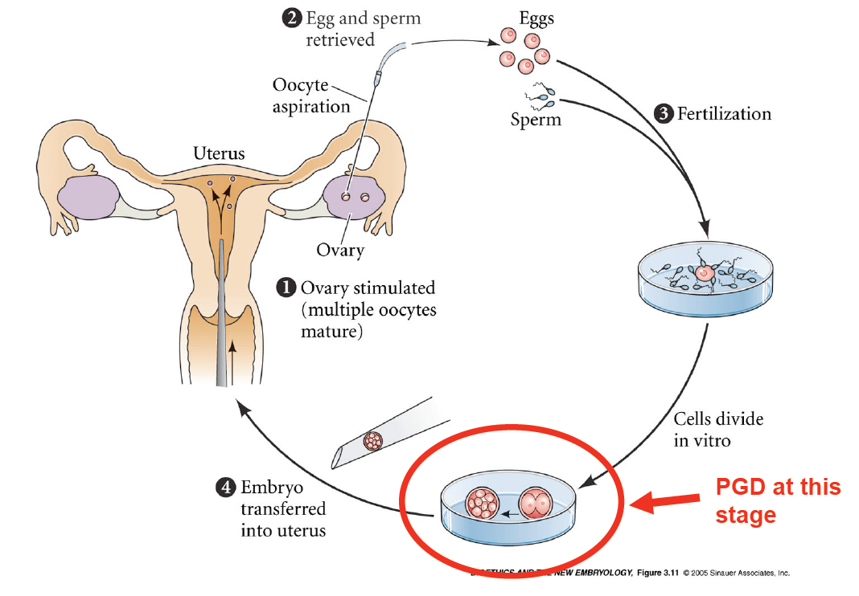
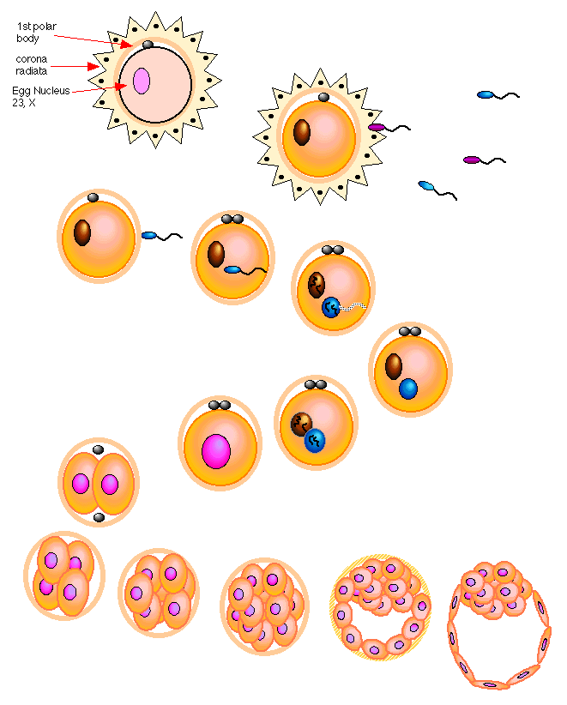

Slide 17
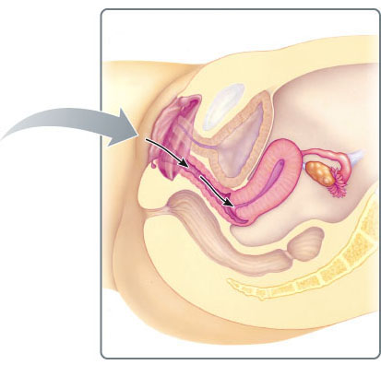
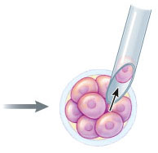
Preimplantation Genetic Diagnosis (PGD)
Eight-cell embryos
Single cells
Embryos
Transfer of selected embryos to patient
Removal of
single cell
for sex
chromosome
analysis
1) Eggs are removed from the ovary, fertilized, and grown to the eight-cell stage.
2) Single cells are identified as either male or female.
3) Embryos
of the desired sex are selected.
4) The selected embryos are transferred to the uterus for development.

Slide 18
Ovarian stimulation for IVF with PGD
Embryo micromanipulation
Technique used for biopsy
Numbers of cells removed from the embryo
May affect :
Embryo development,
Implantation rate,
The pregnancy outcome

Slide 19
PGD may now be offered
All known single-gene disorders
Chromosomal rearrangement
HLA-matched siblings
Cancer predisposition genes
Late-onset disorders
Monogenic disorders
Translocations together with aneuploidy
Couple who carry a genetic disorder

Slide 20
PGD for HLA Typing
“Savior siblings”: International controversy
Matched Hematopoietic Stem Cell Transplantation:
Donate cord blood or bone marrow
Nonmalignant disorders
Genetic diseases affecting the hematopoietic and/or the immune system: (Thalassemia, Fanconi anemia, Wiskott-Aldrich syndrome, sickle-cell disease)
Acquired diseases like aplastic anemia
Malignant diseases like leukemia (↓ Post-transplant morbidity/mortality rates)

Slide 21
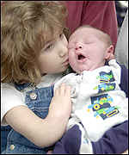
HLA Tissue Typing Saviour Siblings
Molly and Adam Nash
Fanconi Anaemia
Charlie Whitaker Diamond Blackfan
Anaemia
Zain Hashmi Beta thalassaemia

Slide 22
Preimplantation Genetic Diagnosis (PGD)
Advantages:
Very early diagnosis
Only transfer unaffected (or carrier) embryos
Disadvantages
Cost is extremely high
“Success”/implantation rate low
Discard affected or unused embryos,
which has raised ethical concerns

Slide 23
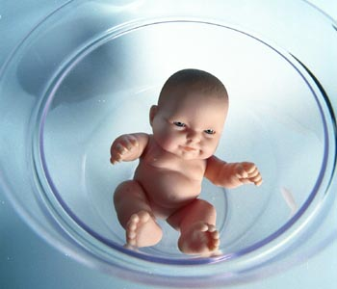
PGD Indications
Procedure is offered to couples:
With known single gene disorders that can be detected by PGD
With known chromosomal abnormalities that can be detected by PGD
Requesting sex selection for X-linked disorders

Slide 24
PGD Indications
The procedure has also been offered to couples: undergoing IVF at risk for aneuploidy
maternal age > 35 years
Prior trisomic conception
With recurrent pregnancy losses
Prior failed IVF cycles (>3 prior embryo transfers with high quality, morphologically normal embryos)
Requesting PGD for HLA-typing (to allow selection of embryos that are histocompatible with live siblings)
Requesting sex selection for “family balancing”

Slide 25
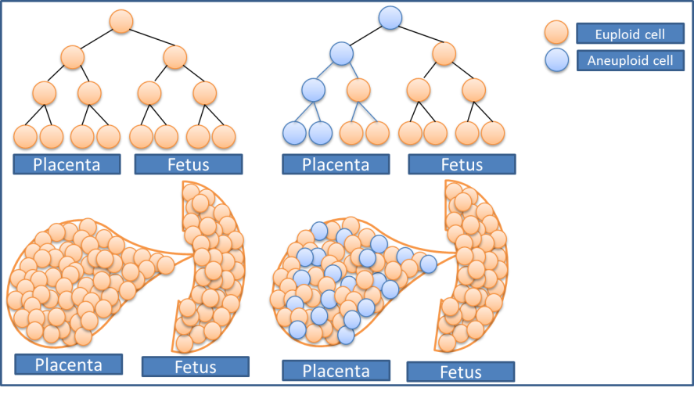
Causes of Misdiagnosis
Human Error
Unprotected sex
mislabeling, misidentification, misinterpretation
wrong embryo transfer
incorrect probes or primers
Technical
Probe or primer failure
contamination (maternal, paternal, operator, carry-over)
Intrinsic (embryo)
Mosaicism
Allele drop out
Uniparental Disomy

Slide 26
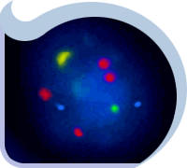
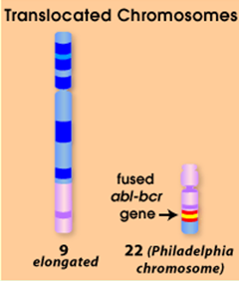
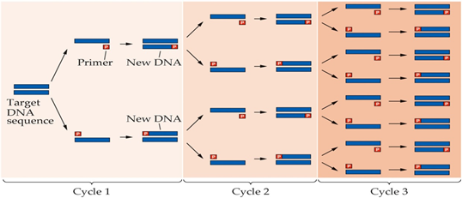
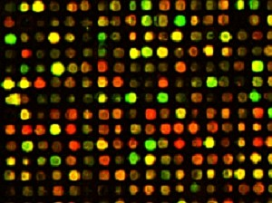
The Methods of Preimplantation Genetic Diagnosis
Remove a single cell (blastomere.) from the 6-8-cell embryo
Two types of assessment techniques are common:
a. chromosome “painting” (or FISH)
b. Genetic testing for specific disease loci (PCR or gene chips)
Limitations of PCR-based tests:
Both alleles may not amplify equally, leading to misdiagnosis or inconclusive results
PCR-based tests only detect disorders at target loci; other mutations may exist elsewhere
Prenatal amniocentesis or CVSis usually recommended

Slide 27
Risks to the child conceived via IVF/PGD:
Low birth weight; premature birth
Developmental delays
Cognitive problems (ADHD)
Urogenital problems
Cerebral pals
Certain cancers (e.g., Beckwith-Weidemann syndrome, which may be related to ICSI)

Slide 29
Models of Regulatory Frameworks for PGD
 | Professional Guidelines | Facilitative Legislation | Restrictive Legislation | Prohibitive Legislation
Method of regulation | Voluntary Peer Review Process | Legislation and delegation to statutory body | Comprehensive legislation | Legislation banning procedures
Jurisdiction | USA New South Wales And Queensland Australia; India | UK Victoria Australia Canada New Zealand | France Slovenia Netherlands | Italy Germany Austria Switzerland Ireland
Notes:
Because of the ethical and safety concerns raised by reprogenetic technologies, there has been added impetus for jurisdictions to determine their respective legal and policy positions in relation to reprogenetic technologies.
Response to the regulation of PGD through out the world has been predictably varied. However, most jurisdictions have implemented some form of regulatory control.
The spectrum of control runs from
a virtually free market system that is regulated only by professional self-regulation and the particular criminal or civil system (US),
to facilitative regimes with a broad legislative framework (NZ, UK)
to more precise frameworks derived from specific legislative initiatives, Restrictive frameworks are as precise as possible in terms of specifying acceptable use of pgd.
to complete prohibition.
New Zealand has recently contributed to this regulatory and policy framework mix with the enactment of the Human Assisted Reproductive Technology Act 2004.
Where PGD is banned, reproductive tourism occurs.

Slide 30
Counselling A educational process by which patientsor/& at risk individuals are given information tounderstand the nature of the genetic disease, its transmission and the options open to them in management and family planning.
Genetic counselling -an integral part of the management of patients and families with genetic disorders

Slide 34
Therapy of Genetic Disorders MGL-14 July. 14th 2014
Mohammed El-Khateeb

Slide 35
Types of Genetic Testing
Carrier testing
Premarital Screening
Neonatal testing:
Prenatal diagnosis
Preimplantation diagnosis
Cell and cell free DNA in Maternal blood
Therapy of Genetic Disorders

Slide 36
Current Therapy of Genetic Disorders
Preventive
Metabolic Manipulation
Gene Product Replacement
Cell or Organ Transplantation
Gene Therapy

Slide 37
Therapy of Genetic Disorders
Preventive Therapy
Preventive screening
Neonatal screening
Population screening
Prenatal diagnosis
Preimplantation diagnosis

Slide 38
Therapy of Genetic Disorders
Metabolic Manipulation
Dietary Restriction
(Lactose restriction for Lactase deficiency; phenylalanine restriction for phenylketonuria)
Dietary Supplementation
( Biotin for Biotinidase deficiency, Starch for G-6-P deficiency)
Chelation and enhanced excretion
(Copper chelation for Wilson Disease)
Metabolic inhibitors
(allopurinol for gout, Statins for hypercholesterolemia,)

Slide 39
Therapy of Genetic Disorders
Gene Product Therapy
Hormone, protein or enzyme replacement
Hormone supplementation:
Hypothyroidism: Thyroid hormones
Congenital adrenal hyperplasia: Cortisol
Growth hormone
Hemophilia: Clotting factors
Diabetes: Insulin
Enzyme replacement
Gauchers: Beta glucosidase
Pompe : Alpha glucosidase
SCID: Adenosine deaminase

Slide 40
Examples of Current Enzyme Therapy
Current FDA approved enzyme replacement therapy
Adenosine deaminase deficiency (SCID)-
Severe combined Immunodeficiency
No targeting to cells, but removal of metabolites from plasma
Several Lysosomal Storage Disorders
Genetic deficiency of Lysosomal Enzymes
Therapy: Targeting of deficient enzyme to lysosomes

Slide 41
ENZYME REPLACEMENT THERAPY
FOR LYSOSOMAL STORAGE DISEASES
Gaucher Disease Approved 1991
Fabry Disease Approved 2001 (EU), 2003 (US)
MPS I Approved 2003 (EU & US)
MPS VI Approved 2005 (US& EU)
MPS II Approved 2006 (US)
Pompe Disease Approved 2006 (US & EU)
Niemann-Pick B Disease Phase 1 Trial Underway

Slide 42
Current Enzyme Therapy of Lysosomal Disorders with Intracellular Replacement of Enzyme:
Currently “standard of care”
Gauchers Disease (beta glucosidase; non neuronopathic)
Current Clinical Trials:
Glycogen Storage Disease Type II (acid maltase)
Fabry Disease (alpha galactosidase)
Hurler Disease (alpha iduronidase)
Hunter Disease (iduronate sulfatase)

Slide 43
Therapy of Genetic Disorders
Cell or Organ Transplantation
Cells :
Bone marrow ,
Stem cells : Embryonic, adult SC Mesenchymal and Peripheral
Organs
Kidney : Fabry Disease
Liver: Tyrosinemia

Slide 44
STEM CELL THERRAPY

Slide 45
Potential of Stem Cells
Totipotent (total):
Total potential to differentiate into any adult cell type
Total potential to form specialized tissue needed for embryonic development
Pluripotent (plural):
Potential to form most or all differentiated adult cell types
Multipotent (multiple):
Limited potential
Forms only multiple adult cell types
Oligodendrocytes
Neurons

Slide 46
Properties of Human Embryonic Stem Cells in Culture
Pluripotent – able to form any of ~200 different types of cells of the body
Self‐renewing in vitro – can propagate or proliferate indefinitely in the undifferentiated state
Express the telomerase enzyme and Oct 4 (a master regulator of ESC pluripotency)
Maintain normal chromosome structure and complement even after long periods in culture (unlike many other tissue culture cell lines)

Slide 47
Adult Stem Cells
Adult or somatic stem cells have unknown origin in mature tissues
Unlike embryonic stem cells, which are defined by their origin (inner cell mass of the blastocyst)

Slide 48
Embryonic vs Adult Stem Cells
Totipotent
Differentiation into ANY cell type
Known Source
Large numbers can be harvested from embryos
May cause immune rejection
Multi or pluripotent
Differentiation into some cell types, limited outcomes
Unknown source
Limited numbers, more difficult to isolate
Less likely to cause immune rejection, since the patient’s own cells can be used

Slide 49
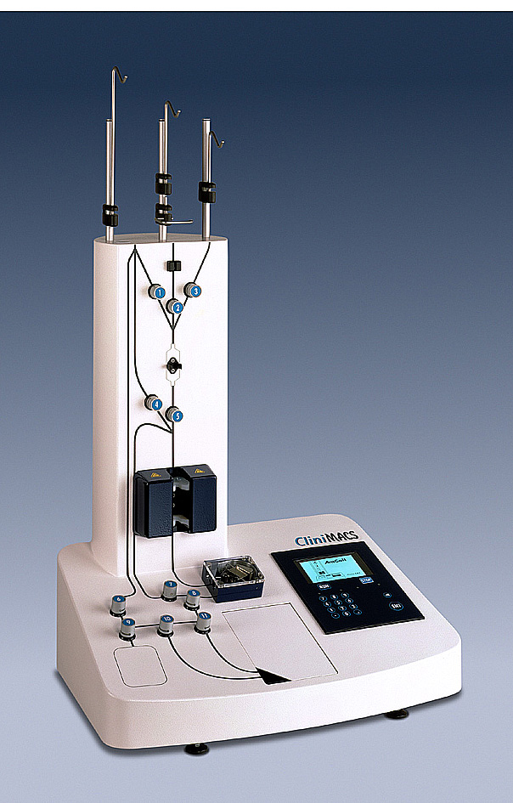
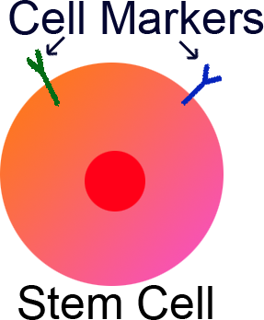
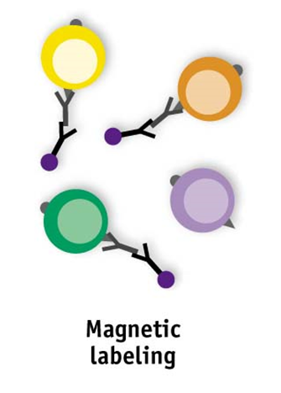
Magnetic Positive
Selection
Stem Cell Markers
c-Kit
Oct4 (ATGCAAAT)
POU Family Protein
CD34
CD38
Cd44
CD133
Nestin

Slide 50
HSC Gene Therapy Timeline.

Slide 51
Stem Cell Therapy Challenges
Ethical considerations for ESC research
Safety challenges – Use of ESCs or differentiated cells derived from ESCs for therapy? Considerations to avoid tumor formation. Immune system challenges to avoid rejection of foreign cells.
Understanding the basic mechanisms that underlie stem cell biology

Slide 52
Summary:
Stem cell therapies offer regenerative prospects for numerous human diseases
Stem cells are capable of renewal and differentiation.
Stem cells are derived from numerous sources and have different potency capacities.
Adult stem cells (ASCs) have been detected in numerous tissues.
Considerable debate surrounds the use of embryonic stem cells, Adult stem cells may offer similar prospects for therapy as do as ESCs, yet a complete understanding of stem cell applications will require a basic understanding of differentiation and renewal mechanisms in ASCs and ESCs as well.

